Slide 1
High-order net-proton cumulants and event-by-event volume definition in the A+A collision at NICA energies G. Feofilov, St. Petersburg State University, St. Petersburg, RF E-mail: g.feofilov@spbu.ru
Net-baryon, net-charge and net-strangeness, are predicted to be sensitive to the correlation length of hot dense matter created in the collisions [1],
Ratios of cumulants C₂/C₁=σ²/M, C₃/C₂.=Sσ, and C₄/C₂ =κσ² were used to reduce the volume dependence. However, the average values of σ, S and k are calculated here assuming the fixed value of volume V in all events!. This is not true.
We propose to use the reduced cumulants, similar to [2], but on the event-by-event basis, following the new procedure with volume (V)^{r} definition [3] in each r^{th} event:
M = <N> =C₁, c1=M/V^{r} = <N^{r}/V^{r}>,
δN =N − <N> δN^{r} =N^{r}/V^{r} − <N^{r}/V^{r}>
σ² =<(δN)²>=C₂, c2=σ_{r}² =<(δN^{r})²>,
S =<(δN)³>/σ³ = S_{r} =<(δN^{r})³>/σ_{r}³ ,
=C₃/C₂^{3/2},
k=<(δN)⁴>/σ⁴ − 3 = =C₄/C₂² k_{r}=<(δN^{r})⁴>/σ_{r}⁴ − 3
We assume that for any r^{th} event. in the selected class of centrality,
the relevant mean volume V^{r} is proportional to the mean number of participants <N^{r}_{part} > :
V^{r} = <N^{r}_{part} >V₀
Here a volume factor V₀ = 2.83 fm³ (see in [1]).
Thus we obtain the reduced deviation
δN^{r} =N^{r}/V^{r} − <N^{r}/V^{r}> for the relevant
distribution of conserved quantity N^{r}
[1] [1] M. A. Stephanov, Phys. Rev. Lett. 102, 032301 (2009).
[2] V. Skokov, B. Friman and K. Redlich, “Volume fluctuations and higher order cumulants of the net baryon number”. arXiv:1205.4756v2
[3] K. Galaktionov, V. Rudnev , and F. Valiev , “Application of Neural Networks for Event-by-Event Evaluation of the Impact Parameter “, Physics of Particles and Nuclei, 2023, Vol. 54, No. 3, pp. 446–448.

Slide 2
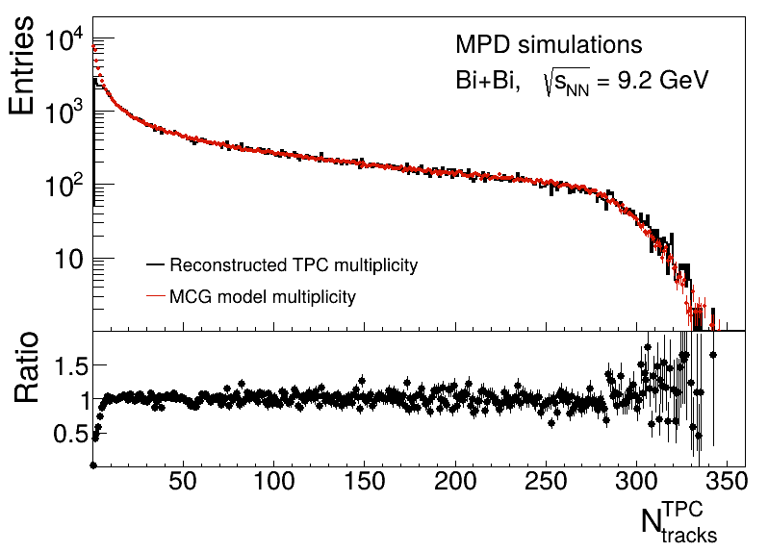
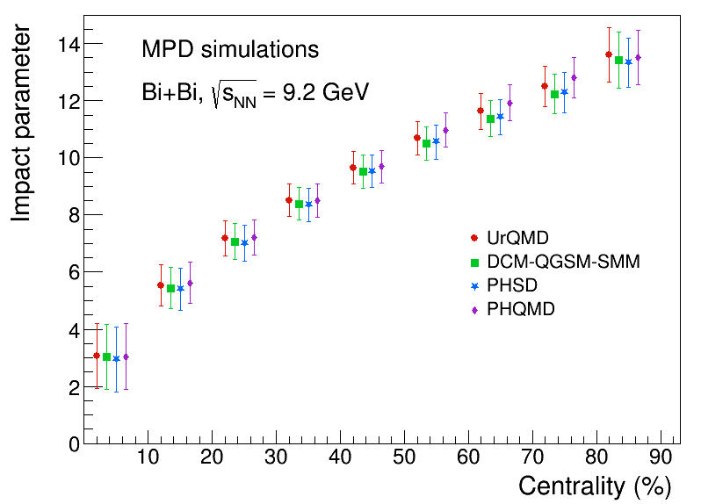
Careful centrality selection
The reconstructed TPC (black) and MCG modeled (red) multiplicity distributions for Bi+Bi collisions at √s_{NN} = 9.2 GeV [1]
Mean impact parameter for 10% centrality intervals for Bi+Bi collisions at √ s_{NN} = 9.2 GeV, modeled with the UrQMD, PHSD, DCM-QGSM-SMM, and PHQMD in [1]
The width of the class of centrality of A+A collisions is directly related to the unavoidable volume fluctuations [2]:
We should select for the analysis of net-proton fluctuations much narrow central classes of multiplicity
or in the number of participating nucleons N_{part} [2]
Another approach – to measure spectator fragments with Hadron Calorimeter in parallel with multiplicity
Application of ML to select narrow centrality classes in ToF technique with high timing resolution [3]
[1] MPD Collaboration, ”MPD physics performance studies in Bi+Bi collisions at √1sNN = 9.2 GeV”, to be published
[2] T. A. Drozhzhova,V. N. Kovalenko,A. Yu. Seryakov,G. A. Feofilov, Physics of Atomic Nuclei, 2016, V 79, Issue 5, pp 737–748
[3] Galaktionov K., Rudnev V., Valiev F. , Physics of Particles and Nuclei, v54, N3, (2023), 446-448, DOI: 10.1134/s1063779623030152
Notes:
Galaktionov K., Rudnev V., Valiev F.
Application of Neural Networks for Event-by-Event Evaluation of the Impact Parameter, Physics of Particles and Nuclei, v54, N3, (2023), 446-448

