Slide 1

Alternative approach for estimating the neck radius of a fissioning nucleus
Ya.O. Otvodenko¹, D.E. Lyubashevsky¹, P.V. Kostryukov^{1,2}
S.V. Kluychnikov¹
¹Voronezh State University, Russia
²Voronezh State University of Forestry and Technologies, Russia
NUCLEUS-2025

Slide 2
The aims and objectives of the research:
The analysis of the dynamics of nuclear fission near the scission point.
Investigation of the dependence of the transverse oscillation frequencies on the quadrupole deformation parameter of the fragment, as well as the evolution of the moments of inertia of the system.
The analysis of the influence of transverse wriggling- and bending- vibrational modes of prefragments.
The estimation of the neck radii at the scission point of fissionable actinide nuclei based on the spin distributions of fission fragments within the framework of the «cold» fission concept.
Comparison of the obtained values with the results of other approaches.
2

Slide 3
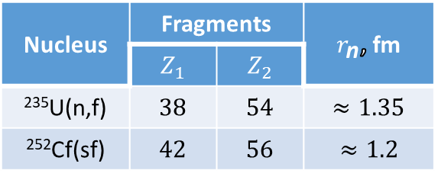
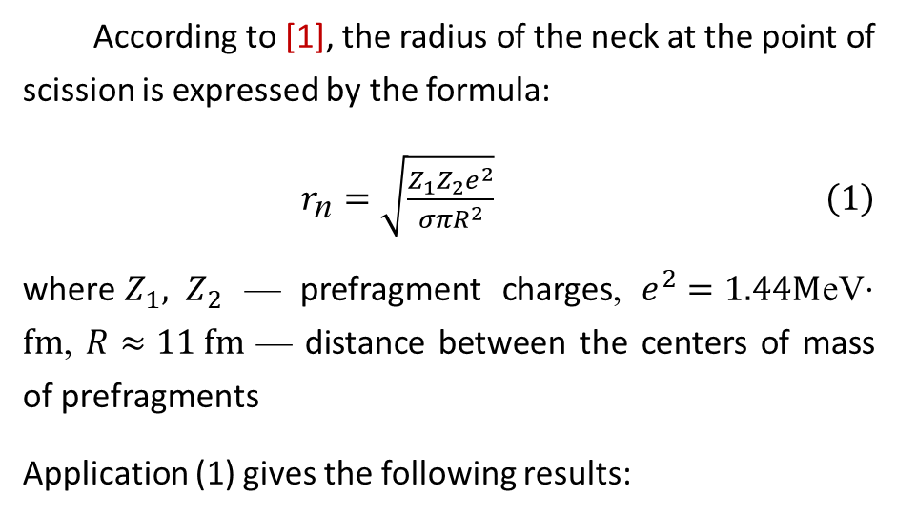
The estimation of the neck radius within the framework of classical approach
The approach is based on the liquid drop model developed in [1]. The radius of the neck r_{n} is determined through the balance of nuclear and Coulomb forces between the prefragments.
The main idea: for configurations with large r_{n}, the nuclear forces exceed the Coulomb force, making the nucleus resistant to rupture. However, as the neck radius decreases, the Coulomb repulsive force begins to dominate, which eventually leads to rupture of the neck at some critical radius.
According to [1], the radius of the neck at the point of scission is expressed by the formula:
$\begin{aligned}r_{\text{n}}=\sqrt{\frac{Z_{1}Z_{2}e^{2}}{σπR^{2}}} \#\left(1\right)\end{aligned}$
where${ Z}_{1}, Z_{2}$ — prefragment charges, $e^{2}=1.44M$eV$⋅fm$, $R≈11 fm$ — distance between the centers of mass of prefragments
Application (1) gives the following results:
Disadvantages of the model: prefragments are represented as spherical objects, microscopic effects are not taken into account.
Nucleus | Fragments |  | $r_{\text{n}}$, fm
 | $$Z_{1}$$ | $$Z_{2}$$
²³⁵U(n,f) | $$38$$ | $54$ | $≈1.35$
²⁵²Cf(sf) | $$42$$ | $$56$$ | $≈1.2$
[1] Davies K.T.R. et al. Phys. Rev. C. 16. № 5. 1890 (1977)
3

Slide 4
The estimation of the neck radius within the framework of classical approach
In [1], a more realistic calculation method is proposed, where the system is mentally divided into two parts according to the minimum radius of the neck, after which the forces are calculated by differentiating the energy of the Coulomb and nuclear interactions by the distance between the centers of mass with the shape of the prefragments unchanged. The interaction energies are determined by integrating the Coulomb interaction and the effective Yukawa two-nucleon interaction for each of the fission prefragments.
Calculations performed in [1] showed that for any type of dissipation, the radius of the neck at the rupture of actinide nuclei is about 2 fm, which exceeds a simple geometric estimate.
Advantages: accounting for the realistic geometry of the deformed fragments.
[1] Davies K.T.R. et al. Phys. Rev. C. 16. № 5. 1890 (1977)
4

Slide 5
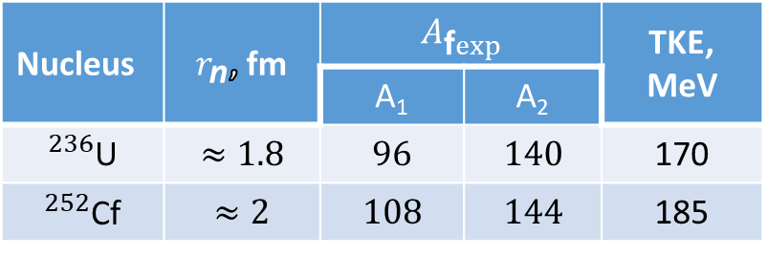
The estimation of the neck radius within the framework of modern approaches
Self-consistent quantum mechanical calculations are used in methods based on the theory of the density functional with time dependence TDDFT [1-3]. TDDFT describes the evolution of the nuclear density through the solution of the Schrodinger equations by the Hartree-Fock-Bogolyubov time-dependent method.
Advantages:
high-precision modeling of the fission process from the initial deformation to the final separation into fragments;
takes into account correlations between nucleons and shell effects.
Disadvantages:
large computing resources, despite the high accuracy;
expanding the range of nuclei studied.
The values ​​of the neck radii at the moment of rupture according to the results of TDDFT calculations are in good agreement with the experimental mass yields:
Nucleus | $r_{\text{n}}$, fm | $$A_{\text{f}exp}$$ |  | TKE, MeV
 |  | A₁ | A₂
$​^{236}$U | $$≈1.8$$ | $$96$$ | $$140$$ | 170
$​^{252}$Cf | $$≈2$$ | $$108$$ | $$144$$ | 185
[1] Bulgac A. Ann. Rev. of Nucl. and Part. Sci. 63. № 1. 97 (2013)
[2] Bulgac A. et al. Phys. Rev. Lett. 126. № 14. 142502 (2021)
[3] Bulgac A., Jin S., Stetcu I. Phys. Rev. C. 100. №. 3. 034612 (2019)
5

Slide 6
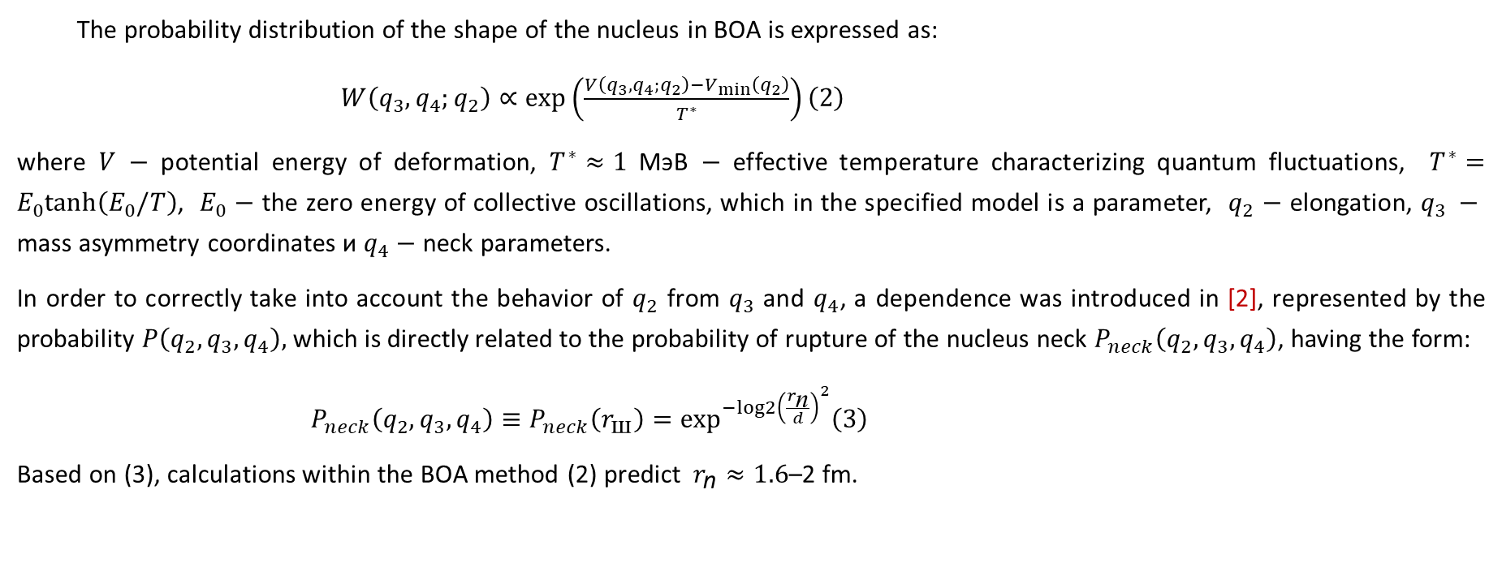
The estimation of the neck radius within the framework of modern approaches
The Born-Oppenheimer approximation (BOA) provides [1,2] an approach to describing fission based on the separation of slow and fast degrees of freedom. Slow variables (the distance between prefragments) are considered as adiabatic parameters, and fast ones (fluctuations in asymmetry and neck parameters) are considered as quantum fluctuations [2].
Advantages: includes the successes of the generalized model and simplifies numerical calculations, while providing very close to experimental data, in particular, mass distributions [3].
Disadvantages: the statistical nature of the method is an obstacle to obtaining a more accurate description of nuclear fission.
The probability distribution of the shape of the nucleus in BOA is expressed as:
$\begin{aligned}W\left(q_{3},q_{4};q_{2}\right)∝exp\left(\frac{V\left(q_{3},q_{4};q_{2}\right)−V_{min}\left(q_{2}\right)}{T^{∗}}\right)\#\left(2\right)\end{aligned}$
where $V$ $−$ potential energy of deformation, $T^{∗}≈1$ МэВ $−$ effective temperature characterizing quantum fluctuations, $T^{∗}=E_{0}tanh\left(E_{0}/T\right)$, $E_{0}$ $−$ the zero energy of collective oscillations, which in the specified model is a parameter, $q_{2}$ $−$ elongation, $q_{3} −$ mass asymmetry coordinates и $q_{4}$ $−$ neck parameters.
In order to correctly take into account the behavior of $q_{2}$ from $q_{3}$ and $q_{4}$, a dependence was introduced in [2], represented by the probability $P\left(q_{2},q_{3},q_{4}\right),$which is directly related to the probability of rupture of the nucleus neck $P_{neck}\left(q_{2},q_{3},q_{4}\right)$, having the form:
$\begin{aligned}P_{neck}\left(q_{2},q_{3},q_{4}\right)≡P_{neck}\left(r_{\text{ш}}\right)=\exp^{−log2{\left(\frac{r_{\text{n}}}{d}\right)}^{2}}\#\left(3\right)\end{aligned}$
Based on (3), calculations within the BOA method (2) predict $r_{\text{n}}≈1.6$–2 fm.
[1] Pomorski K. et. al. Eur. Phys. J. A 53 №.3. 59 (2017)
[2] Pomorski K. et al. Chin. Phys. C 45. № 5. 054109 (2021)
[3] Wilson J. et al. Nature 590. № 7847. 566 (2021)
6

Slide 7
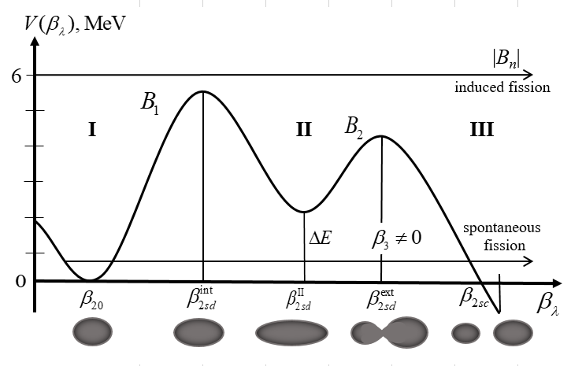
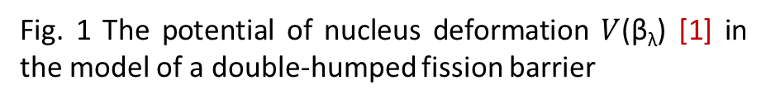
The process of binary fission within the framework of the «cold» nuclear fission model.
The approach [1-3] based on the theory of Wigner random matrices [4] is used to describe the wave function:
(4)
where corresponds to the i-quasi-particle excited state of CFN and the wave function describes the collective deformation motion of the CFN with the excitation energy |B_{n}| and corresponds to the transition fission state of the CFN [5].
and have values , where N is the total number of quasi-particle states participating in formation of wave function (4).
Fig. 1 The potential of nucleus deformation $V$(β_{λ}) [1] in the model of a double-humped fission barrier
[1] S.G. Kadmensky, V.P. Markushev, V.I. Furman, Nucl. Phys. 35. 300 (1982).
[2] S.G. Kadmensky, Nucl. Phys. 65. 1833 (2002).
[3] S.G. Kadmensky, L.V. Titova, P.V. Kostryukov, Bull. Ras. Phys. 82. 1299 (2015).
[4] E.P. Wigner, Ann. Math. 62. 548 (1955); 65. 203 (1958); 67. 325 (1958).
[5] A. Bohr, B. Mottelson Nuclear Structure (Benjamin, New York, 1974), V.1, V2.
7

Slide 8
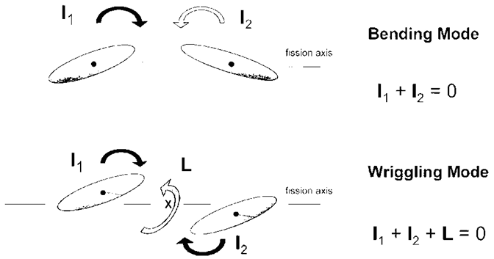
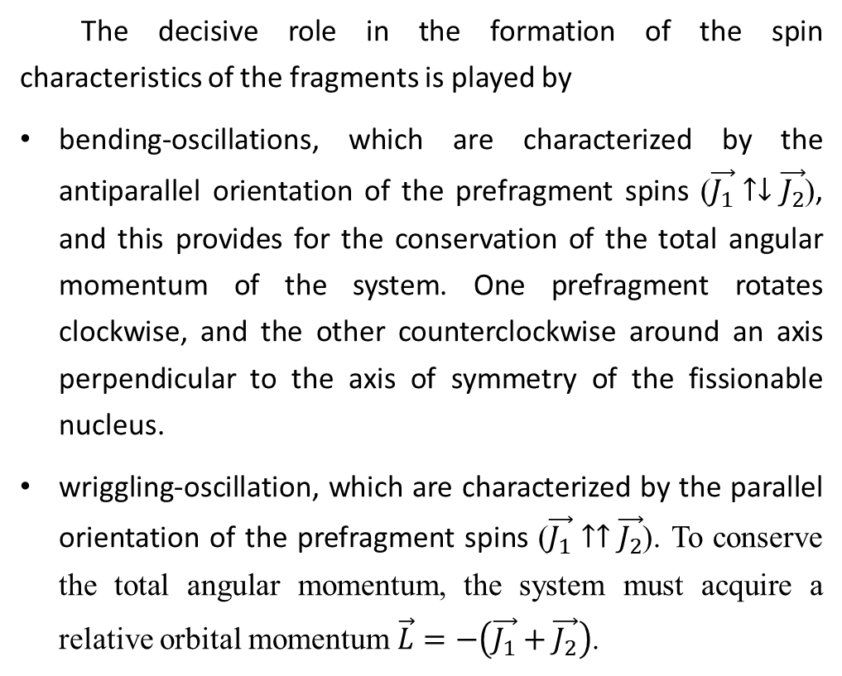
On the role of transverse vibrations in the formation of spin distributions of fragments
The decisive role in the formation of the spin characteristics of the fragments is played by
bending-oscillations, which are characterized by the antiparallel orientation of the prefragment spins ($\vec{J_{1}}↑↓\vec{J_{2}}$), and this provides for the conservation of the total angular momentum of the system. One prefragment rotates clockwise, and the other counterclockwise around an axis perpendicular to the axis of symmetry of the fissionable nucleus.
wriggling-oscillation, which are characterized by the parallel orientation of the prefragment spins ($\vec{J_{1}}↑↑\vec{J_{2}}$). To conserve the total angular momentum, the system must acquire a relative orbital momentum $\vec{L}=−\left(\vec{J_{1}}+\vec{J_{2}}\right)$.
Fig. 2 Transverse bending- and wriggling- vibrations of a fissionable nucleus in the vicinity of the point of scission into fission fragments.
8

Slide 9
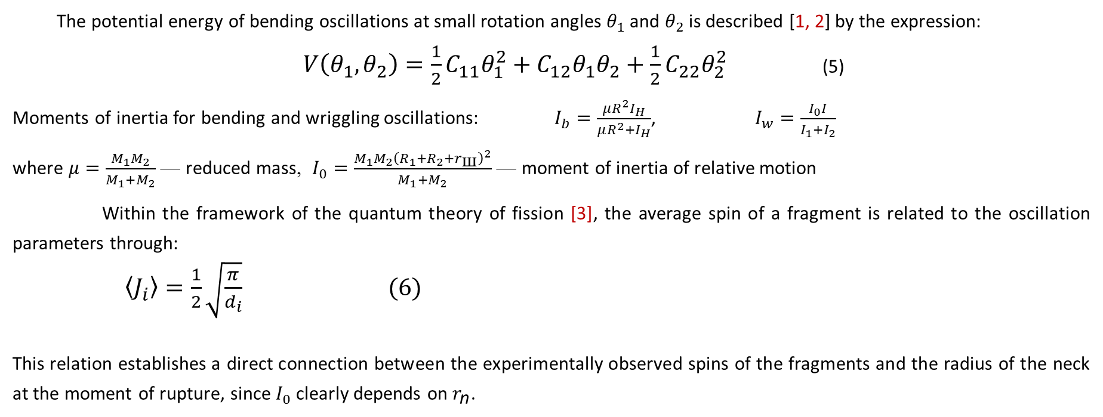
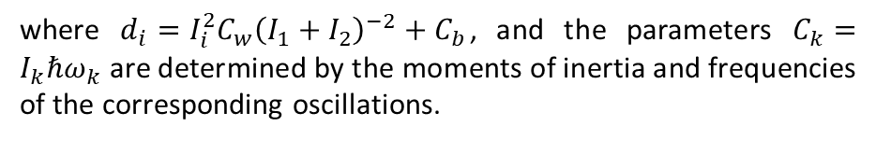
Alternative approach for estimating the neck radius of a fissioning nucleus
The basis of the developed approach [Titova L. V. et al., in the collection Physical foundations of science-intensive technologies in the modern world. Voronezh, 2025. In print] is the concept of «cold» fission, experimentally confirmed by the observed stable anisotropies in the angular distributions of fission products, which indicate that the fissile system remains «cold» (𝑇<0.5 MeV) at all stages of the process.
The potential energy of bending oscillations at small rotation angles $θ_{1}$ and $θ_{2}$ is described [1, 2] by the expression:
$\begin{aligned}V\left(θ_{1},θ_{2}\right)=\frac{1}{2}C_{11}θ_{1}^{2}+C_{12}θ_{1}θ_{2}+\frac{1}{2}C_{22}θ_{2}^{2}\#\end{aligned}$ (5)
Moments of inertia for bending and wriggling oscillations: $I_{b}=\frac{μR^{2}I_{H}}{μR^{2}+I_{H}}$, $I_{w}=\frac{I_{0}I}{I_{1}+I_{2}}$
where $μ=\frac{M_{1}M_{2}}{M_{1}+M_{2}}$ — reduced mass, $I_{0}=\frac{M_{1}M_{2}{\left(R_{1}+R_{2}+r_{\text{ш}}\right)}^{2}}{M_{1}+M_{2}}$ — moment of inertia of relative motion
Within the framework of the quantum theory of fission [3], the average spin of a fragment is related to the oscillation parameters through:
$\begin{aligned}\left\langle J_{i}\right\rangle =\frac{1}{2}\sqrt{\frac{π}{d_{i}}} (6)\end{aligned}$
This relation establishes a direct connection between the experimentally observed spins of the fragments and the radius of the neck at the moment of rupture, since $I_{0}$ clearly depends on $r_{\text{n}}$.
where $d_{i}=I_{i}^{2}C_{w}{\left(I_{1}+I_{2}\right)}^{−2}+C_{b}$, and the parameters $C_{k}=I_{k}ℏω_{k}$ are determined by the moments of inertia and frequencies of the corresponding oscillations.
[1] Shneidman T.M. et al. Phys. Rev. C 65. № 6. 064302 (2002)
[2] Adamian G.G. et al. Phys. of At. Nucl. 67. 1701 (2004)
[3] Kadmensky S. G. et al. Phys. of At. Nucl. 87 № 3. 359 (2024)
9

Slide 10
Method of calculating the moment of inertia of nuclei
hydrodynamic model [1]
The hydrodynamic approach describes the nucleus as a drop of a nuclear liquid in which the moments of inertia are determined based on the mass distribution and the shape of the fragments. This method takes into account the contribution of the collective motion of nuclear matter.
Estimation of the moments of inertia of fission fragments was performed in [D. E. Lyubashevsky et al. Chin. Phys. C 49. 034104 (2025)]
where $β −$the deformation parameter of the nucleus, J_{hyd}/J₀ $−$ the ratio of the moments of inertia in the hydrodynamic model to the solid body
[1] Migdal A. B. Sov. Phys. JETP. 10. №. 1. 176 (1960)
10

Slide 11
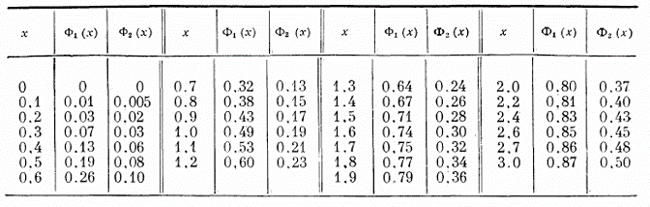
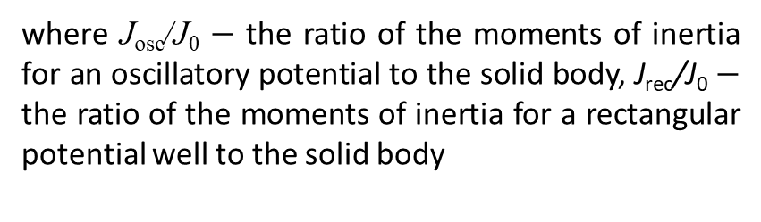
Method of calculating the moment of inertia of nuclei
The oscillatory model is based on the representation of nuclear levels within the oscillatory potential. This approach takes into account quantum effects and the distribution of nucleons in a field close to a harmonic oscillator.
oscillatory potential [1]
rectangular potential well [1]
The rectangular potential model uses an approximation of a spherical or deformed potential with rigid walls. This method considers the movement of nucleons in a finite depth potential, which makes it possible to estimate the contribution of shell effects.
TABLE I. Values of the functions Ф₁ and Ф₂, determined from Eqs. (43) and (51) [1]
where J_{osc}/J₀ $−$ the ratio of the moments of inertia for an oscillatory potential to the solid body, J_{rec}/J₀ $−$ the ratio of the moments of inertia for a rectangular potential well to the solid body
[1] Migdal A. B. Sov. Phys. JETP. 10. №. 1. 176 (1960)
11

Slide 12
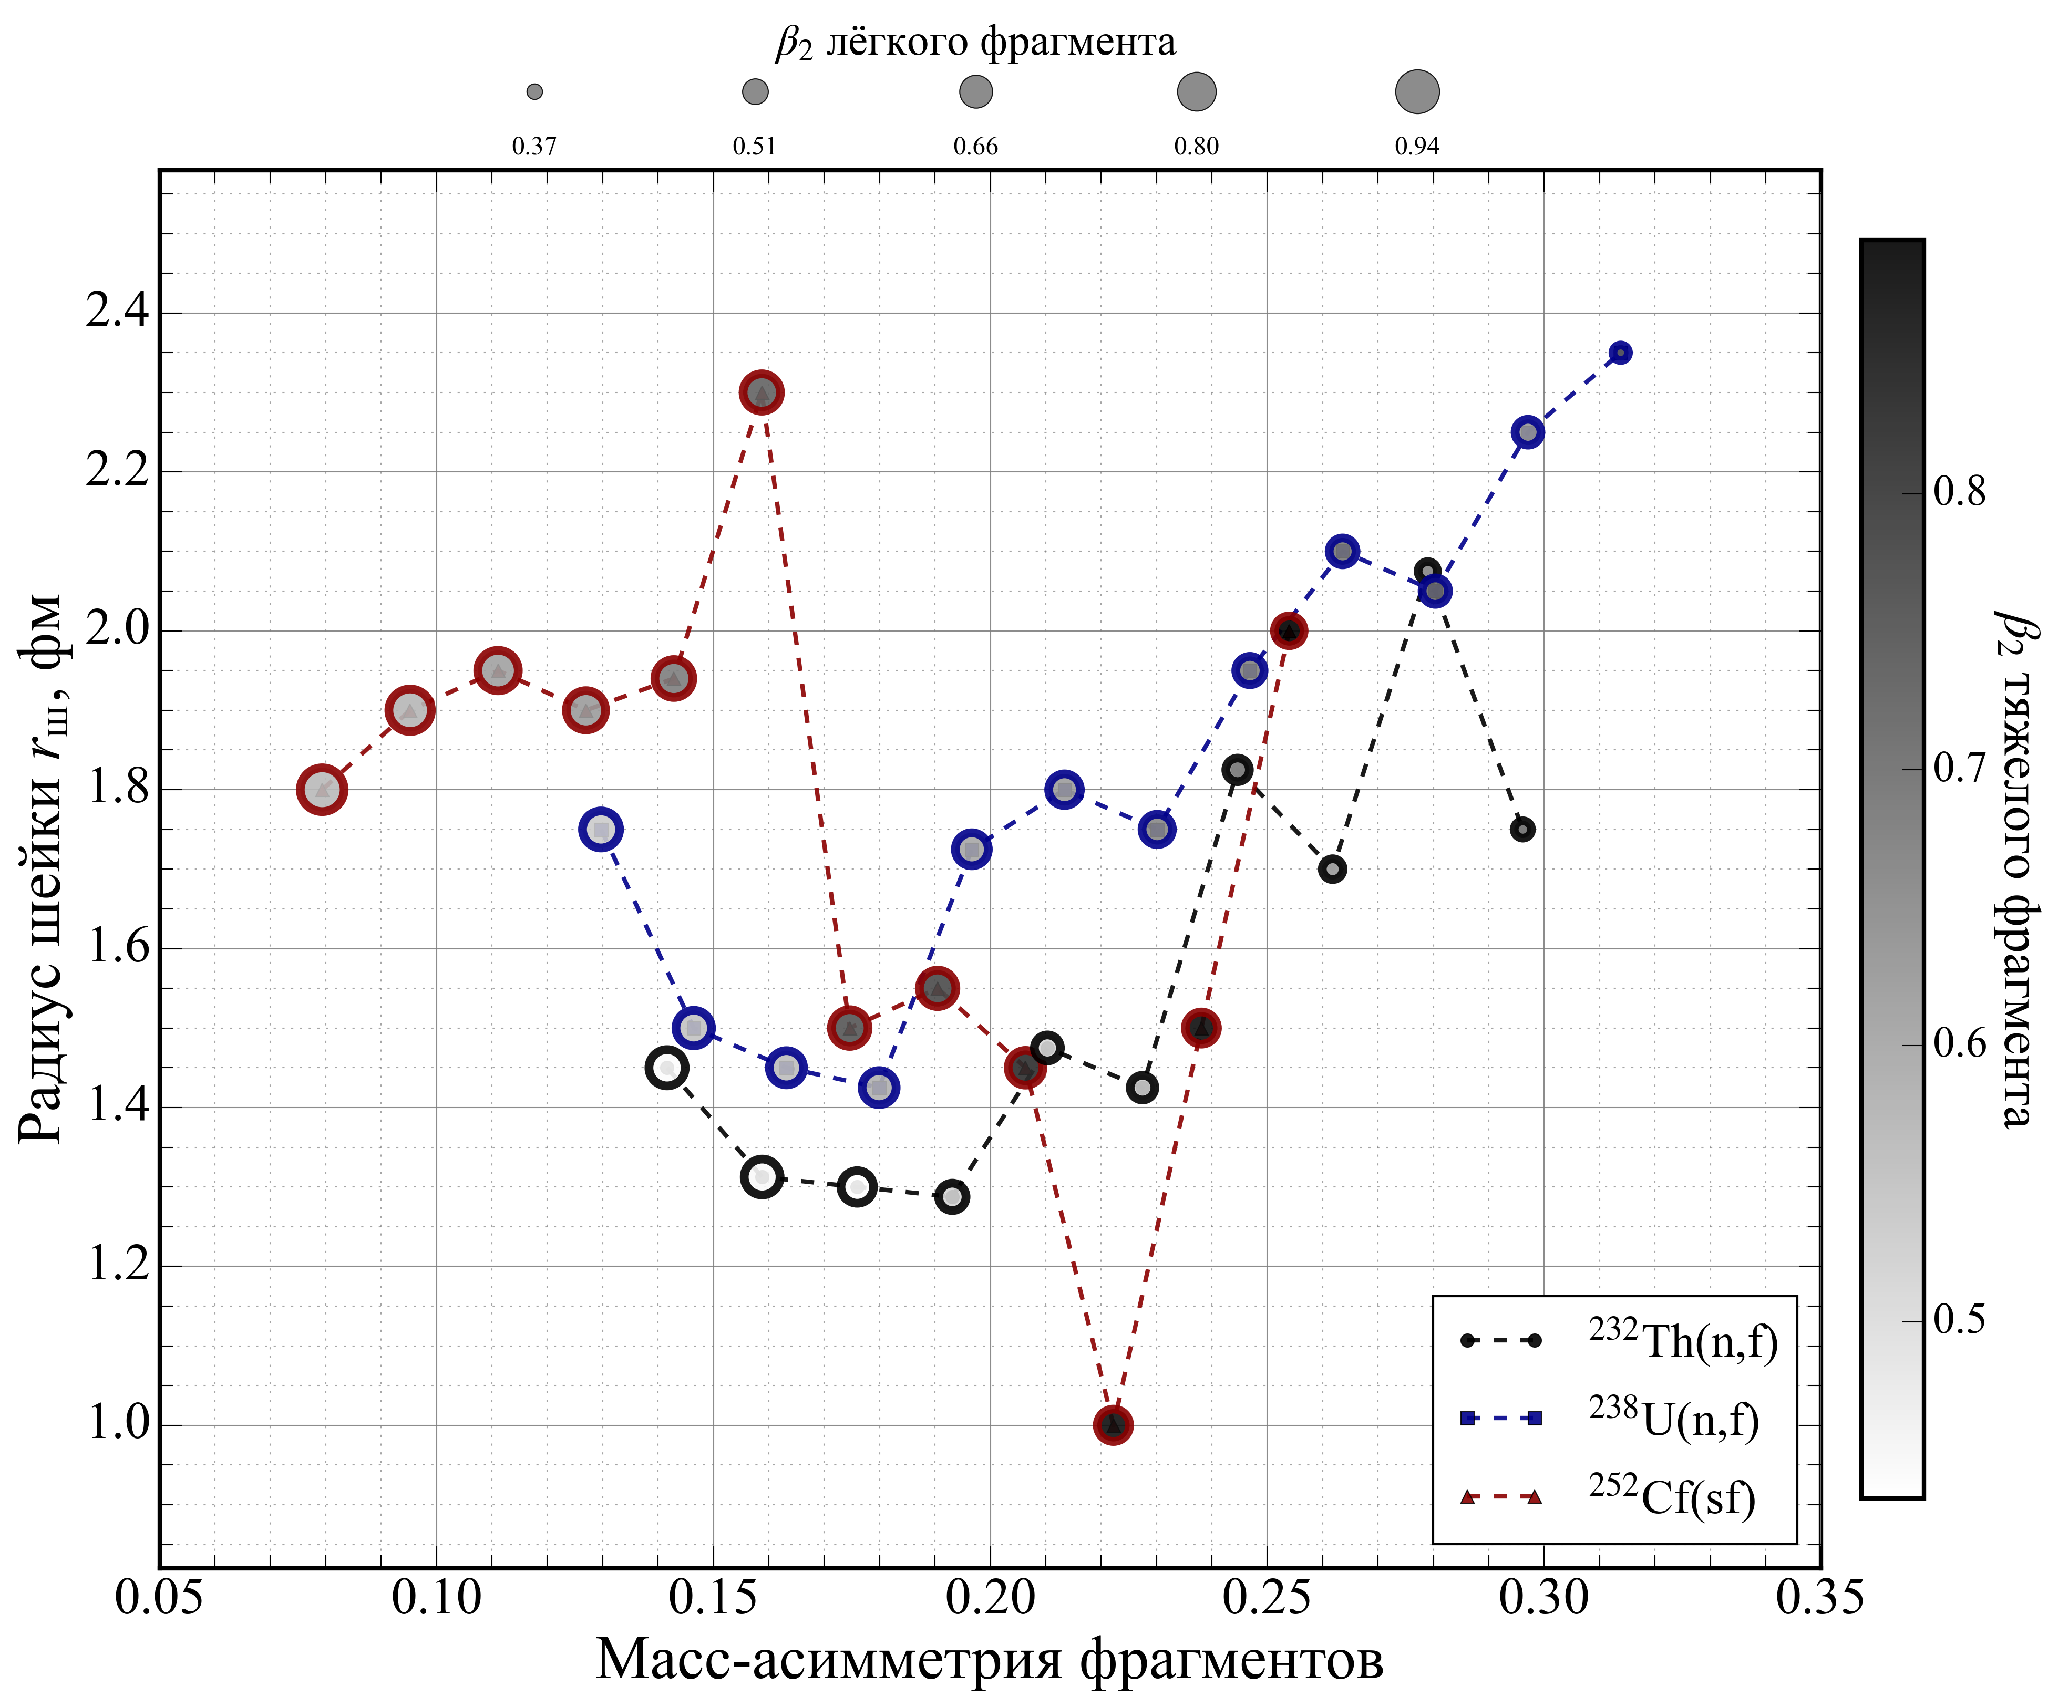
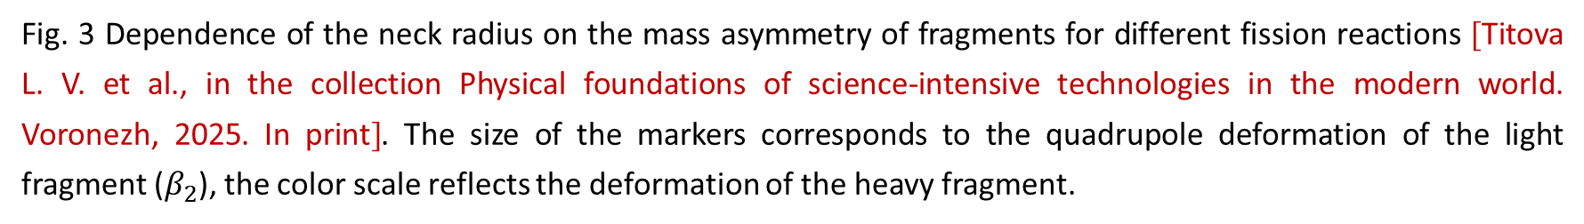
Preliminary results
Fig. 3 Dependence of the neck radius on the mass asymmetry of fragments for different fission reactions [Titova L. V. et al., in the collection Physical foundations of science-intensive technologies in the modern world. Voronezh, 2025. In print]. The size of the markers corresponds to the quadrupole deformation of the light fragment ($β_{2}$), the color scale reflects the deformation of the heavy fragment.
12

Slide 13
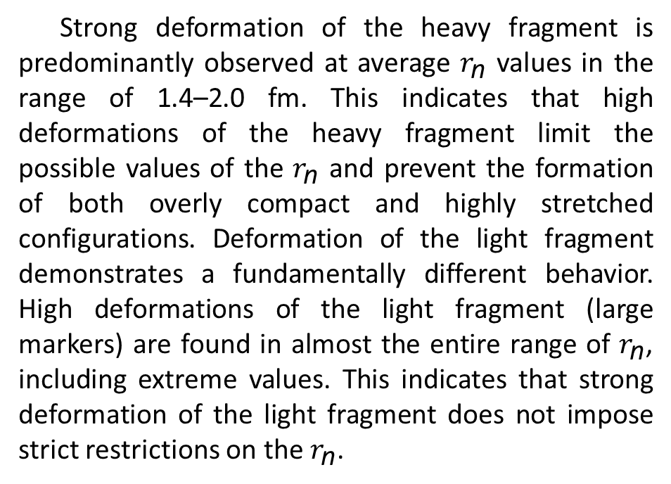
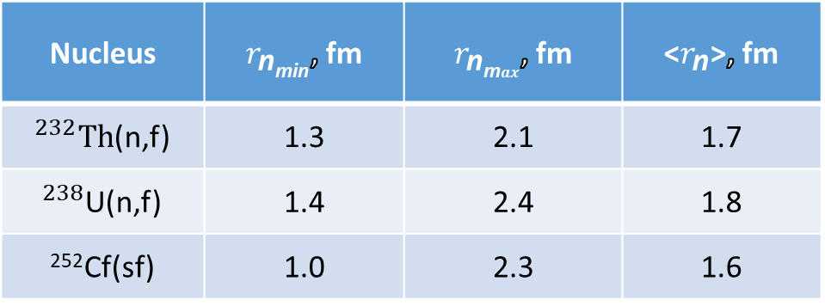
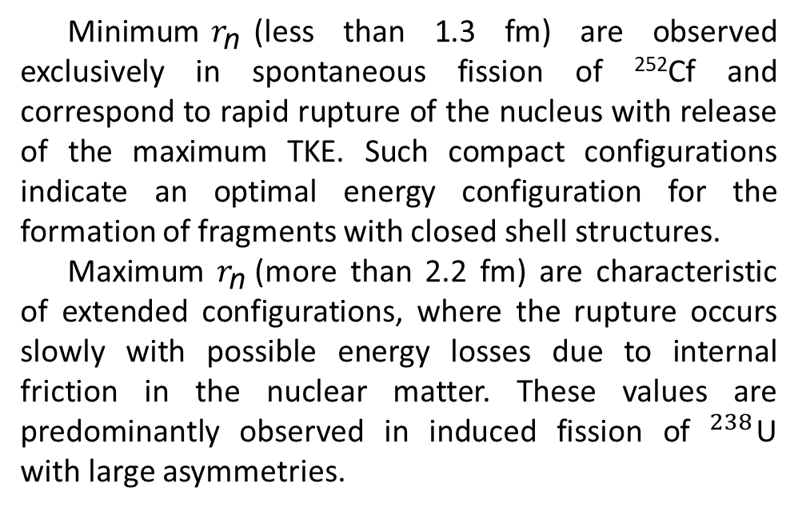
Preliminary results
Strong deformation of the heavy fragment is predominantly observed at average $r_{\text{n}}$ values ​​in the range of 1.4–2.0 fm. This indicates that high deformations of the heavy fragment limit the possible values ​​of the $r_{\text{n}}$ and prevent the formation of both overly compact and highly stretched configurations. Deformation of the light fragment demonstrates a fundamentally different behavior. High deformations of the light fragment (large markers) are found in almost the entire range of $r_{\text{n}}$, including extreme values. This indicates that strong deformation of the light fragment does not impose strict restrictions on the $r_{\text{n}}$.
Nucleus | $r_{\text{n}\text{min}}$, fm | $r_{\text{n}\text{m}ax}$, fm | <$r_{\text{n}}$>, fm
$​^{232}Th$(n,f) | 1.3 | 2.1 | 1.7
$​^{238}$U(n,f) | 1.4 | 2.4 | 1.8
²⁵²Cf(sf) | 1.0 | 2.3 | 1.6
Minimum$r_{\text{n}}$(less than 1.3 fm) are observed exclusively in spontaneous fission of ²⁵²Cf and correspond to rapid rupture of the nucleus with release of the maximum TKE. Such compact configurations indicate an optimal energy configuration for the formation of fragments with closed shell structures.
Maximum $r_{\text{n}}$(more than 2.2 fm) are characteristic of extended configurations, where the rupture occurs slowly with possible energy losses due to internal friction in the nuclear matter. These values ​​are predominantly observed in induced fission of $​^{238}$U with large asymmetries.
An anticorrelation is observed between the deformations of the light and heavy fragments. This indicates that the available deformation energy of the system is distributed between the fragments in such a way that a strong deformation of one fragment is compensated by a smaller deformation of the other.
12

Slide 14
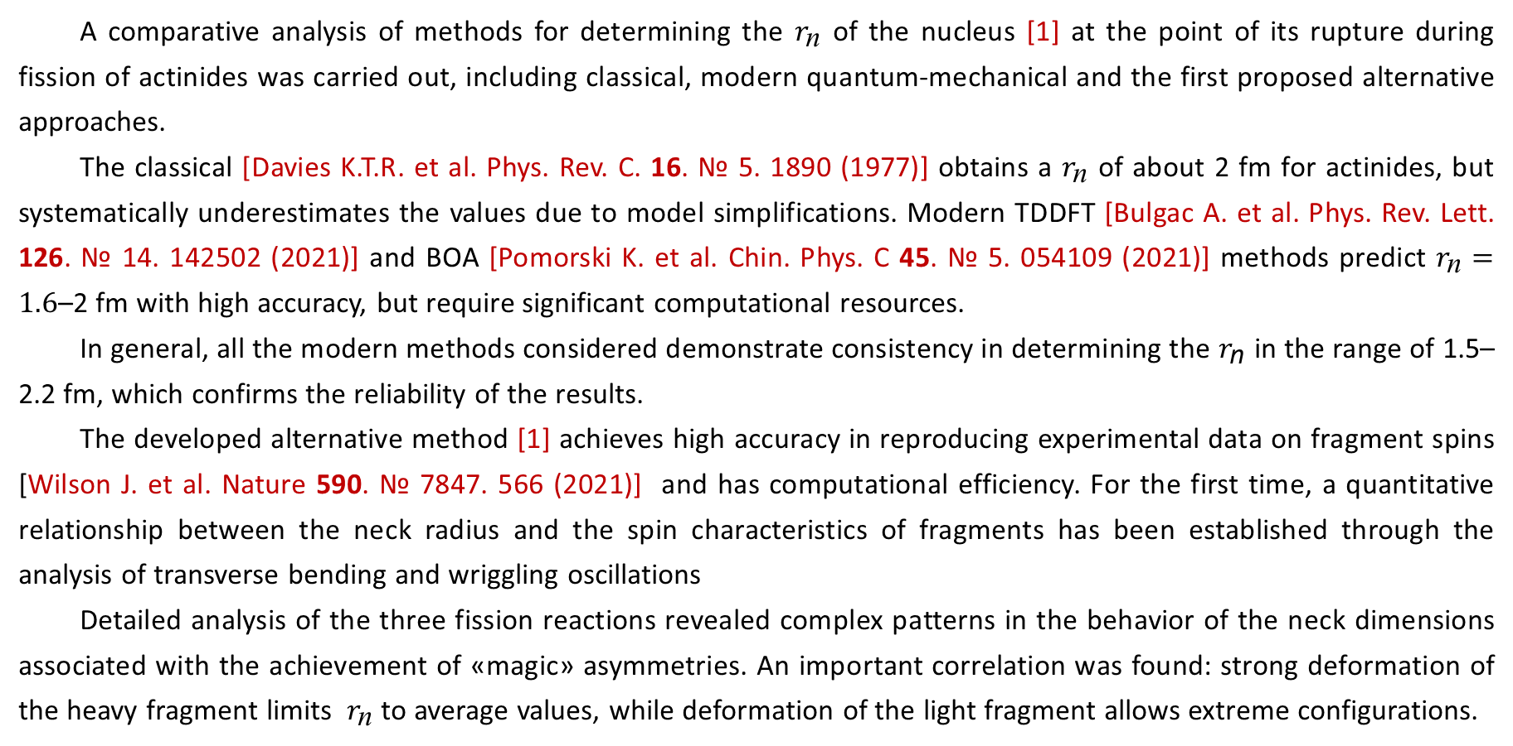
Conclusion
A comparative analysis of methods for determining the $r_{\text{n}}$ of the nucleus [1] at the point of its rupture during fission of actinides was carried out, including classical, modern quantum-mechanical and the first proposed alternative approaches.
The classical [Davies K.T.R. et al. Phys. Rev. C. 16. № 5. 1890 (1977)] obtains a $r_{\text{n}}$ of about 2 fm for actinides, but systematically underestimates the values ​​due to model simplifications. Modern TDDFT [Bulgac A. et al. Phys. Rev. Lett. 126. № 14. 142502 (2021)] and BOA [Pomorski K. et al. Chin. Phys. C 45. № 5. 054109 (2021)] methods predict $r_{\text{n}}=1.6$–2 fm with high accuracy, but require significant computational resources.
In general, all the modern methods considered demonstrate consistency in determining the $r_{\text{n}}$ in the range of 1.5–2.2 fm, which confirms the reliability of the results.
The developed alternative method [1] achieves high accuracy in reproducing experimental data on fragment spins [Wilson J. et al. Nature 590. № 7847. 566 (2021)] and has computational efficiency. For the first time, a quantitative relationship between the neck radius and the spin characteristics of fragments has been established through the analysis of transverse bending and wriggling oscillations
Detailed analysis of the three fission reactions revealed complex patterns in the behavior of the neck dimensions associated with the achievement of «magic» asymmetries. An important correlation was found: strong deformation of the heavy fragment limits $r_{\text{n}}$ to average values, while deformation of the light fragment allows extreme configurations.
[1] Titova L. V. et al., in the collection Physical foundations of science-intensive technologies in the modern world. Voronezh, 2025. In print
13

Slide 15
Thank you for attention

