Slide 1


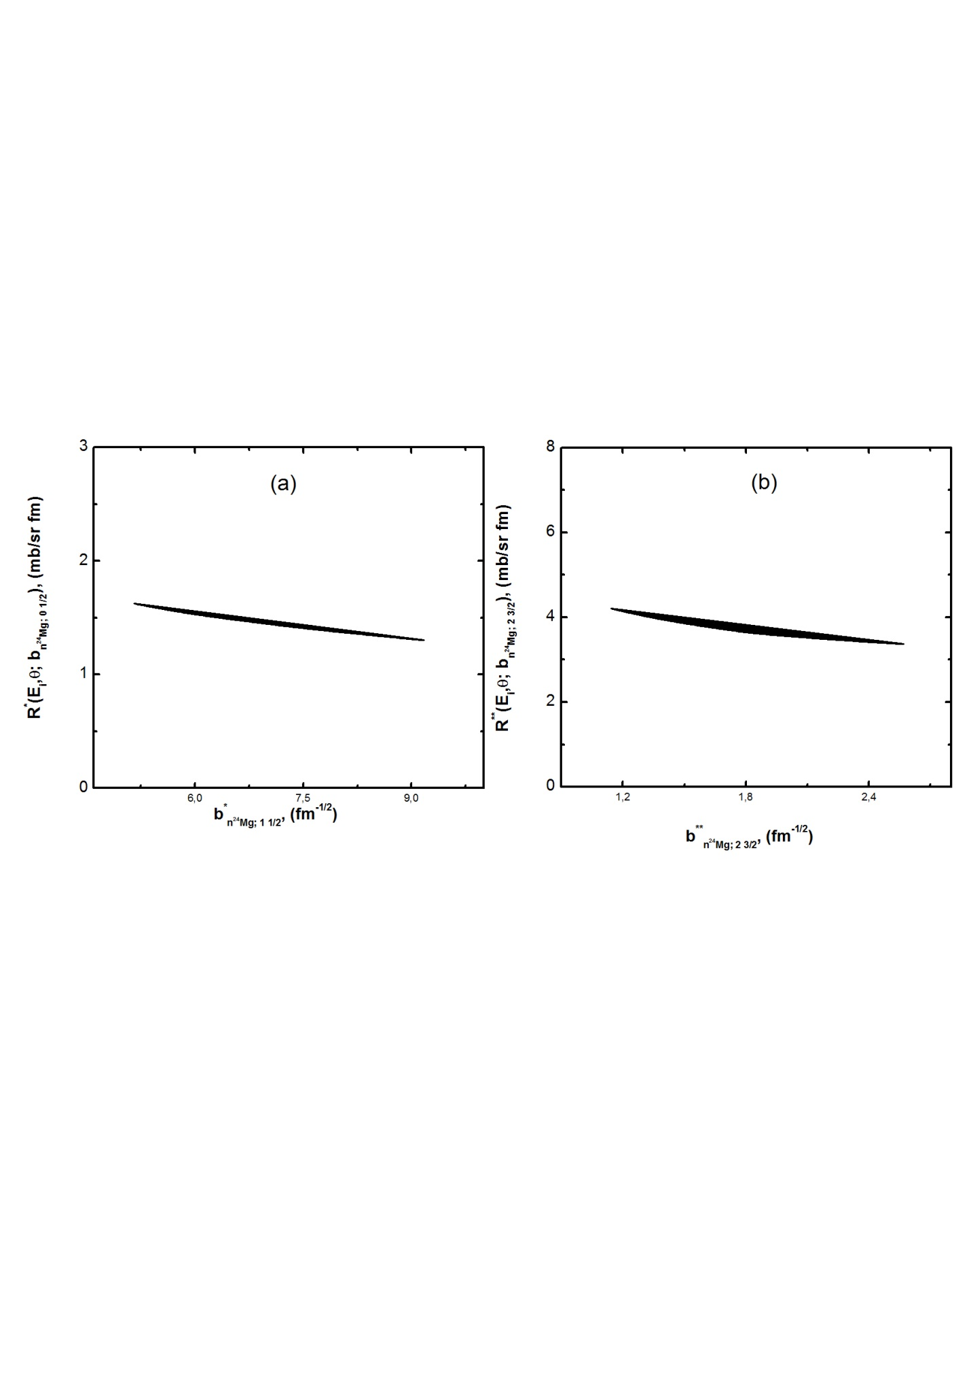
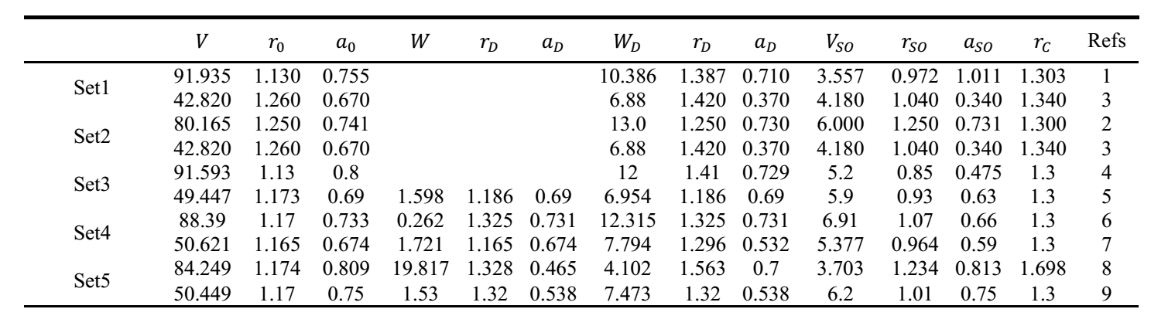
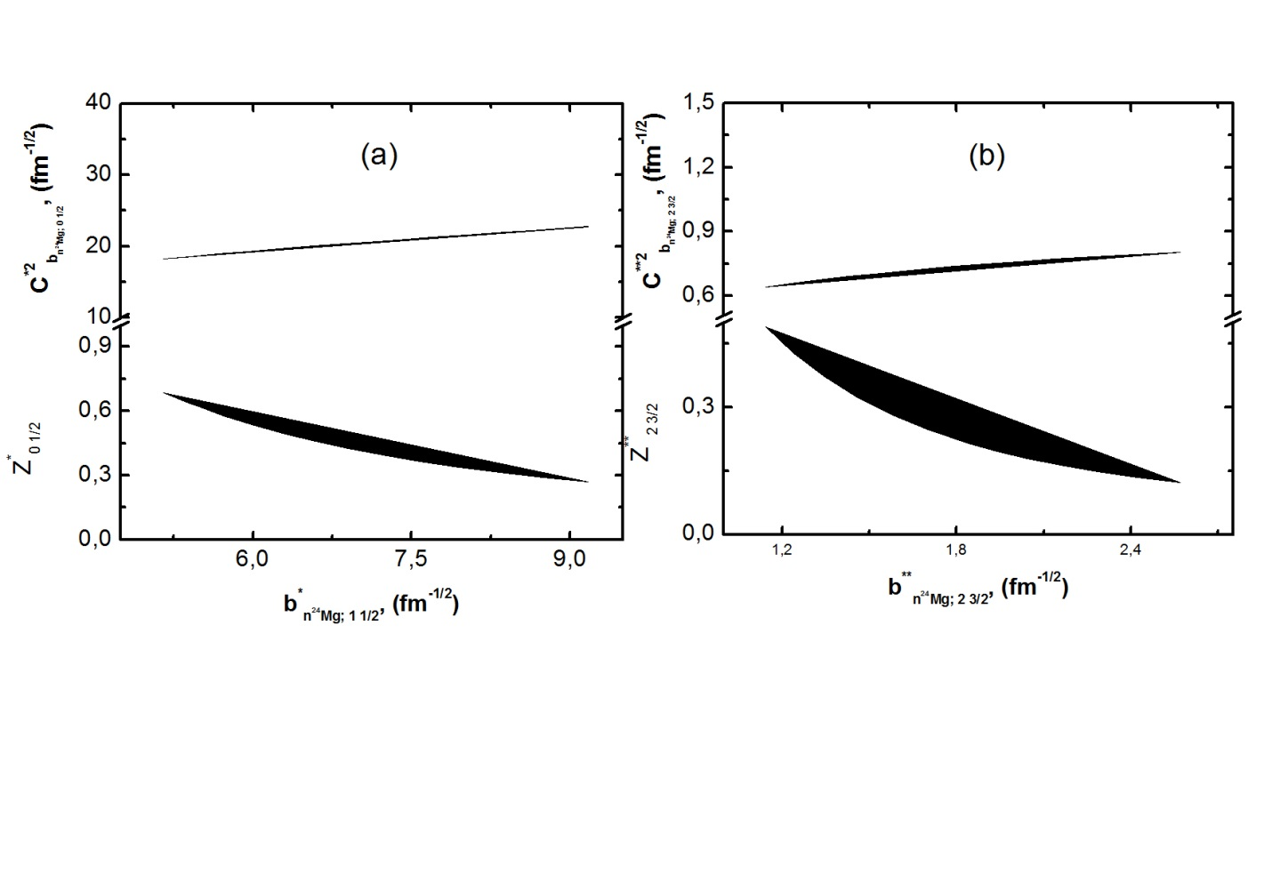
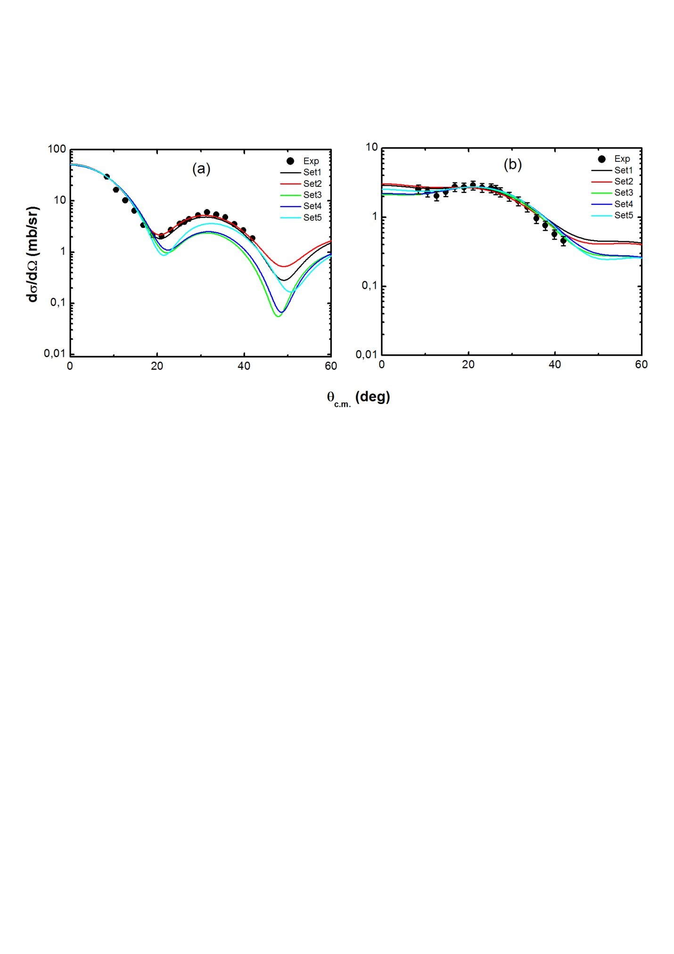
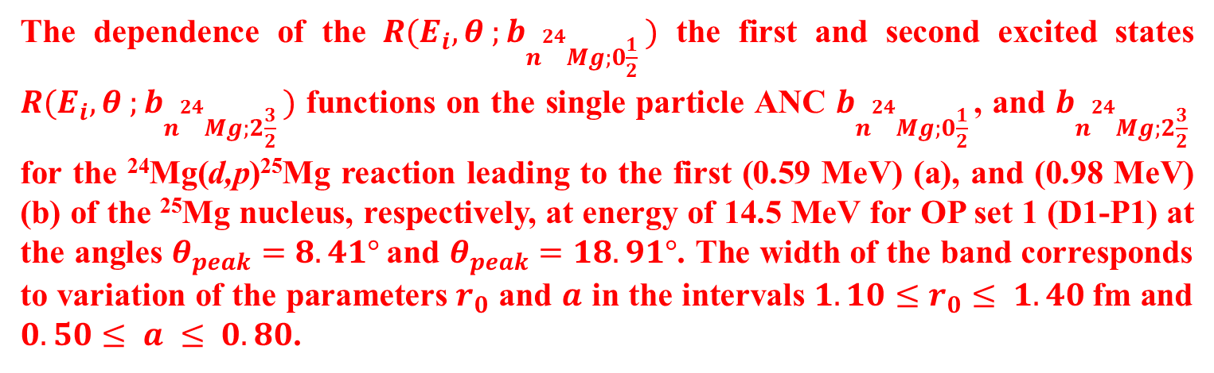
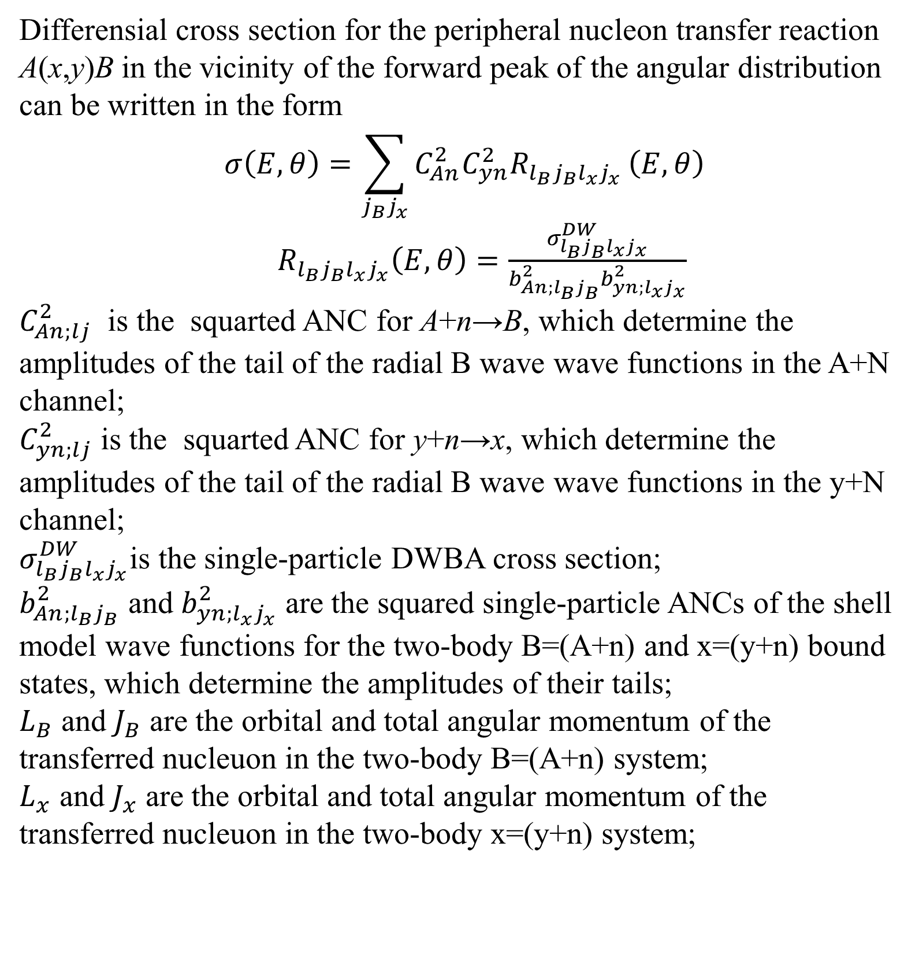
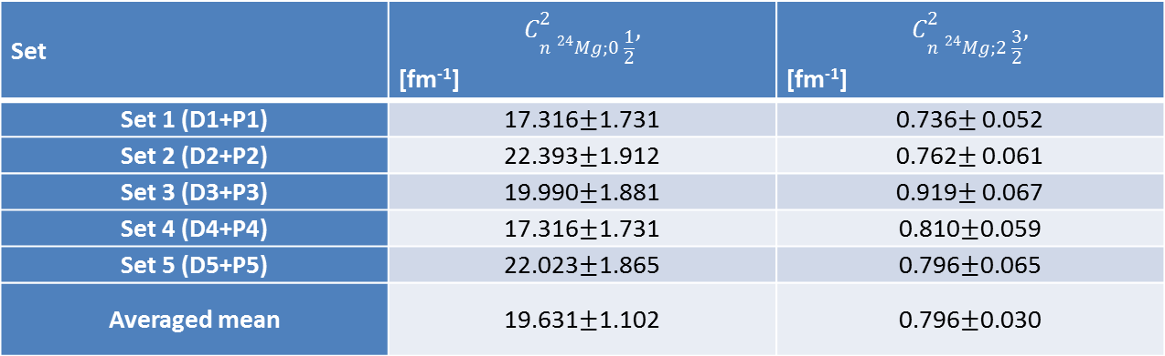
Spectroscopic data on the ²⁵Mg→²⁴Mg+n excited configurations from the ²⁴Mg(d,p)²⁵Mg reaction.
LXXV International Conference «NUCLEUS – 2025. Nuclear physics, elementary particle physics and nuclear technologies»
S.V. Artemov¹; O.R. Tojiboev¹; N.Burtebayev²; Maulen Nassurlla^{2,3}; F.Kh. Ergashev¹; A.A. Karakhodjaev¹;
E.Sh. Ikromkhonov¹; I.Ya. Son¹
¹ Institute of Nuclear Physics, 100214 Tashkent, Uzbekistan
² Institute of Nuclear Physics, 050032 Almaty, Kazakhstan
³ Al-Farabi Kazakh National University, 050040 Almaty, Kazakhstan
ACTUALITY
Currently, the most suitable way to obtain information about the structure of light nuclei is direct nuclear nucleon transfer reactions. Among a number of existing approaches to the analysis of such processes, in recent decades the modified DWBA method has been created and significantly developed, which makes it possible to obtain practically model-free structural quantities - asymptotic normalization coefficients (ANC), which important for nuclear theory. It allows, in combination with the expansion of the experimental capabilities of accelerator and measuring equipment, to obtain the necessary data on the structure of both ordinary stable and exotic nuclei. A powerful impetus for the development of this method was the possibility of using ANC in calculating cross sections for nuclear astrophysical reactions that are inaccessible for direct measurements at temperatures of the stellar environment (so-called “ANC method”). To obtain data suitable for analysis, precision measurements of experimental differential cross sections for nucleon transfer reactions are necessary at energies close to the Coulomb barrier, where the reactions are peripheral.
Data Analysis
The dependence of the $R(E_{i}, θ ;b_{n{}_{}^{24}{Mg;0\frac{1}{2}} })$ the first and second excited states $R(E_{i}, θ ;b_{n{}_{}^{24}{Mg;2\frac{3}{2}} })$ functions on the single particle ANC $b_{n{}_{}^{24}{Mg;0\frac{1}{2}} }$, and $b_{n{}_{}^{24}{Mg;2\frac{3}{2}} }$ for the ²⁴Mg(d,p)²⁵Mg reaction leading to the first (0.59 MeV) (a), and (0.98 MeV) (b) of the ²⁵Mg nucleus, respectively, at energy of 14.5 MeV for OP set 1 (D1-P1) at the angles $θ_{peak}=8.41°$and $θ_{peak}=18.91°$. The width of the band corresponds to variation of the parameters $r_{0}$ and $a$ in the intervals $1.10≤r_{0}≤ 1.40$fm and $0.50≤ a ≤ 0.80$.
For a specific nucleus A at a fixed deuteron energy (E ~ 14.5 MeV) and without taking into account the imaginary component of the spin-orbit interaction (which is usually unimportant), the OP is represented as
where the form factors f(r,R_{j},a_{j}) are taken in the Woods-Saxon form:
R_{j} = r_{j}·A^{1/3} ; r_{j} и a_{j} – geometric parameters of radius and diffuseness.
ANC and SF for vertexes
²⁵Mg→²⁴Mg+n(0.58 MeV), and the ²⁵Mg→²⁴Mg+n(0.98 MeV).
Basic formulas of the Modified DWBA
1. Haixia An and Chonghai Cai Phys.Rev. C73. 054605 (2006).
2. F.Hinterberger. G.Mairle. U.Shmidt-Rohr. G.J.Wagner. Nucl.Phys.. A111 (1968). 265.
3. C.M. Perey and F.G. Perey Atomic data and nuclear data tables 17. l-101 (1976).
4. G. Perrin et al Nucl. Phys. A282. 221 (1977).
5. R.L. Varner. W.J. Thompson. T.L. McAbee. E.J. Ludwig. T.B. Clegg. Phys. Rep.201. 57 (1991).
6. W.W. Daehnick. J.D. Childs. Z. Vrcelj. Phys. Rev. C21. 2253 (1980).
7. A.J.Koning Nuclear Physics A713 (2003) 231–310.
8. Yinlu Han. Yuyang Shi. and Qingbiao Shen Phys. Rev. C74. 044615 (2006).
9. D. Becchetti. G.W. Greenlees Phys. Rev. 182 (1969) p.1190.
Differensial cross section for the peripheral nucleon transfer reaction A(x,y)B in the vicinity of the forward peak of the angular distribution can be written in the form
$$σ\left(E,θ\right)=\sum_{j_{B}j_{x}}{C_{An}^{2}C_{yn}^{2}R_{l_{B}j_{B}l_{x}j_{x}}}\left(E,θ\right)$$
$R_{l_{B}j_{B}l_{x}j_{x}}\left(E,θ\right)=\frac{σ_{l_{B}j_{B}l_{x}j_{x}}^{DW}}{b_{An;l_{B}j_{B}}^{2}b_{yn;l_{x}j_{x}}^{2}}$
$C_{An;lj}^{2}$ is the squarted ANC for A+n→B, which determine the amplitudes of the tail of the radial B wave wave functions in the A+N channel;
$C_{yn;lj}^{2}$ is the squarted ANC for y+n→x, which determine the amplitudes of the tail of the radial B wave wave functions in the y+N channel;
$σ_{l_{B}j_{B}l_{x}j_{x}}^{DW}$is the single-particle DWBA cross section;
$b_{An;l_{B}j_{B}}^{2}$ and $b_{yn;l_{x}j_{x}}^{2}$ are the squared single-particle ANCs of the shell model wave functions for the two-body B=(A+n) and x=(y+n) bound states, which determine the amplitudes of their tails;
$L_{B}$ and $J_{B}$ are the orbital and total angular momentum of the transferred nucleuon in the two-body B=(A+n) system;
$L_{x}$ and $J_{x}$ are the orbital and total angular momentum of the transferred nucleuon in the two-body x=(y+n) system;
The results of the analysis of the experimental differential cross section of the ²⁴Mg(d,p)²⁵Mg reaction.
The determined squared ANC values for ground and first three excited states of ²⁵Mg nucleus
Set | $$C_{n {}_{}^{24}{Mg};0 \frac{1}{2}}^{2},$$ [fm⁻¹] | $$C_{n {}_{}^{24}{Mg};2 \frac{3}{2}}^{2},$$ [fm⁻¹]
Set 1 (D1+P1) | 17.316$±$1.731 | 0.736$±$ 0.052
Set 2 (D2+P2) | 22.393$±$1.912 | 0.762$±$ 0.061
Set 3 (D3+P3) | 19.990$±$1.881 | 0.919$±$ 0.067
Set 4 (D4+P4) | 17.316$±$1.731 | 0.810$±$0.059
Set 5 (D5+P5) | 22.023$±$1.865 | 0.796$±$0.065
Averaged mean | 19.631$±$1.102 | 0.796$±$0.030
Using the obtained ANC values, the S(E) factors and reaction rate of nuclear astrophysical capture reaction ²⁴Mg(n,γ) ²⁵Mg at astrophysical energies can be calculated.

