Slide 1


LXXV International Conference «NUCLEUS – 2025. Nuclear physics, elementary particle physics and nuclear technologies»
Model Natural Helium Alternative Fast Neutron Detector Using PHITS Monte Carlo Simulations
Hai C. V. ^{1, 2} , Nga C. T. B. ²
¹ Joint Institute for Nuclear Research, Russia
² Faculty of Nuclear Engineering, Da Lat University, Vietnam
Speaker: Cao Van Hai
Position: Engineer
Laboratory: Frank Laboratory of Nuclear Physics
Saint Petersburg - July, 05th 2025
Notes:
Good morning, everyone. My name is [Cao Van Hai]. I come from Laboratory of Nuclear Physics
Today, I will present Small Size Alternative Fast Neutron Detector
based on Helium-4 gas Using PHITS Monte Carlo Simulation

Slide 2
LXXV International Conference «NUCLEUS – 2025. Nuclear physics, elementary particle physics and nuclear technologies»
1. Reasons
Traditional methods usually use the moderator for fast neutrons to thermal energies, then they absorbed in Helium-3 detectors
Moderator
Helium-3 detector
By this way brings some limitations: limited supplier, limited reserves, high cost
Notes:
In today's meeting I would like to talk about a part of the project I am working on, in this talk I will focus on building concepts, models, creating simulation configurations to prepare for a first prototype in the upcoming stage.

Slide 3
LXXV International Conference «NUCLEUS – 2025. Nuclear physics, elementary particle physics and nuclear technologies»
Popular material: “no source of high-enriched raw materials”. Helium-4 is an abundant, non-radioactive isotope.
1. Reasons
Low cost: limited budgets, require low-cost measurement equipment
⁴He’ – alpha particle
n
⁴He
recoil nucleus
Easy to manufacture: The manufacturing process often requires high technology and special materials.
Easy to manufacture: The manufacturing process often requires high technology and special materials.
Elastic scattering
n’
Notes:
One proposed material is helium4,
Low cost: Many applications, especially in developing countries or laboratories with limited budgets, require low-cost measurement equipment. Traditional detectors such as He-3 are expensive and scarce.
Easy to manufacture: The complex manufacturing process of existing neutron detectors often requires high technology and special materials. Our goal is to find a solution that simplifies the manufacturing process, using common techniques.
Popular material: The main problem is the “no source of high-enriched raw materials”. This means that we cannot rely on rare isotopes or high-purity materials, which are difficult and expensive to find. Helium-4 is an abundant, non-radioactive isotope that is commercially available at a reasonable price.

Slide 4
LXXV International Conference «NUCLEUS – 2025. Nuclear physics, elementary particle physics and nuclear technologies»
1. Reasons
Interaction with fast neutrons: Fast neutrons interact with He-4 nuclei primarily via elastic scattering (n,α).
He’
n
He
recoil nucleus
Elastic scattering
n’
This reaction produces alpha particles and recoil He-4 nuclei, both of which are energetic and ionize the medium, producing a light signal (scintillation). Available for detection
Notes:
Fast neutrons interact with He-4 nuclei via elastic scattering (n+4He→n′+4He∗).The recoil nucleus ionizes and excites surrounding gas atoms, producing scintillation light in the VUV region, 80 nm ~ 16 eV - around 15 000 photons per Mev.

Slide 5
LXXV International Conference «NUCLEUS – 2025. Nuclear physics, elementary particle physics and nuclear technologies»
1. Reasons
It will ionize and excite near gas atoms, producing scintillation light in the VUV region, 80 nm ~ 16 eV - about 15 000 photons per Mev.
He’
n
He
recoil nucleus
Elastic scattering
n’
Notes:
Fast neutrons interact with He-4 nuclei via elastic scattering (n+4He→n′+4He∗).The recoil nucleus ionizes and excites surrounding gas atoms, producing scintillation light in the VUV region, 80 nm ~ 16 eV - around 15 000 photons per Mev.

Slide 6
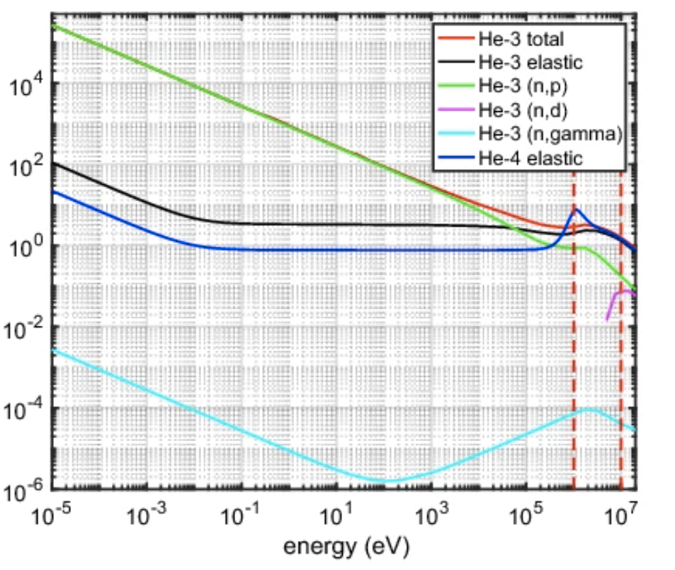
LXXV International Conference «NUCLEUS – 2025. Nuclear physics, elementary particle physics and nuclear technologies»
1. Reasons
High sensitivity to fast neutrons: Helium-4 has a high elastic scattering cross section for fast neutrons to produce a signal
In high energy region:
He-3
(n, p) [green] -> (n, d) [pink] (>10 MeV);
Higher gamma sensitive [light blue];
Decrease elastic scattering [black].
He-4
Decrease elastic scattering but higher than He-3 [dark blue]
Fig. 1. Micro-cross-sections of He-3 and He-4 (wide energy range)
Notes:
Fast neutrons interact with He-4 nuclei via elastic scattering (n+4He→n′+4He∗).The recoil nucleus ionizes and excites surrounding gas atoms, producing scintillation light in the VUV region, 80 nm ~ 16 eV - around 15 000 photons per Mev.

Slide 7
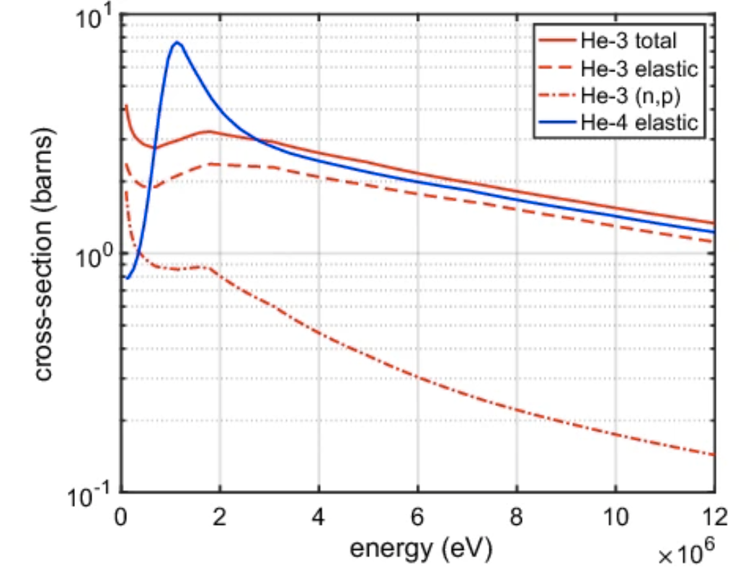
LXXV International Conference «NUCLEUS – 2025. Nuclear physics, elementary particle physics and nuclear technologies»
1. Reasons
In high energy region:
He-3
is not effective in detecting fast neutrons via the (n, p) reaction because the cross section is low.
He-4
the elastic cross-section is almost of the total cross-section at fast neutron energies.
This means that when a fast neutron collides with a He-4 nucleus, transferring energy to the He-4 nucleus. It is this recoil event that generates the scintillation signal in the detector.
Fig. 2. Micro-cross-sections of He-3 and He-4 (high energy scale)
Notes:
Fast neutrons interact with He-4 nuclei via elastic scattering (n+4He→n′+4He∗).The recoil nucleus ionizes and excites surrounding gas atoms, producing scintillation light in the VUV region, 80 nm ~ 16 eV - around 15 000 photons per Mev.

Slide 8
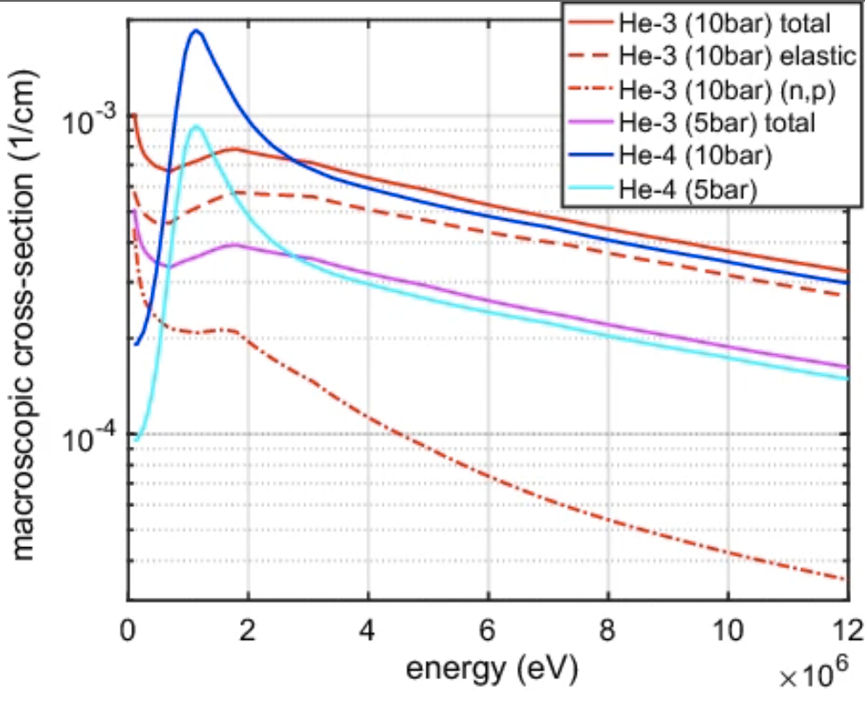
LXXV International Conference «NUCLEUS – 2025. Nuclear physics, elementary particle physics and nuclear technologies»
1. Reasons
In high energy region:
He-3
The cross section of (n, p) reaction is very low due 10 bar;
Total cross-section increases as the pressure increases from 5 bar [pink] to 10 bar [red].
He-4
the elastic cross-section cross section increases as the pressure increases from 5 bar [light blue] to 10 bar [dark blue];
Higher than He-3 at 10 bar.
Fig. 3. Macroscopic cross-sections of He-3 and He-4 at different pressures (focusing on high energies)
Notes:
Fast neutrons interact with He-4 nuclei via elastic scattering (n+4He→n′+4He∗).The recoil nucleus ionizes and excites surrounding gas atoms, producing scintillation light in the VUV region, 80 nm ~ 16 eV - around 15 000 photons per Mev.

Slide 9
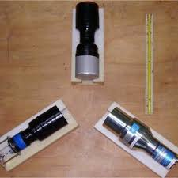
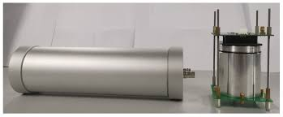
LXXV International Conference «NUCLEUS – 2025. Nuclear physics, elementary particle physics and nuclear technologies»
Solid scintillators (NaI, BGO) detectors can be used to detect fast neutrons which are very sensitive to gamma rays.
- Additional techniques like pulse shape discrimination ;
Price: can be quite expensive, especially for large sizes;
High technical requirements: NaI is easy to absorb moisture, high density BGO but less energy resolution than NaI.
1. Reasons
He-4 low gamma sensitive - low density - He-4 detectors are well-suited for applications where fast neutron detection is needed in high gamma backgrounds.
Noble gas: no chemical reaction, safe to use and easily put into closed chambers.
Non-toxic;
Not emission: He-4 is a stable isotopes, does not emit background radiation.
Fig. 4. BGO and NaI, … neutron detector
Notes:
Fast neutrons interact with He-4 nuclei via elastic scattering (n+4He→n′+4He∗).The recoil nucleus ionizes and excites surrounding gas atoms, producing scintillation light in the VUV region, 80 nm ~ 16 eV - around 15 000 photons per Mev.

Slide 10
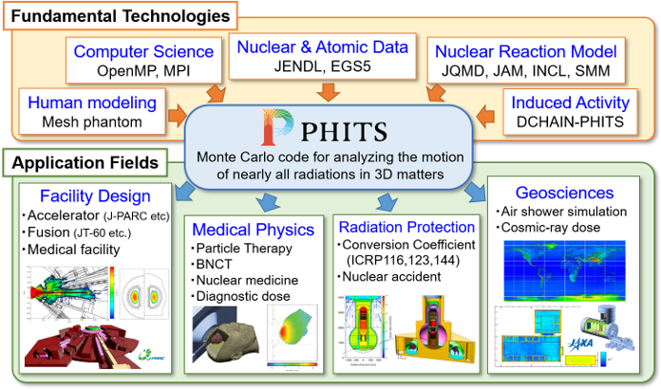
LXXV International Conference «NUCLEUS – 2025. Nuclear physics, elementary particle physics and nuclear technologies»
2. Phits
PHITS (Particle and Heavy Ion Transport code System) is a general purpose Monte Carlo particle transport simulation code developed under collaboration between JAEA, RIST, KEK and several other institutes.
It can deal with the transport of all particles over wide energy ranges, using several nuclear reaction models and nuclear data libraries.
PHITS can support your researches in the fields of accelerator technology, radiotherapy, space radiation, and in many other fields which are related to particle and heavy ion transport phenomena

Slide 11
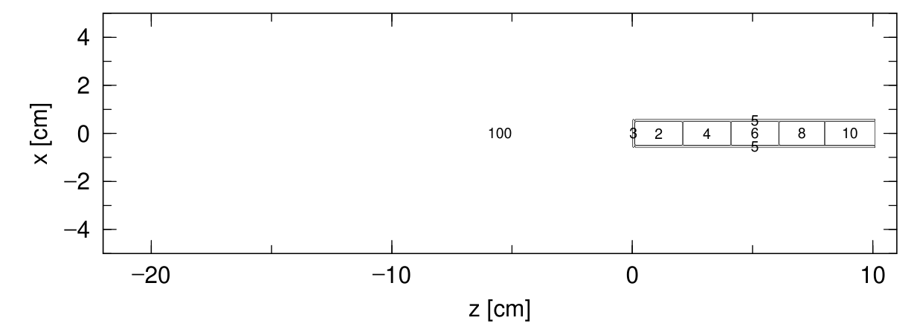
LXXV International Conference «NUCLEUS – 2025. Nuclear physics, elementary particle physics and nuclear technologies»
3. Description of detector in PHITS

Slide 12
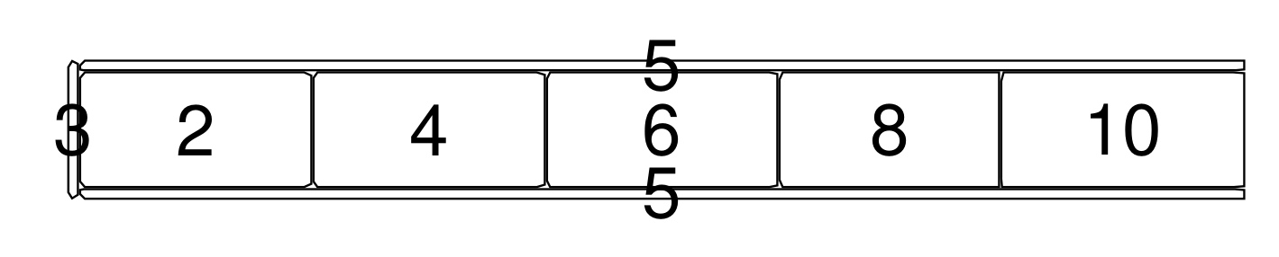
LXXV International Conference «NUCLEUS – 2025. Nuclear physics, elementary particle physics and nuclear technologies»
3. Description of detector in PHITS
Table 1: Description parameters
Inside Diameter | 1 cm
Outside Diameter | 1.2 cm
Length of sensitive volume | 10 cm
Window thickness | 1 mm
Material | 6061 (T6) Aluminum alloy
Gas - filled | Helium-4, BGO
Pressure | 20 – 50 – 80 atm (He-4)
Radiation source | Cf-252 and Cs-137

Slide 13
LXXV International Conference «NUCLEUS – 2025. Nuclear physics, elementary particle physics and nuclear technologies»
3. Description of detector in PHITS
Neutron
Gamma
Helium-4 detector
BGO detector
BGO detector
Helium-4 detector
20 atm
50 atm
80 atm
20 atm
50 atm
80 atm

Slide 14
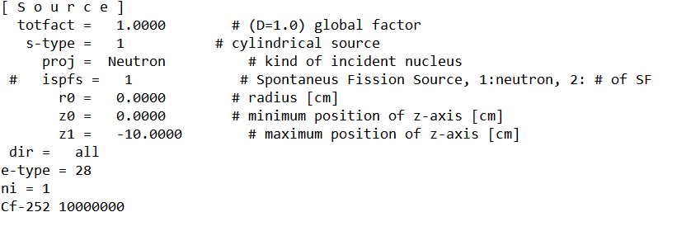
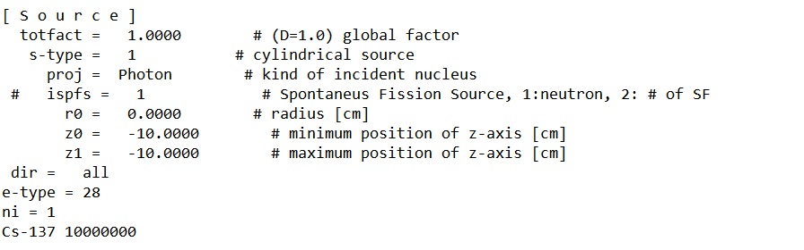
LXXV International Conference «NUCLEUS – 2025. Nuclear physics, elementary particle physics and nuclear technologies»
3. Description of detector in PHITS (radiation source)
Cf-252 parameters setup
Cs-137 parameters setup

Slide 15
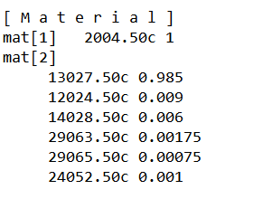
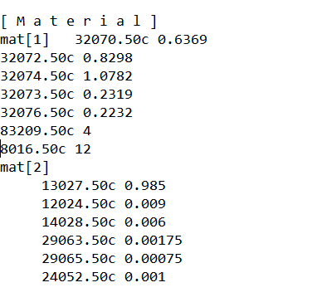
LXXV International Conference «NUCLEUS – 2025. Nuclear physics, elementary particle physics and nuclear technologies»
3. Description of detector in PHITS (material)
He-4 parameters setup
BGO parameters setup

Slide 16
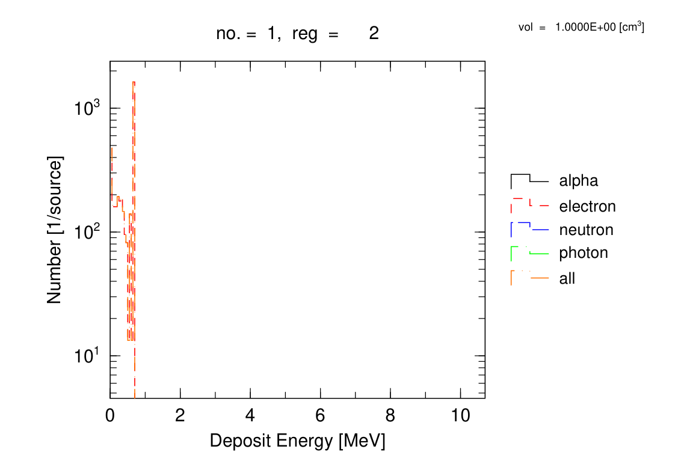
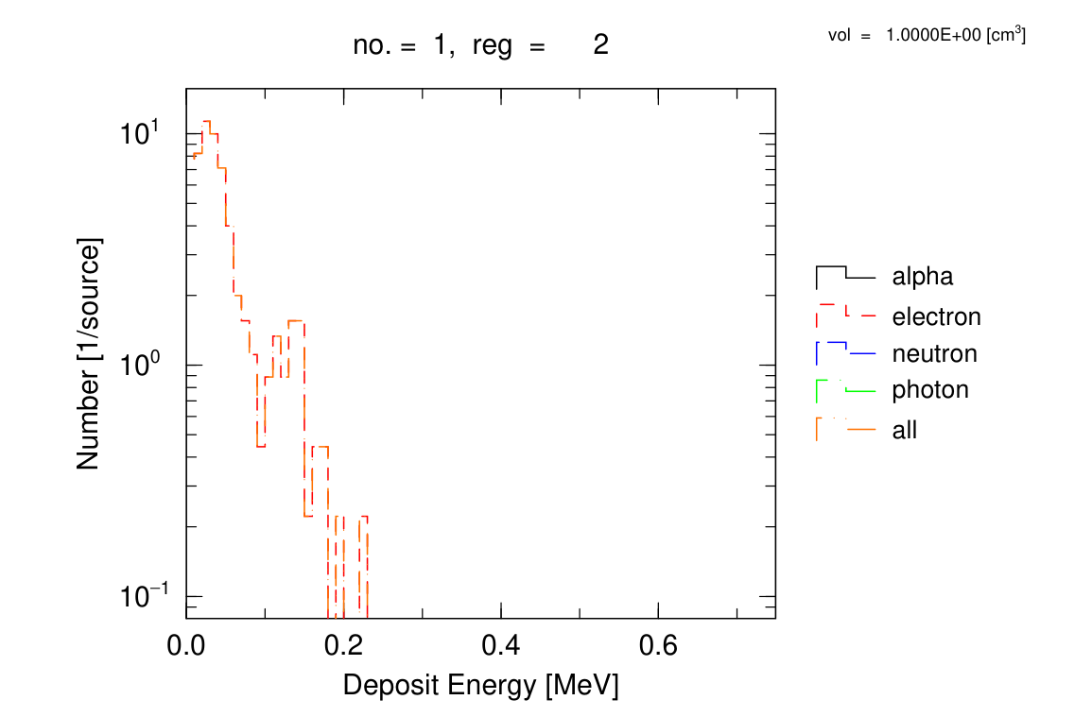
LXXV International Conference «NUCLEUS – 2025. Nuclear physics, elementary particle physics and nuclear technologies»
4. Result
Fig. 4. BGO gamma sensitive
Fig. 5. He-4 – 80 atm gamma sensitive
Notes:
The results show that the higher the tube pressure, the greater the interaction efficiency of neutrons with the detector, proportional to the density of helium-4.

Slide 17
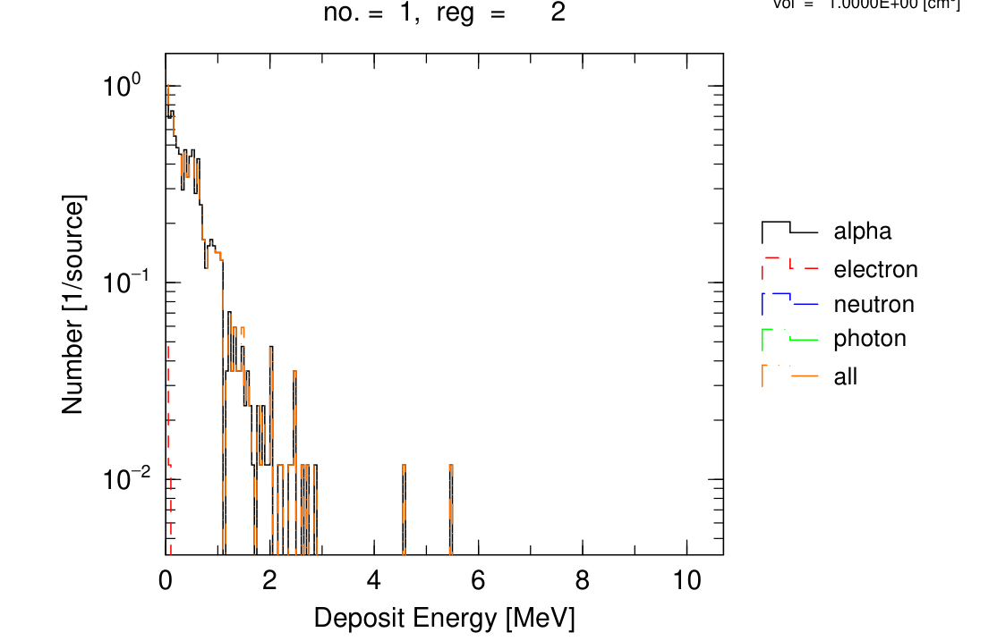
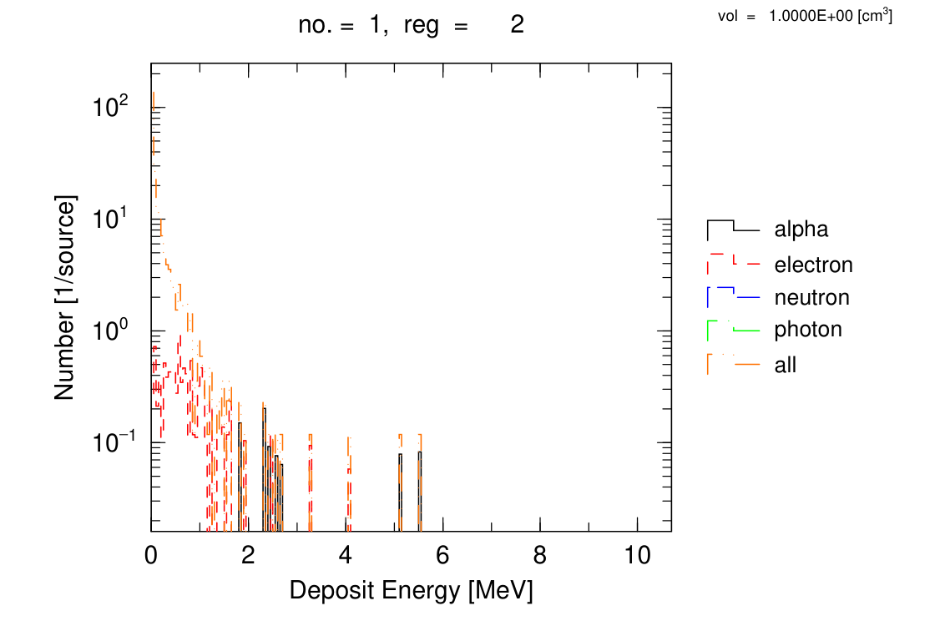
LXXV International Conference «NUCLEUS – 2025. Nuclear physics, elementary particle physics and nuclear technologies»
4. Result
Fig. 5. BGO neutron sensitive
Fig. 6. He-4 – 80 atm neutron sensitive
Notes:
The results show that the higher the tube pressure, the greater the interaction efficiency of neutrons with the detector, proportional to the density of helium-4.

Slide 18
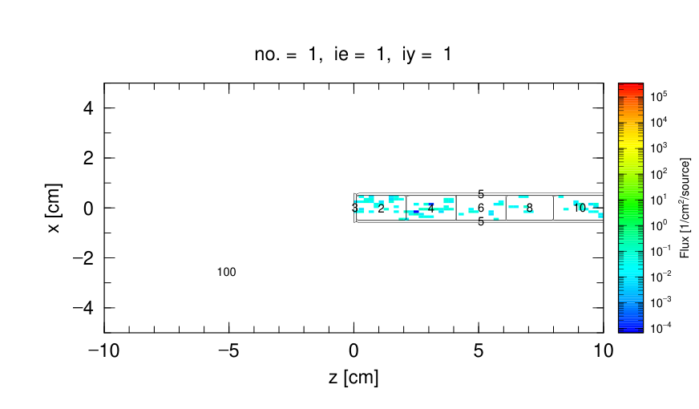
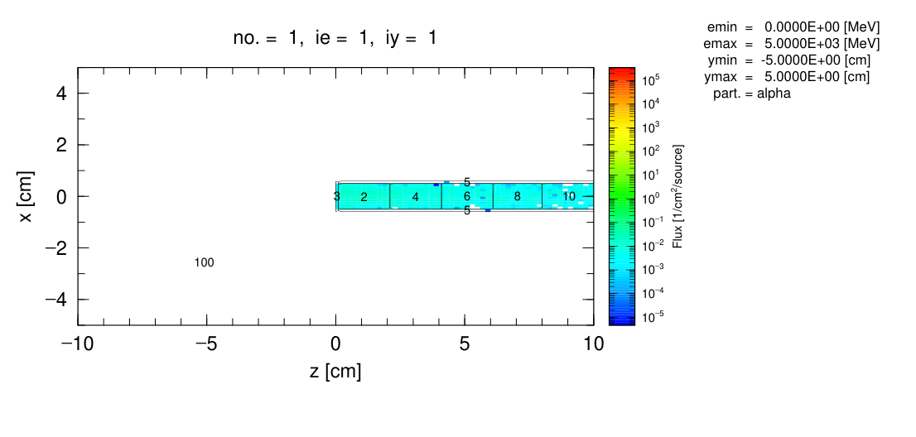
LXXV International Conference «NUCLEUS – 2025. Nuclear physics, elementary particle physics and nuclear technologies»
4. Result
80 atm
20 atm
Fig. 7. Pressure dependence on efficient detection
Notes:
The results show that the higher the tube pressure, the greater the interaction efficiency of neutrons with the detector, proportional to the density of helium-4.

Slide 19
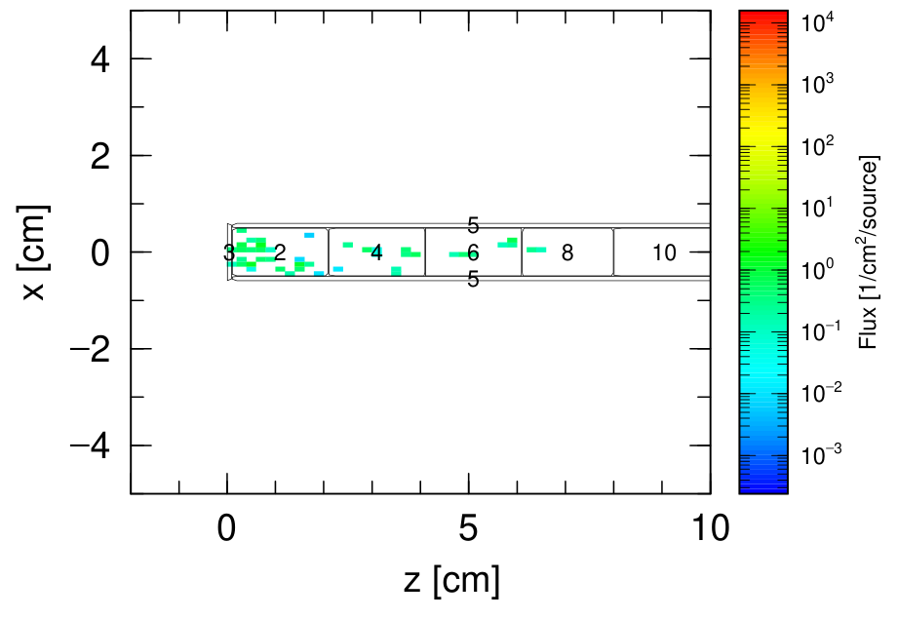
LXXV International Conference «NUCLEUS – 2025. Nuclear physics, elementary particle physics and nuclear technologies»
3. Result
Fig. 9. The interaction of neutron in detector
Fig. 8. Detector response sensitive length

Slide 20
LXXV International Conference «NUCLEUS – 2025. Nuclear physics, elementary particle physics and nuclear technologies»
4. Expand the issue to consider
Wavelength Shifter: Nitrogen, Sodium Salisylic
How to light collected?
DETECTOR
PMT
High gain, Fast response time, large sensitive area.
Big size, high voltage, magnetic sensitive, expensive, high power,….
SiPM
Compact size, low operating voltage, insensitive magnetic fields low power, cheap.
Dark current, temperature sensitive,
Photosensor

Slide 21
LXXV International Conference «NUCLEUS – 2025. Nuclear physics, elementary particle physics and nuclear technologies»
4. Expand the issue to consider
Next Work
Next will analyze the choice of SiPM or PMT
Choose wavelength shifting chemical
Create first prototype
Build model with thermal neutron
Any suggestions let me know!

Slide 22
LXXV International Conference «NUCLEUS – 2025. Nuclear physics, elementary particle physics and nuclear technologies»
Thank you for your attention!
Saint Petersburg - July, 05th 2025

Slide 25
Next Work
Next will analyze the choice of SiPM or PMT
Choose wavelength shifting chemical
Create first prototype
Build model with thermal neutron
Any suggestions let me know

Slide 28
Lí do

Slide 29
motivation

