Slide 1

Verification of the CVC Hypothesis Based on Superallowed Fermi Beta Transitions Between 0⁺ States with Isospin 1
A. K. Vlasnikov, I.S. Gusev
Saint Petersburg State University
Saint Petersburg
2025

Slide 2
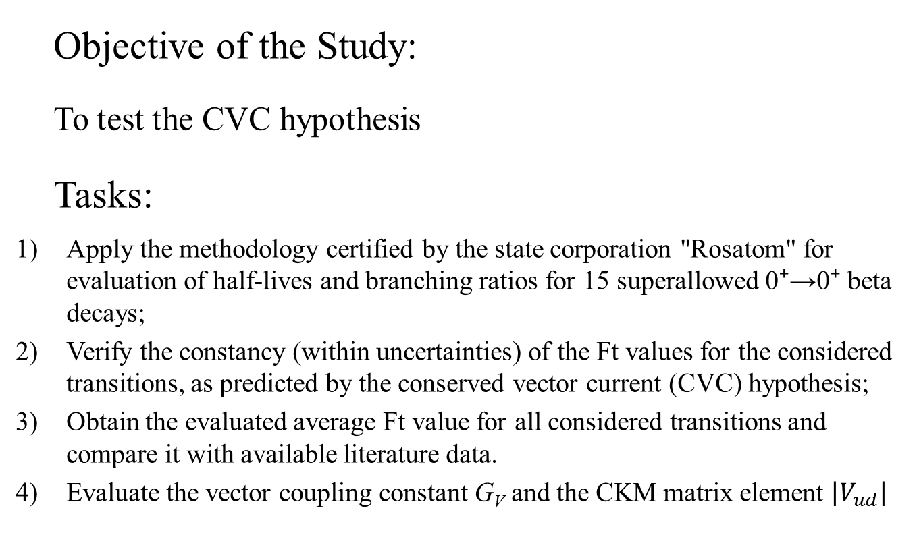
Introduction
Objective of the Study:
To test the CVC hypothesis
Tasks:
Apply the methodology certified by the state corporation "Rosatom" for evaluation of half-lives and branching ratios for 15 superallowed 0⁺→0⁺ beta decays;
Verify the constancy (within uncertainties) of the Ft values for the considered transitions, as predicted by the conserved vector current (CVC) hypothesis;
Obtain the evaluated average Ft value for all considered transitions and compare it with available literature data.
Evaluate the vector coupling constant G_{V} and the CKM matrix element $\left|V_{ud}\right|$

Slide 3
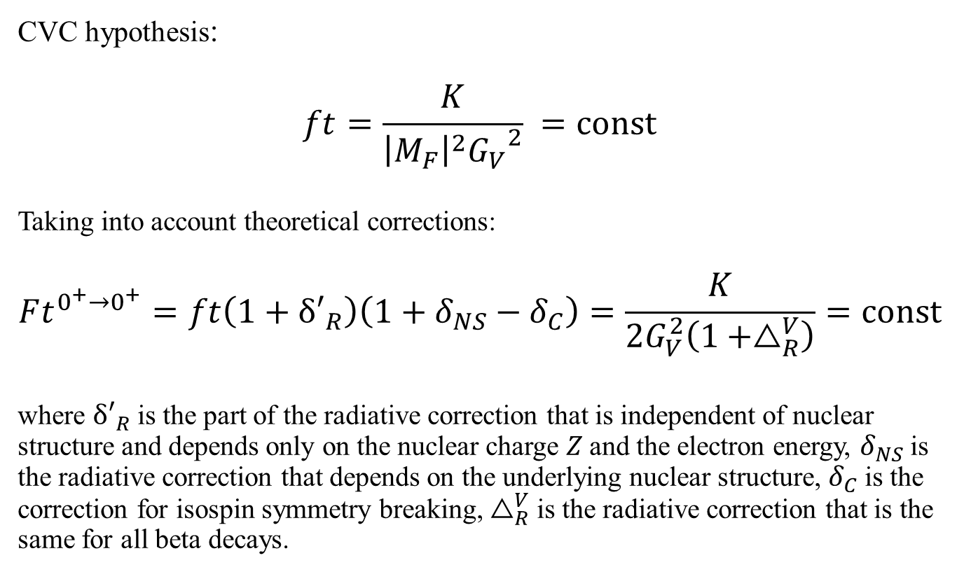
Objective of the Study
CVC hypothesis:
$$ft=\frac{K}{{\left|M_{F}\right|}^{2}{G_{V}}^{2}} =const$$
Taking into account theoretical corrections:
$$Ft^{0^{+}→0^{+}}=ft\left(1+δ′_{R}\right)\left(1+δ_{NS}−δ_{C}\right)=\frac{K}{2G_{V}^{2}\left(1+△_{R}^{V}\right)}=const$$
where $δ′_{R}$is the part of the radiative correction that is independent of nuclear structure and depends only on the nuclear charge 𝑍 and the electron energy, $δ_{NS}$is the radiative correction that depends on the underlying nuclear structure, $δ_{C}$is the correction for isospin symmetry breaking, $△_{R}^{V}$is the radiative correction that is the same for all beta decays.

Slide 4
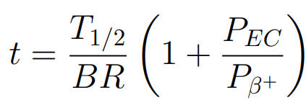
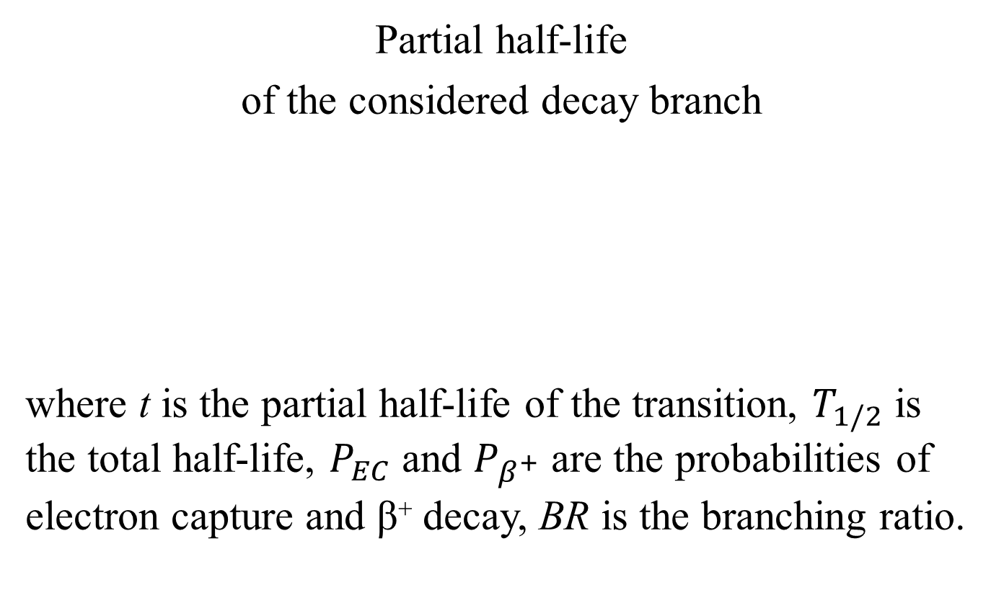
Objective of the Study
Partial half-life
of the considered decay branch
where t is the partial half-life of the transition, $T_{1/2}$ is the total half-life, $P_{EC}$ and $P_{β^{+}}$ are the probabilities of electron capture and β⁺ decay, BR is the branching ratio.

Slide 5
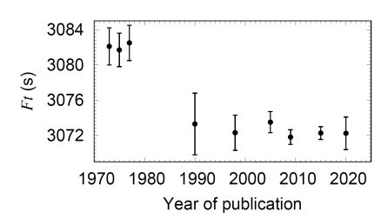
Relevance
Evolution of the average $Ft^{0^{+}→0^{+}}$ performed by Hardy and Towner.

Slide 6



Methodology
Formation of the Input Data Set:
Selection of published independent results;
Possible adjustment of results
Identification of statistical outliers (Chauvenet’s criterion)

Slide 7
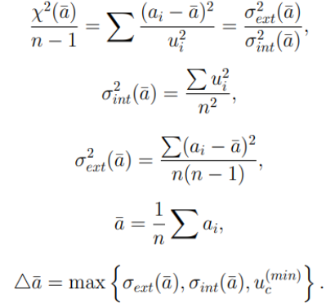
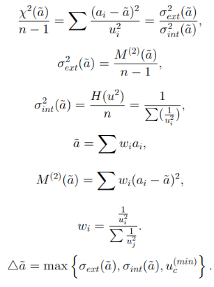
Methodology
For the unweighted average:
For the weighted average:

Slide 8


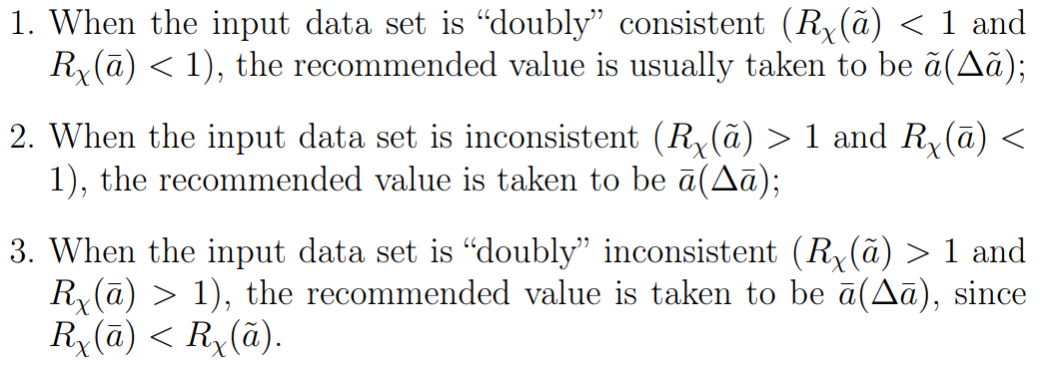
Methodology
In the updated methodology, the selection of the recommended value is performed as follows:

Slide 9
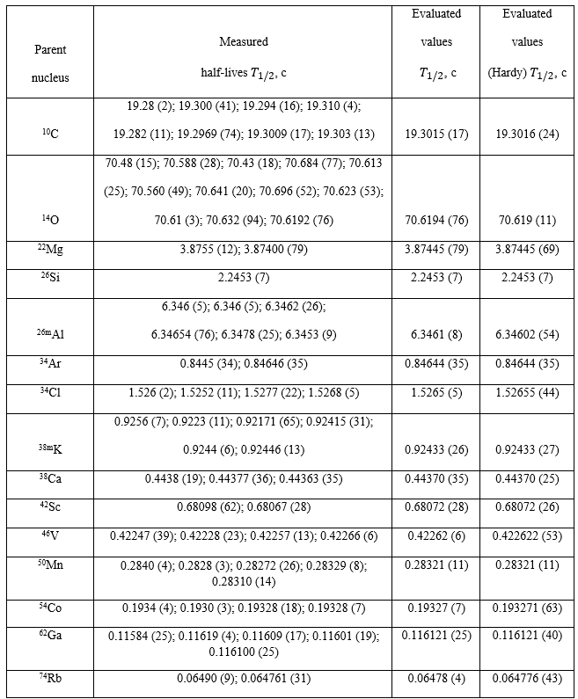
Results and Discussion
Half-life evaluation $T_{1/2}$

Slide 10
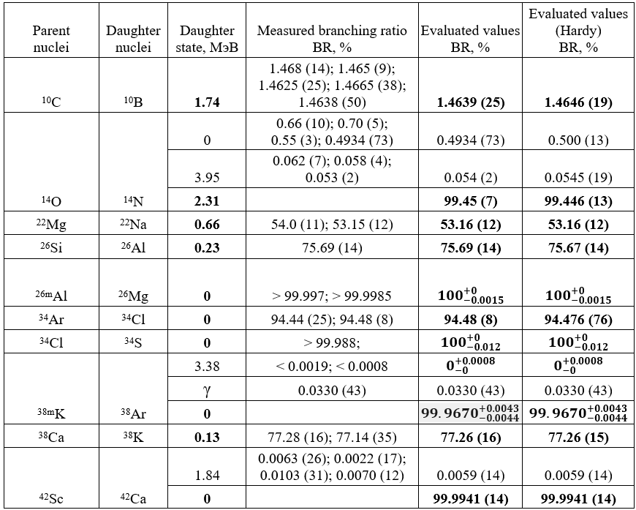
Results and Discussion
Branching ratio evaluation$BR$

Slide 11
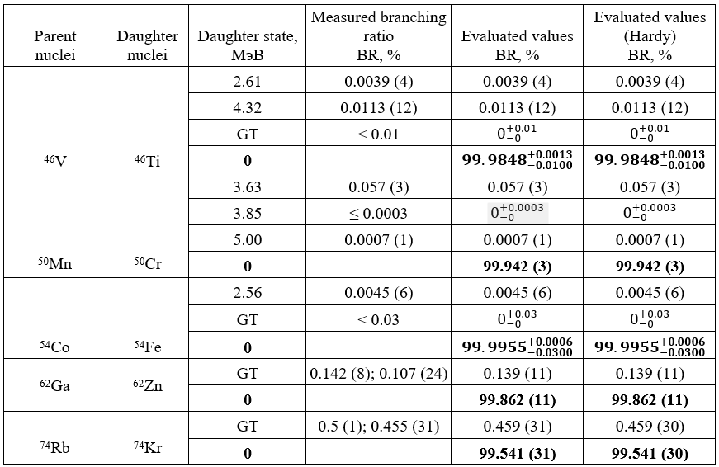
Results and Discussion
Branching ratio evaluation$BR$

Slide 12
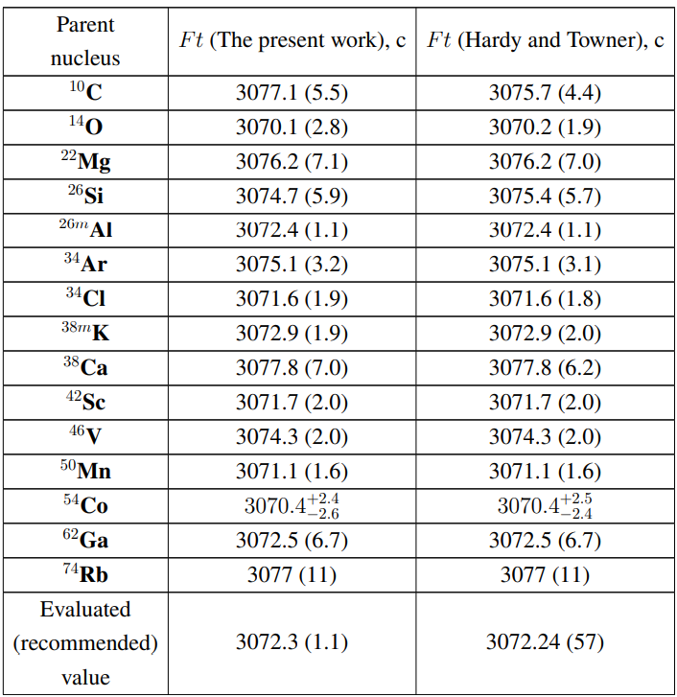
Results and Discussion
Calculated Ft values

Slide 13
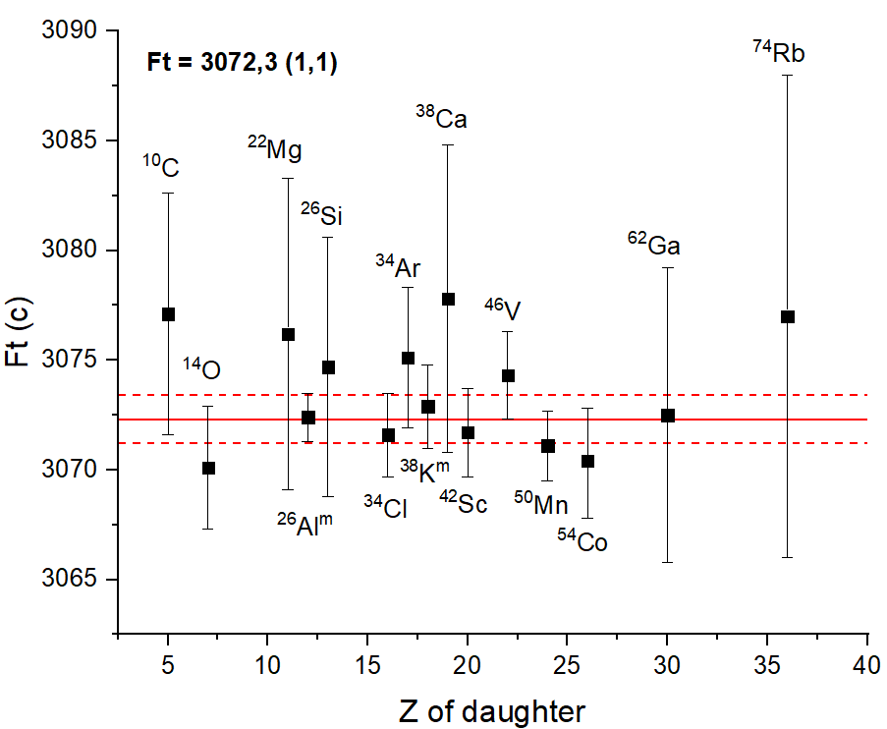
Results and Discussion

Slide 14
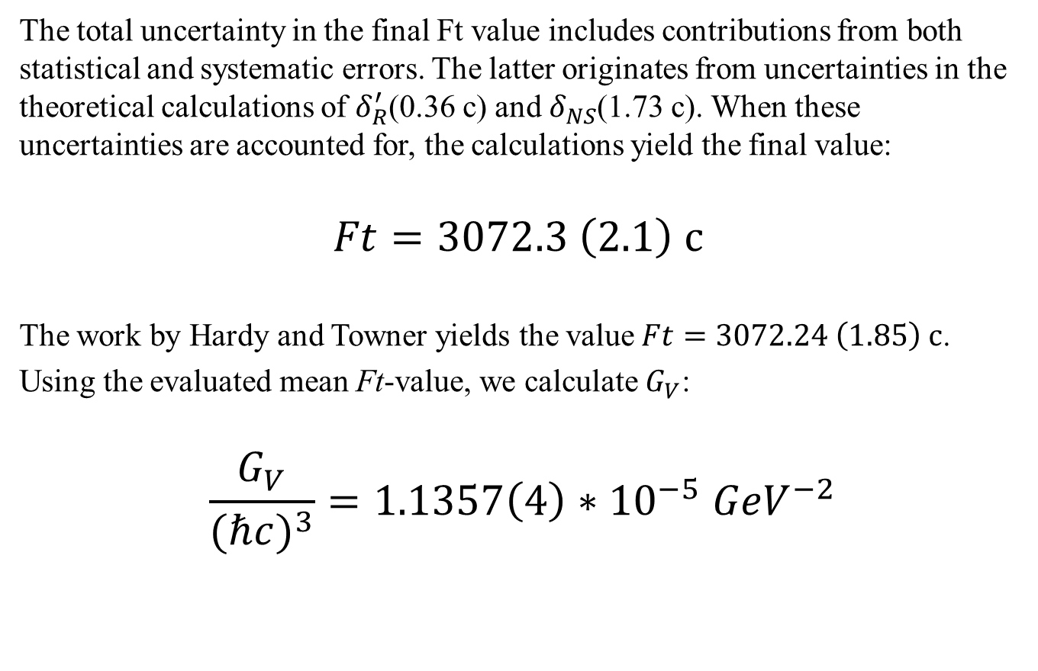
Results and Discussion
The total uncertainty in the final Ft value includes contributions from both statistical and systematic errors. The latter originates from uncertainties in the theoretical calculations of $δ_{R}^{′}$(0.36 с) and $δ_{NS}$(1.73 с). When these uncertainties are accounted for, the calculations yield the final value:
$$Ft=3072.3 \left(2.1\right) с$$
The work by Hardy and Towner yields the value$Ft=3072.24 \left(1.85\right) с$.
Using the evaluated mean Ft-value, we calculate${ G}_{V}$:
$$\frac{G_{V}}{{(ℏc)}^{3}}=1.1357\left(4\right)∗{10}^{−5} {GeV}^{−2}$$

Slide 15
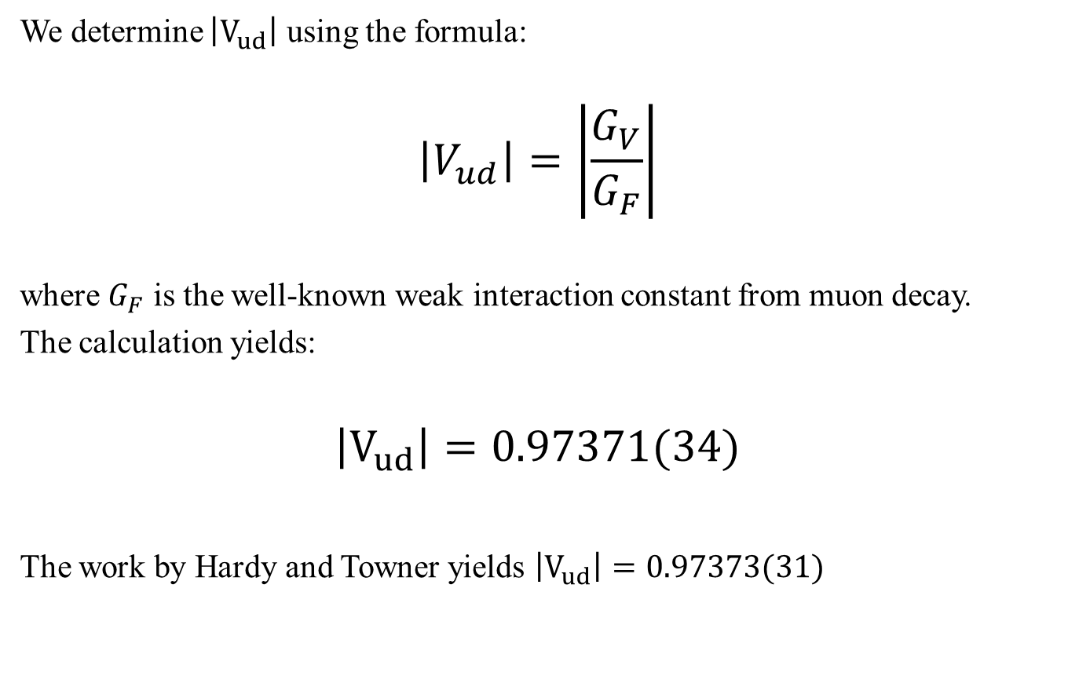
Results and Discussion
We determine $\left|V_{ud}\right|$ using the formula:
$$\begin{aligned}\left|V_{ud}\right|=\left|\frac{G_{V}}{G_{F}}\right|\end{aligned}$$
where $G_{F}$ is the well-known weak interaction constant from muon decay.
The calculation yields:
$$\left|V_{ud}\right|=0.97371(34)$$
The work by Hardy and Towner yields $\left|V_{ud}\right|=0.97373(31)$

Slide 16
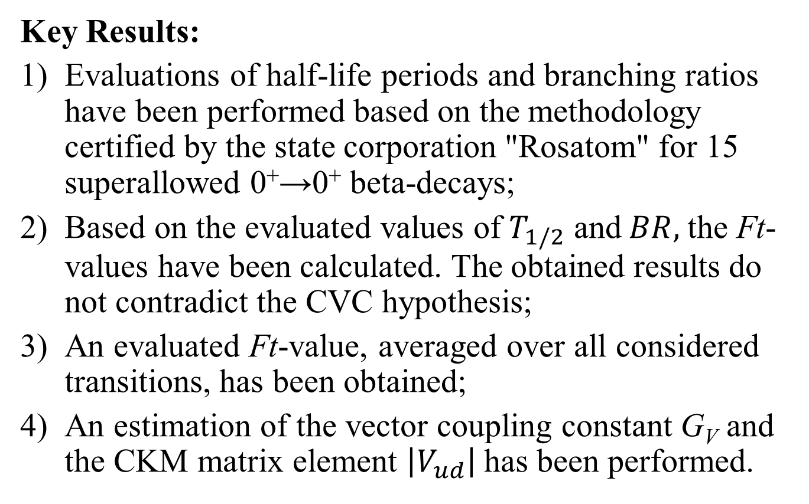
Conclusion
Key Results:
Evaluations of half-life periods and branching ratios have been performed based on the methodology certified by the state corporation "Rosatom" for 15 superallowed 0⁺→0⁺ beta-decays;
Based on the evaluated values of$T_{1/2}$ and$BR,$the Ft-values have been calculated. The obtained results do not contradict the CVC hypothesis;
An evaluated Ft-value, averaged over all considered transitions, has been obtained;
An estimation of the vector coupling constant G_{V} and the CKM matrix element $\left|V_{ud}\right|$has been performed.

Slide 17
Thank you for your attention!

Slide 18
references
Hardy J. C., Towner I. S. Superallowed nuclear decays: 2020 critical survey, with implications for and CKM unitarity // Phys. Rev. C. 2020. V. 102, Art.N0.045501.
Kuzmenko, N. K. Current status of the recommended half-lives for theradionuclides used as the standards of photon emitters // Appl. Radiat. Isot.2022. V. 180, Art.N0. 110039.

