Slide 1

AB INITIO STUDIES OF ISOBAR-ANALOG STATES OF LIGHT NUCLEI
Yu. M. Tchuvil'sky
Skobeltsyn Institute of Nuclear Physics, Lomonosov Moscow State University, Moscow, Russia
D. M. Rodkin
Dukhov Research Institute for Automatics, Moscow, Russia

Slide 2
GOALS AND OBJECTIVES
The main objective of the report is to popularize ab initio studies of light nuclei as one of the most important tools of nuclear spectroscopy.
As an example, a “pure” scheme for analyzing the spectra of isobaric analog states, their verification and prediction, which does not involve any empirical data on the properties of the nuclei being studied, is presented.

Slide 3
CHIRAL EFFECTIVE FIELD THEORY HAMILTONIAN
Leading order (LO)
Next to leading order (NLO)
Next-next to leading order (N2LO)
N3LO
…………….
Diagrams of the chiral effective theory.

Slide 4
The weights of amplitudes of all chosen diagrams are fitted to all known two- and three-nucleon systems data. The Similarity Renormalization Group transformation that preserves two- and three-nucleon data is used to tune a potential used in multiparticle calculations. The corresponding Hamiltonian is exployted in large-scale variational calculations.
The results presented bellow are obtained with the use of Daejeon16 potential constructed based on N3LO forces and well proven in NCSM calculations of light nuclei spectra (A.M. Shirokov, I.J. Shin, Y. Kim et al. (2016)). Code Bigstick is used for shell-model computing of the energies and WFs of decaying nuclear states and fragments.

Slide 5
NO-CORE SHELL MODEL (NCSM) AS A GROUND OF AB INITIO APPROACHES
The dynamics of canonic NCSM is described by A-nucleon Hamiltonian with realistic NN- (+NNN-) interaction. The variational problem is solved by diagonalization of the Hamiltonian matrix on the basis of A-nucleon Slater determinants (so-called M-scheme):
(1)
which, as a rule, consist of the spherical oscillator one-nucleon wave functions. All matrix elements are taken into account.
The results of calculations may be refined using various extrapolation methods.

Slide 6
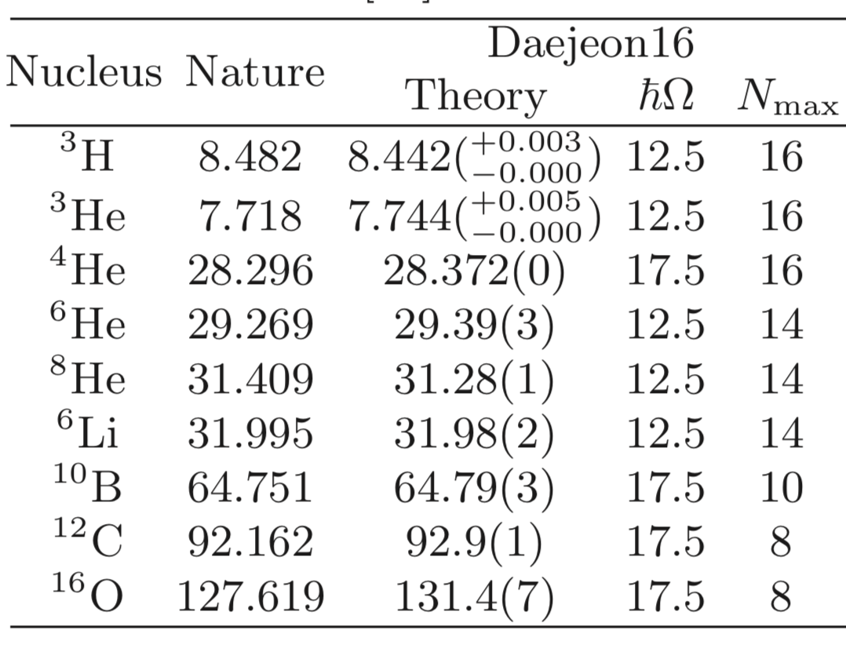
TOTAL BINDING ENERGY. TYPICAL RESULTS
Descriptive ability of such method is good.
ћω is oscillator parameter (MeV), N_{max} – the basis limitation.
Predictive power is high too. The energy of 14F and 4n resonance observed in the same time or later were predicted in such a way with asatisfactory accuracy.

Slide 7
NCSM, NUCLEAR PROPERTIES AND GAMMA-TRANSITIONS
NCSM calculations with the potentials built in such a way reproduce quite well not only the total binding energies of nuclei up to 16O and excitation energies of their lower levels. The magnetic moments of nuclei and the probabilities of M1-transitions are also reproduced well.
The accuracy of NCSM calculations of nuclear radii, quadrupole moments and probabilities of E2 transitions is lower, but, nevertheless, satisfactory.
Due to the successful description of M1 transitions demonstrated by calculations, it can be assumed that calculating the probability of allowed β transitions will also not cause serious difficulties.

Slide 8
If one excludes problems with determining of E1 transitions probabilities, and the positions of highly excited levels, then one can reasonably expect that modern theory is capable of giving reliable predictions of many important spectroscopic characteristics of light nuclei.
As a result, for undetected levels and loosely measured transitions, it looks reasonable to base on these theoretical data. So, in some areas of nuclear spectroscopy, ab initio calculations are already becoming competitive with measurments of the same observables.
All of the above is also true (with the possible exception of nuclear radii) for exotic nuclear systems far from the β-stability line.

Slide 9
PROBLEMS AWAITING SOLUTION
Now it seems natural to pose the problem of expanding the list of reliably calculated and predictable nuclear characteristics up to the creation of a complete area of ​​research – theoretical nuclear spectroscopy of light nuclei.
Here is a list of the main physical problems that are awaiting their solution or the creation of an approach to a solution that will radically improve the quality and reliability of the description of the spectroscopic characteristics of nuclei:
1. Description of transitions (electromagnetic, weak) between levels of different parity, in particular E1- and forbidden β-transitions.

Slide 10
2. Development of the theory of weakly bound but nucleon-stable light nuclei, and, first of all, the description of the one- and two-neutron halo.
3. Study of nucleon-unstable nuclei and highly excited levels of nuclei lying above the threshold of alpha, neutron or proton decay. This is the general direction in modern experimental physics of light nuclei. The main characteristics of such objects, along with the total binding energy, are the decay widths - total and partial (into separate channels).
4. Implementation of ab initio approaches to the description of the structure of colliding nuclei in the theory of nuclear reactions at relatively low energies.

Slide 11
5. Improving the quality of the description of spectroscopic characteristics (asymptotic normalization coefficients, etc.) that determine the cross sections of low-energy processes characteristic of nuclear astrophysics.
6. Studying short-range nucleon correlations within the ab initio approach, in particular, describing the “quasideuteron” absorption of gamma quanta.

Slide 12
ISOSPIN AND COULOMB EFFECTS
Most models of nucleon–nucleon interactions assume that the strong interaction conserves isospin, so that isobaric nuclei differ in their properties only due to the Coulomb interaction.
The action of the Coulomb potential leads to a violation of the "purity" of nuclear wave functions in isospin. The average isospin value <T²>^{1/2} is calculated as usual. To calculate the weight of individual isospin components, the projection operator onto states with fixed isospin was used:
Stable Coulomb differences of isobar analog multiplets ​​served as a sign of analog partners, as well as a criterion for selecting real resonance states.

Slide 13
FIVE-NUCLEON SYSTEMS
Measured ⁵He spectrum

Slide 14
Measured ⁵Li spectrum

Slide 15
J≤5/2, T=1/2 ⁵He AND ⁵Li STATES
 | ⁵He |  | ⁵Li
J^{π} | TBE_{exp}(E*) | TBE_{th} | TBE_{exp} (E*) | TBE_{th} | ΔE_{exp} | ΔE_{ht}
3/2– | 27.50(0.00) | 27.25 | 26.61 (0.00) | 26.53 | 0.89 | 0.72
1/2– | 26.23(1.27) | 25.46 | 25.12 (1.49) | 25.09 | 0.77 | 0.37
3/2⁺ | 10.66 (16.84) | 9.76 | 9.76(16.87) | 8.78 | 0.90 | 0.98
3/2⁺ | 8.24 (19.26) | 6.55 | 7.38 (19.23) | 5.69 | ----- | 0.86
5/2⁺ | 6.36 (19.14) | 6.53 | 6.90 (19.71) | 5.61 | ----- | 0.92
5/2⁺ | 6.11 (21.39) | 5.54 | 5.42(21.09) | 4.85 | ----- | 0.69
3/2⁺ | 6.25 (21.25) | 5.35 | 5.42(21.09) | 4.62 | ----- | 0.73
3/2– | 7.54 (19.96) | 4.46 | 7.33 (19.28) | 3.84 | 0.21 | 0.62
1/2⁺ | 6.61(20.89) | 3,80 | 6,08 (20.53) | 3,27 | ----- | 0,53
3/2⁺ | 1.73(25.77) | 2.67 | 1.19(25.42) | 2.13 | ----- | 0.54
1/2⁺ | 5.86(20.89) | 2.27 | 5.33 (21.28) | 1.75 | 0.53 | 0,52
5/2⁺ | 3.37(21.64) | 1.76 | 2.87 (23.74) | 1.26 | ----- | 0.50
5/2– | 3.44(24.06) | 1.13 | 4.55 (22.06)* | 0.35 | -1.11 | 0.78
*Γ=15.5 MeV

Slide 16
Our calculations indicate the existence of at least 18 more levels with isospin 1/2. The reliability of these results is somewhat lower than those presented in the presented table, but they are still worthy of attention in the context of predicting resonance reaction cross sections and processing measurement results.

Slide 17
T=3/2 ⁵H, ⁵He AND ⁵Li LOWEST J^{π} STATES
J^{π} | H, E_{th} | H, E* | He, E_{th} | He, E* | <Т> | Δ(Н,Не) | Li, E_{th} | Li, E* | <T> | Δ(Нe,Li)
1/2⁺ | 5.47* | 0.0 | 5.08 | 22.17 | 1.49 | 0.39 | 4.32 | 22.21 | 1.49 | 0.76
5/2⁺ | 4.15 | 1.32 | 3.75 | 23.50 | 1.42 | 0.40 | 3.05 | 23.48 | 1.43 | 0.70
3/2⁺ | 3.68 | 1.80 | 3.30 | 23.95 | 1.49 | 0.38 | 2.61 | 23.92 | 1.49 | 0.69
3/2– | 3,28 | 2.19 | 2,81 | 24.44 | 1.14 | 0.47 | 2.21 | 24.32 | 1.46 | 0.60
1/2– | 3,07 | 2.40 | 2.77 | 24.48 | 1.42 | 0.30 | 2.06 | 24.47 | 1.41 | 0.71
5/2– | 2,59 | 2.88 | 2.19 | 25.06 | 1.35 | 0.40 | 1.56 | 24.97 | 1.40 | 0.63
*E_{exp} = 6.685 ±0.107 MeV
The stability of the magnitude of the Coulomb difference ΔE allows one to indirectly study the states of 5H by obtaining its isobar analogues in reactions induced by collisions of stable nuclei, for example, in the transfer reactions 10Be(p,5He*[T=3/2] )6Li or 10Be(p,5Li*[T=3/2] )6He.

Slide 18
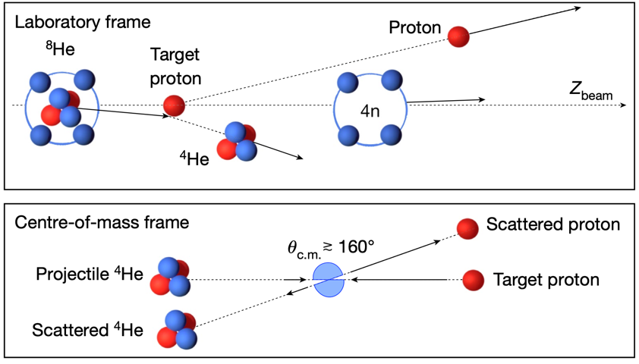
TETRANEUTRON
E = 2.37 ± 0.38(stat) ± 0.44(sys) MeV; Г = 1.75 ± 0,22(stat) ± 0.30(sys) MeV. M. Duer at al, Nature 606, 678 (2022)
Search for the tetraneutron system was performed in the ²H(⁸He,⁶Li)4n and ²H(⁸He,³He)⁷H→³H+4n reactions. Evidence for a hump at E* ~ 3.5 MeV was observed in both reactions.

Slide 19
SEARCH FOR THE TETRANEUTRON ISOBAR ANALOGS
Based on the analogy with the given examples, it is logical to assume that there are isobaric analogues of the tetraneutron - 4H and 4He with isospin T=2. In addition to confirming the experiments with the tetraneutron, these studies can answer the question of whether the strong interaction really preserves (or to what extent violates) isospin.
The total binding energy (TBE) of 4H(T=2) and 4He(T=2) nuclei, the Coulomb energy of 4He(T=2), and isospin mean value and the amplitudes of the components with a fixed isospin in this state were studied. The Daejeon16 is charge-invariant, so the total binding energies of the 4n and 4H(T=2) states coincide.

Slide 20
The results obtained for N* = 10 (in MeV) are the following:
ћω | TBE,He | TBE,H | <E_{coul}>,keV | <E_{coul}> - ΔE | <T>
4 | -3.500 | -3.314 | 172 | 14 | 1.950
5 | -4.094 | -3.878 | 203 | 13 | 1.956
6 | -4.674 | -4.432 | 231 | 11 | 1.982
Total binding energies of A=4, T=2 isobars, Coulomb energy and mean value of isospin operator.
Inclusion of the Coulomb interaction between the protons of the 4He nucleus lowers its binding energy by 216 keV (at ℏω = 5 MeV). This Coulomb difference is in a good agreement with the Coulomb difference of the lower states of the same nuclei with T = 1, equal to 248 keV.

Slide 21
Calculation of the energy of this state of 4He on a basis cleared of components with T = 0 and T = 1 reduces the Coulomb difference by 13 keV. The result is in fact independent on basis parameters. Thus, the manifestation of the Thomas-Ehrman (Nolen-Shiffer) effect in it is confirmed. If future measurements were to reveal even a small difference in the energies of the 4n and 4H and/or any significant deviation in the Coulomb energy difference between 4H and 4He, this would be a significant step toward understanding the nature of nuclear forces.
For the 4n (and, as a consequence, 4H (T=2)) system, it turned out to be possible to perfrm calculations up to N* = 16. In this case TBE obtained with ℏω = 5 MeV is equal to -2.71 MeV. So, one can expect the TBE of 4He (T=2) 0+ to be equal to -2.91 MeV and, consequently, this level should be sought at an energy of 31.2 MeV above the ground state of 4He.

Slide 22
Analyzing just presented results, we can conclude that due to the smallness of the admixture of states with T = 0, 1, resonance reactions with the formation of the compound states of interest 4H and 4He are, in all likelihood, of little promise. For the same reason, the reaction of knocking out alpha particles from 8Li is also unpromising for this purpose. Therefore, we believe that attention should be paid to direct cluster transfer reactions.

Slide 23








It is proposed to study these states in the reactions 6He(T=1) + 2H(T=0) → 4H(T=2) + 4He(T=1) and 6He(T=1) + 2H(T=0) → 4He(T=2) + 4H(T=1).
that is, in reactions of transfer of singlet deuteron and dineutron. In the calculations of cross-sections of direct nuclear reactions various mechanisms: pole, simultaneous independent nuclron, sequential nucleon, should be taken into account.

Slide 24
CONCLUSIONS
1. Isospin and Coulomb effects in light nuclei were investigated within the framework of a rigorous ab initio approach.
2. A mathematical apparatus was developed to calculate the weight of individual isospin components, using the projection operator onto states with a fixed isospin.
3. Detailed calculations of the spectra of the 5H – 5He –5Li multiplet resonances, were performed. Based on the the results of calculations and their analysis, the list of reliably established levels of the 5He and 5Li nuclei was significantly expanded. In such a way the efficiency and reliability of this approach was demonstrated.

Slide 25
4. An indirect method is proposed for studying the states of the 5H nucleus by means of more convenient reactions in which its isobaric analogies are obtained and a theoretical calculation of the corresponding Coulomb differences.
5. The total binding energy of isobar analogs of teraneutron - 4H(T=2) and 4He(T=2) states, the Coulomb energy of 4He(T=2), the mean value of its isospin <T> and the weights of components with a fixed isospin value in this state were calculated.
6. For the pair 4n and 4H(T=2), the contribution to the Coulomb difference from the effect of the difference in their wave functions was calculated using the charge-independent NN potential.

Slide 26
7. Nuclear processes that seem to be the most convenient for obtaining the 4H (T=2) or 4He (T=2) states were proposed. These are direct reactions of transfer of a singlet deuteron or dineutron (particles with isospin T=1): 6He(d,4He*(T=1))4H*(T=2) or 6He(d, 4H*(T=1))4He*(T=2), respectively.
Ultimately, we believe that ab initio theoretical approaches have become now an instrument of equal strength in the studies of spectroscopy of light nuclei.

Slide 27

THANK YOU FOR YOUR ATTENTION!

