Slide 1



Эмиссия фрагментов в столкновениях тяжелых ионов промежуточных энергий на основе неравновесного квантового гидродинамического подхода
А.Т. Дьяченко^{1.2}
¹ Петербургский институт ядерной физики им. Б.П. Константинова, НИЦ «Курчатовский институт»
² Петербургский государственный университет путей сообщения Императора Александра I

Slide 2
Emission of fragments in collisions of intermediate-energy heavy ions based on the non-equilibrium quantum hydrodynamic approach
A.T. D’yachenko^{1.2}
;
¹NRC “Kurchatov Institute” B.P. Konstantinov Petersburg Nuclear Physics Institute
²Emperor Alexander I Petersburg State Transport University;

Slide 3
In .
Based on the nonequilibrium hydrodynamic approach, double differential cross sections for the spectra of light fragments emitted in the FRAGM (ITEP) experiment in collisions of carbon nuclei with a beryllium target at energies of 300 and 950 MeV/nucleon are described. To describe the fragment yield, the coalescence model was used taking into account the Goldhaber factorization. Improvement of the agreement for describing the asymmetry of the momentum distribution of the fragment yield was achieved here using the Lifshitz-Slezov asymptotic profile function in the coalescence model
In the nonequilibrium hydrodynamic approach at high energies of colliding heavy ions, the Hubble law for the resulting fireball during its expansion was studied and in this approximation agreement with the results of calculations using the PHSD model was obtained.
Taking the Hubble law as a basis, in the next approximation within the framework of hydrodynamics, the average vorticity was found and the polarization of the emitted particles in collisions of gold nuclei at an energy of GeV/nucleon was estimated. For the impact parameter 8 fm, the polarization turned out to be about 5%, which is in agreement with the experimental data of the STAR collaboration for hyperons and calculations using the PHSD model. This may be of interest for future experiments at the NICA collider . Already the first comparison with experimental data on the distribution of protons, deuterons and tritons in the collision of argon nuclei at the energy of 3.2 GeV per nucleon with different nuclei in the BM@N experiment turned out to be successful. We were able to successfully describe the double differential cross sections for the formation of cumulative protons and light fragments for the collision of carbon nuclei in the reaction ¹²C+¹²C at an energy of 20 GeV per nucleon on a fixed target, obtained at the U-70 accelerator of the IHEP (Serpukhov).

Slide 4
The Schrödinger equation and Hydrodynamics
"… важно сконцентрировать имеющиеся ресурсы на основных прорывных направлениях..." В.В. Путин.
To take into account dissipation in the process of collisions of complex systems, in addition to equations (2)-(3), a dissipative function related to the temperature of the system should be introduced into these equations

Slide 5
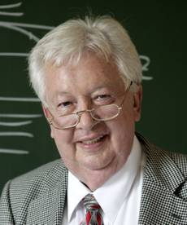
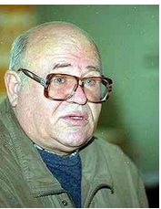
Fortov V.E,.Lomonosov I.V. // Phys. Usp. 2014. V. 57. no. 3. P.219
Fortov V.E., Sharkov B. Yu., Stöcker H.// Phys. Usp. 2012. V. 55. no. 6. P. 582.
Stöcker H., Greiner W. // Phys. Rept. 1986. V. 137. №. 5-6. P. 277.
D’yachenko A.T., Gridnev K.A., Greiner W. // J. Phys. 2013. V.G40.P. 085101
Korteweg D.J., Vries G.// Phil. Mag. 1895. V. 39. P. 422.
Scheid W, Muller H, Greiner W. 1974 // Phys. Rev. Lett. 1974, V. 32, P. 741
Baldin A.M. et al. Cumulative mesoproduction // Sov. J. Nucl. Phys. 1974. V. 18,no. 1. P. 41-44.
Bayukov Yu.D. et al. Scaling invariance effects in proton-nucleus backward scattering in few-GeV energy range // Sov. J. Nucl. Phys. 1974. V. 18, no. 6. P. 639-641.
GREINER Walter
1935-2016
L.D. Landau, Izv. Akad. Nauk Ser.Fiz. 17, 51(1953).
GRIDNEV Konstantin Alexandrovich
1938-2015
6
Notes:
5

Slide 6
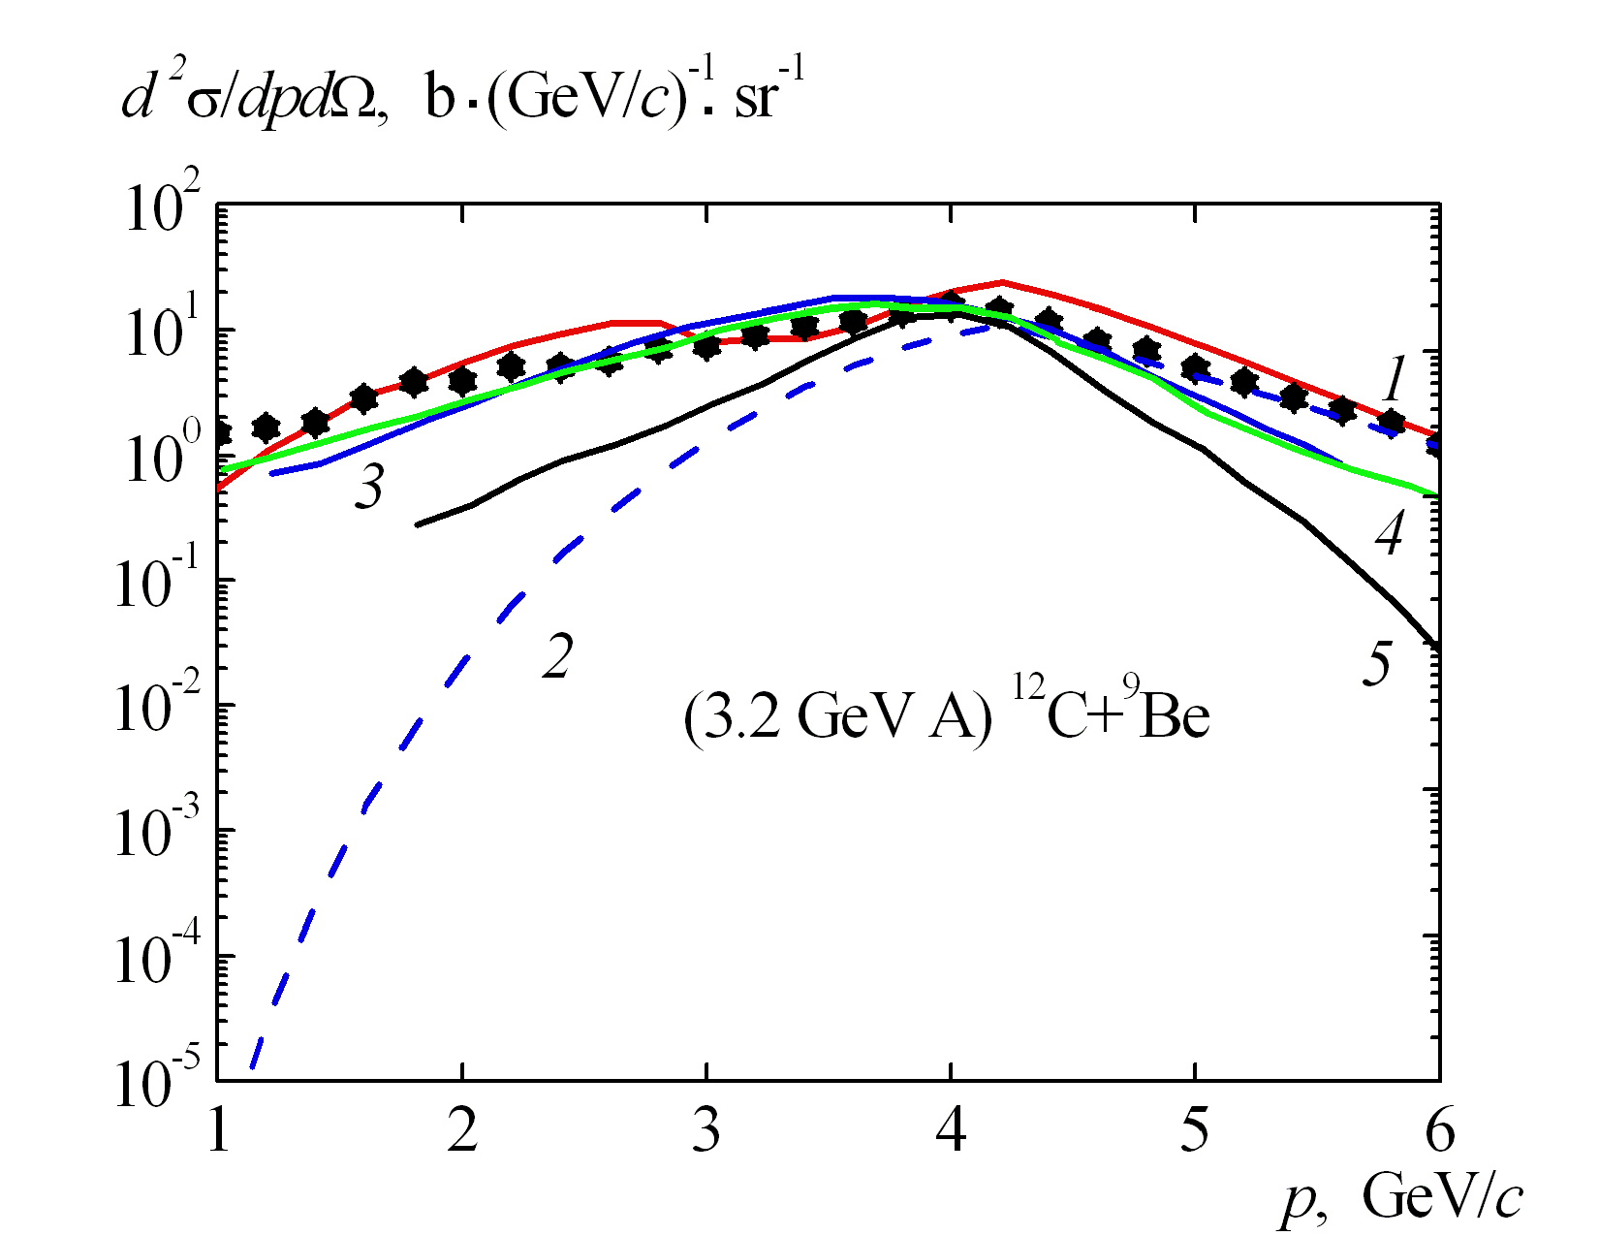
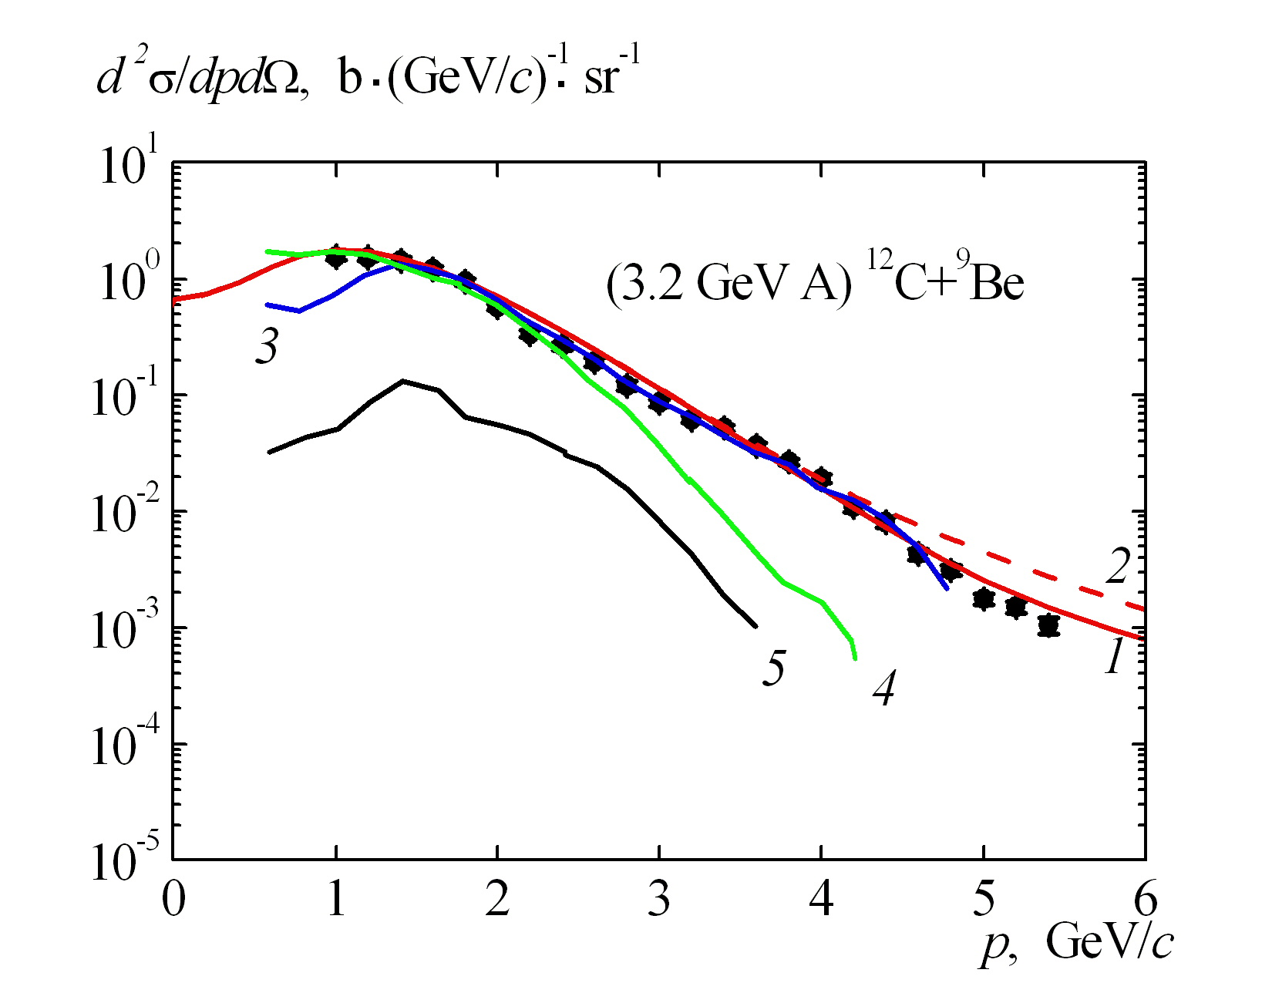
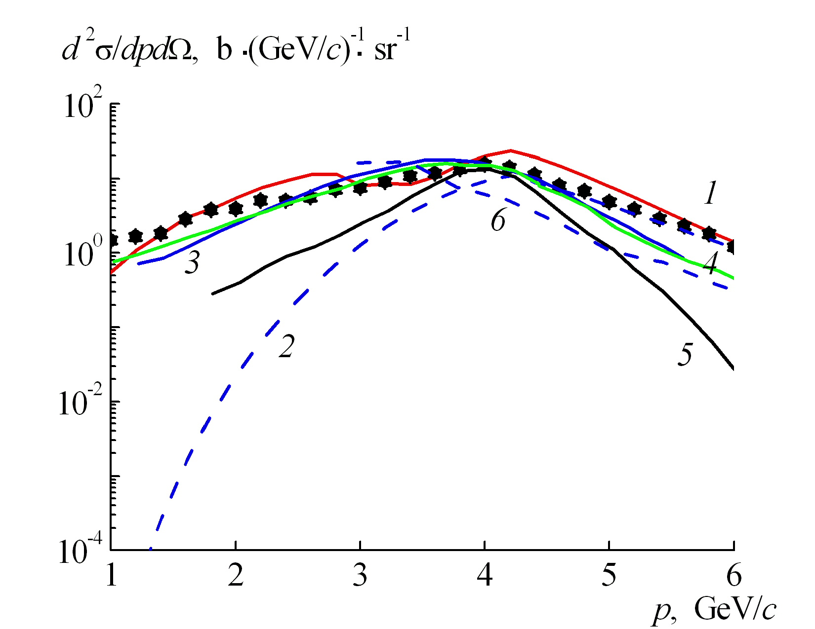
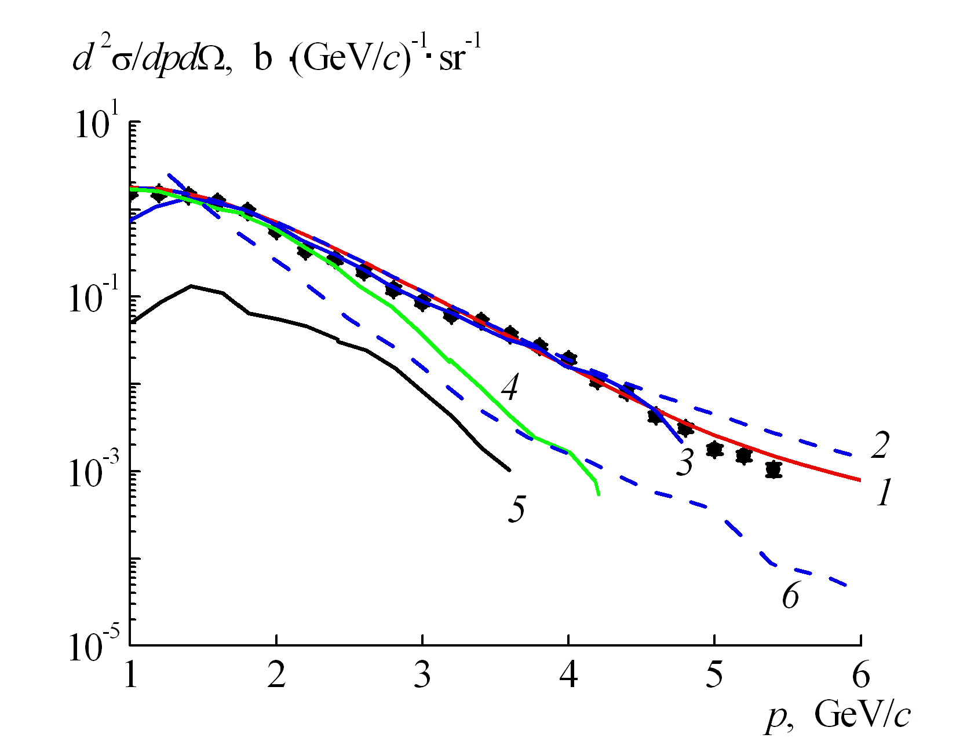
¹²C+⁹Be 3.2 GeV/nucl. (protons) 3,5⁰
¹²C+⁹Be 3.2 GeV/nucl. (negative pions) 3,5⁰
Б.М. Абрамов, М. Базнат, Ю.А. Бородин, …, В.В. Куликов, и др., ЯФ 84, 331 (2021)
1,2 Our approach
3 Sobolevsky
4 Mashnik
5 GEANT4
6 HSD
19

Slide 7
EQUATIONS OF QUANTUM RELATIVISTIC HYDRODYNAMICS
The equations of relativistic hydrodynamics can be related to the effective Klein-Fock-Gordon equation.
It contains the effective mean field , where is the effective density-dependent mean nucleon potential, is the nucleon mass, с is the speed of light, is the Planck constant, and also the dissipative term , where is the thermal energy density, is the adiabatic index .
In addition to the Klein-Gordon equation (1) with the dissipative term, or the equations of hydrodynamics (the continuity equation and the Euler equation), an equation for the thermal term should be added
, (
From equation (1) follow the equations of relativistic quantum hydrodynamics, containing the Madelung quantum potential

Slide 8
HYDRODYNAMIC MODEL OF FRAGMENTATION
L.D. Landau drew attention to the propagation of a shock wave as the only possibility of realizing the first stage of the process of collisions of protons and nuclei with nuclei, and proposed a one-dimensional solution of the hydrodynamic equations for the subsequent adiabatic stage of expansion of the system during the collision of high-energy protons. In our hydrodynamic approach, after the passage of a shock wave with a changing front, a hot spot is formed – a source of high-energy particles. In the approximation and pressure
for the Hubble law for 4 velocities
where
the hydrodynamic equations are reduced to the equations
,
these equations have a simple solution
Taking into account equation (2), we have for adiabatic expansion
,
Using this approximate solution in the next order approximation, we can obtain the linear equations
,
.(

Slide 9
Аn approximate analytical solution
The variables are separated here , and for the time-dependent , we obtain a linear differential equation of the second order
That is, for we find an approximate analytical solution
,
(
.
From this formula we can see the first term growing exponentially with time
and the onset of fragmentation for an expanding fireball – hot spot at
This hydrodynamic consideration has an analogy with the expanding early Universe during the formation of stars and galaxies [35] (the well-known Jeans instability).
If we take into account the quantum terms in equation (5), this leads to an additional term in equation (12):
on its left-hand side, then there will be
fm the expression under the square root for K
becomes negative
i.e. there is no growing solution with increasing time
This means that for small hot spot radii, the qunntum terms in hydrodynamics lead to stability with respect to fragmentation

Slide 10
NUMERICAL IMPLEMENTATION. COMPARISON WITH EXPERIMENTAL DATA
In the previous section, an approximate analytical solution for the onset of fragmentation in the hydrodynamic approach was obtained. In our approach , after the formation of a hot spot and its subsequent hydrodynamic evolution, fragmentation occurs when the system reaches a critical density , determined from the condition .
In this case, the double differential cross section in the A+B
reaction has the form

Slide 11
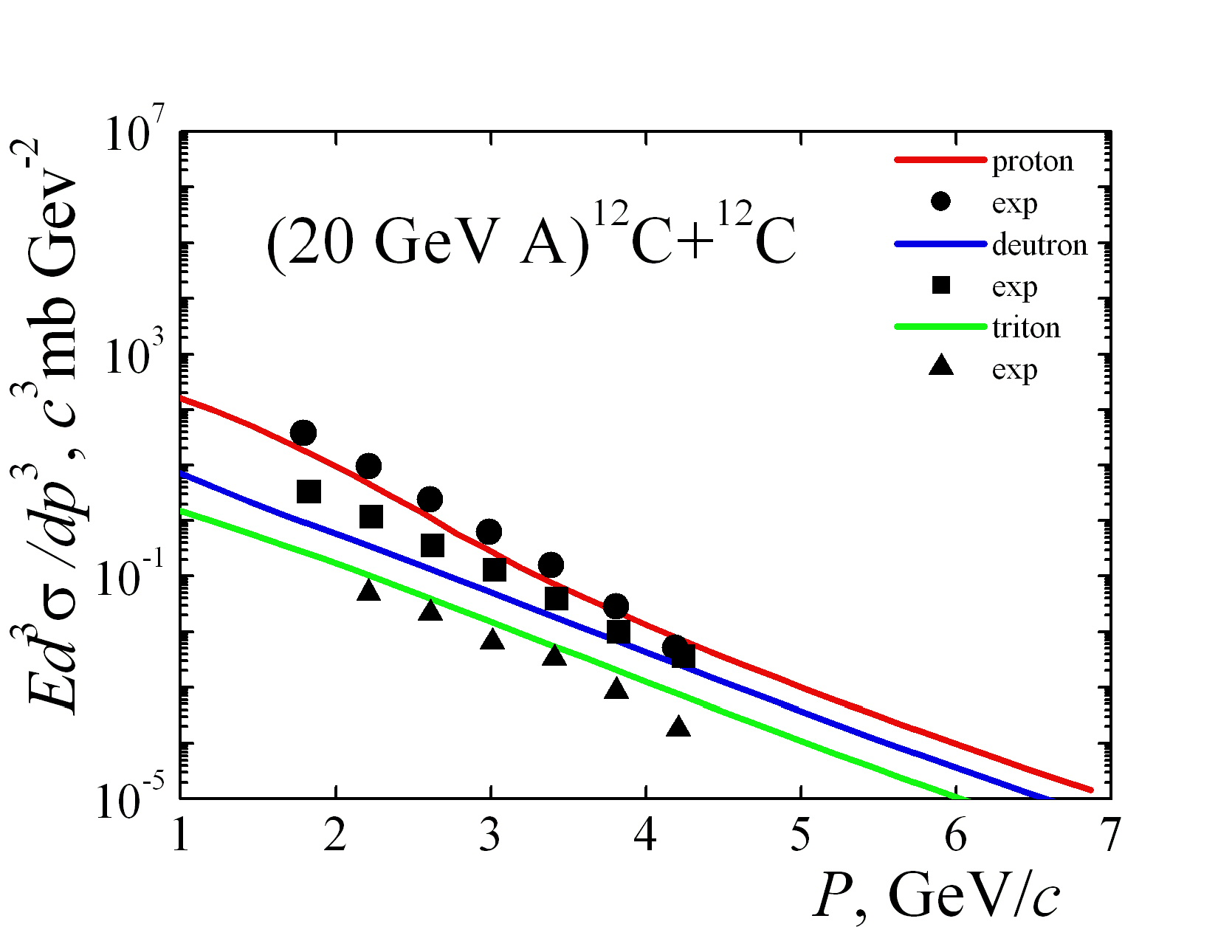
Cumulative fragments (IHEP)
Figure 1 shows the invariant double differential cross sections for the emission of protons, deuterons and tritons at an angle of 40º in the reaction ¹²C+¹²C f+X at an energy of 19.6 GeV per nucleon for incident ¹²C nuclei. The results of calculations using formula (15) (red line – protons, blue line – deuterons, green line – tritons), dots – experimental data from work [30], obtained at the U-70 accelerator (IHEP). One can see agreement with the experiment in the emission spectra of these fragments and the presence of scaling – the same slope of these curves. In this case, good agreement was obtained for tritons, for deuterons there is an agreement closer to the end of the experimental spectrum. These are the spectra of cumulative fragments, the average temperature in our approach is 150 MeV, as in our previous work [29], devoted to the description of the emission of cumulative protons, pions, kaons and antiprotons at the U-70 accelerator at the same energy of incident carbon nuclei.

Slide 12
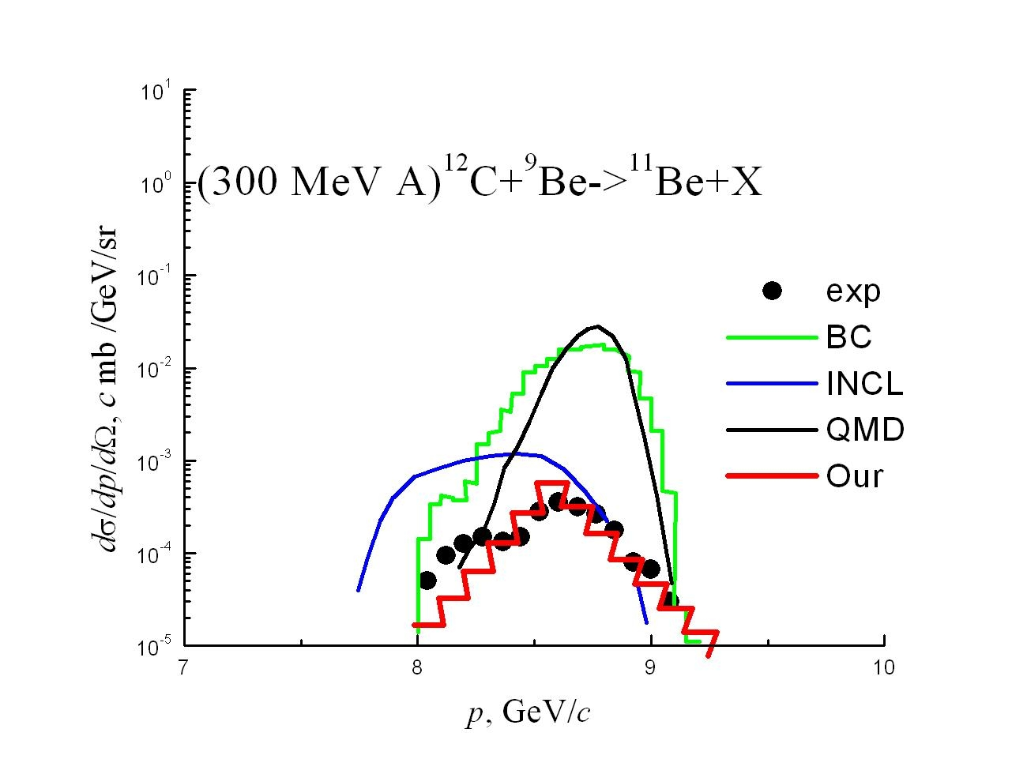
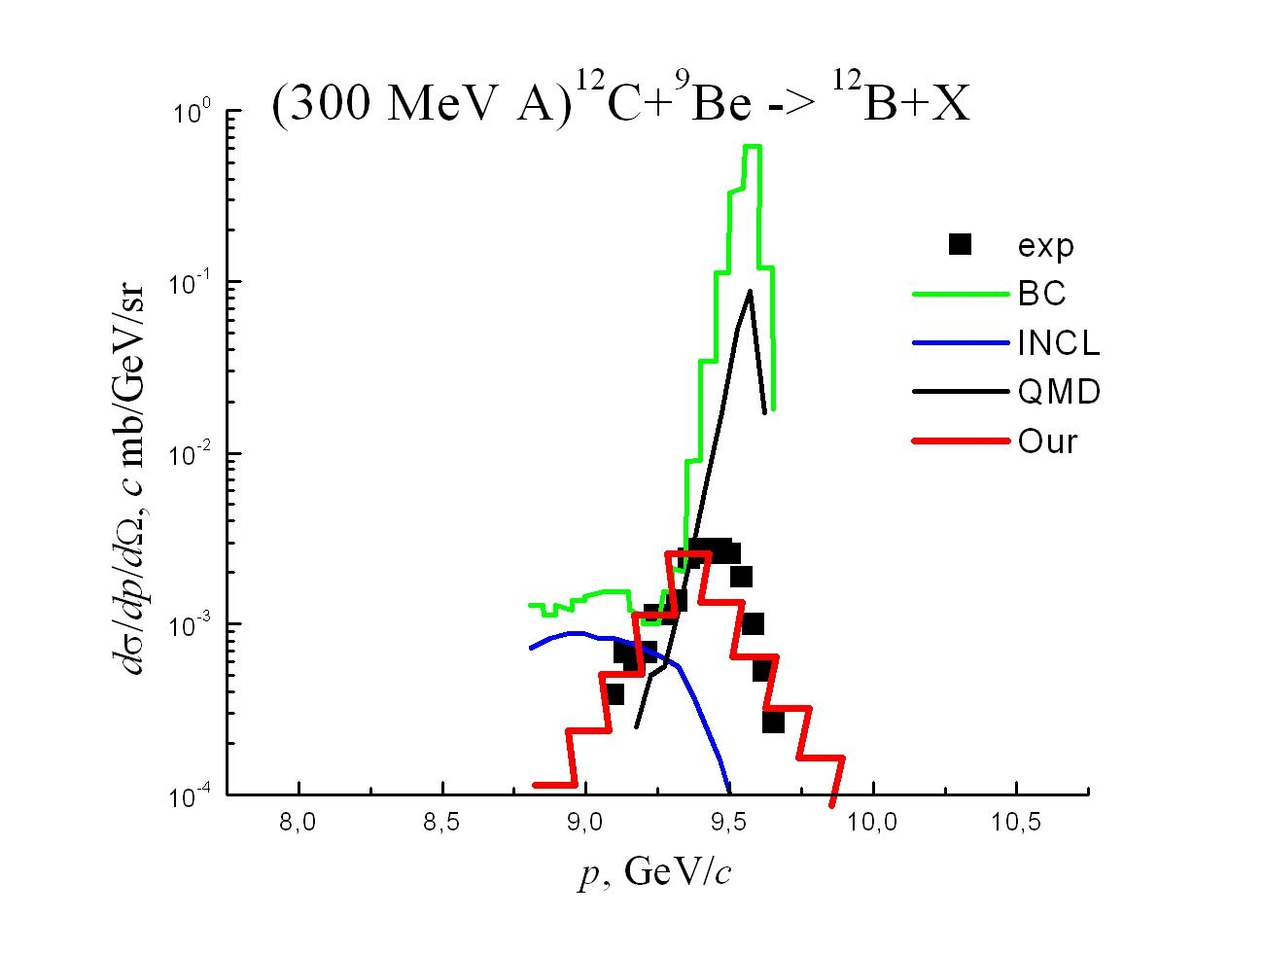
FRAGM(ITEP)
Fig. 2 shows the double differential cross sections of the yield of ¹¹Be fragments emitted at an angle of 3.5º in the reaction ¹²C+⁹Be ¹¹Be+X at an energy of 300 MeV per nucleon for incident carbon nuclei .
Fig. 3 shows the double differential cross sections of the yield of ¹²B for the incident carbon nuclei.
The dots correspond to the experimental data obtained in the FRAGM (ITEP) experiment [24] Our calculated curves red and blue in these figures correspond to the average 40 MeV temperature, and red curves were obtained in the calculation taking into account the quantum terms, as in our works, and blue curves – without taking these terms into account. As can be seen from Figs. 2 and 3, there is agreement between our calculations and the available experimental data. The calculated curves obtained in work [24] for cascade models and for quantum molecular dynamics [16] differ significantly from each other and from these experimental data.

Slide 13
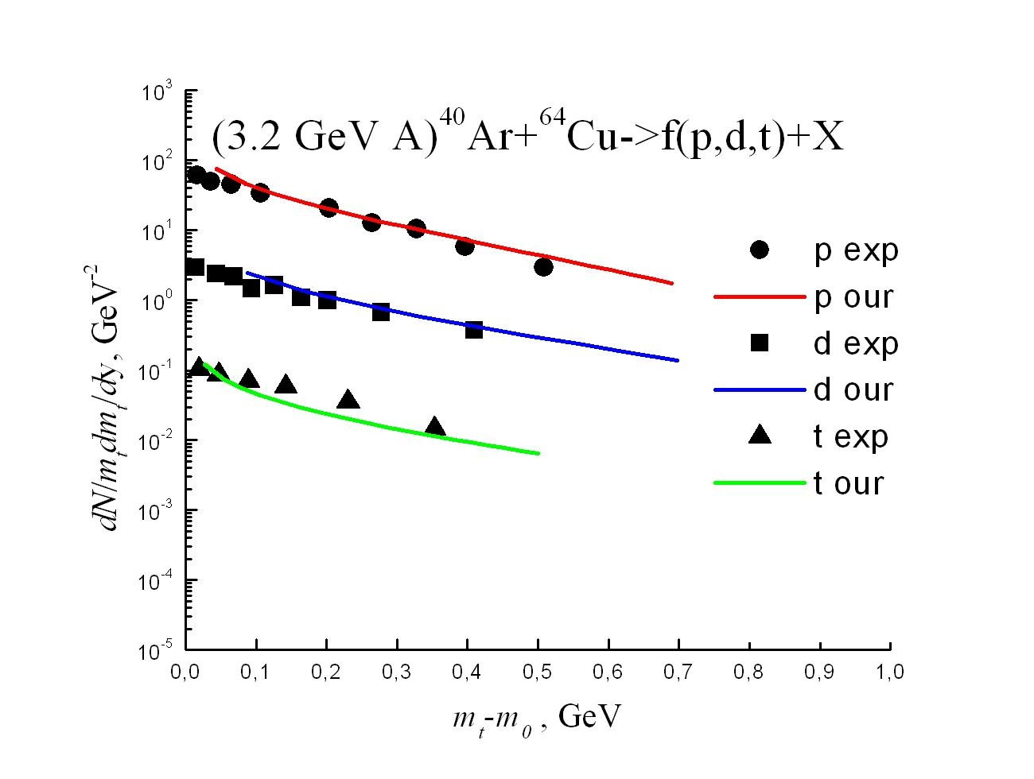
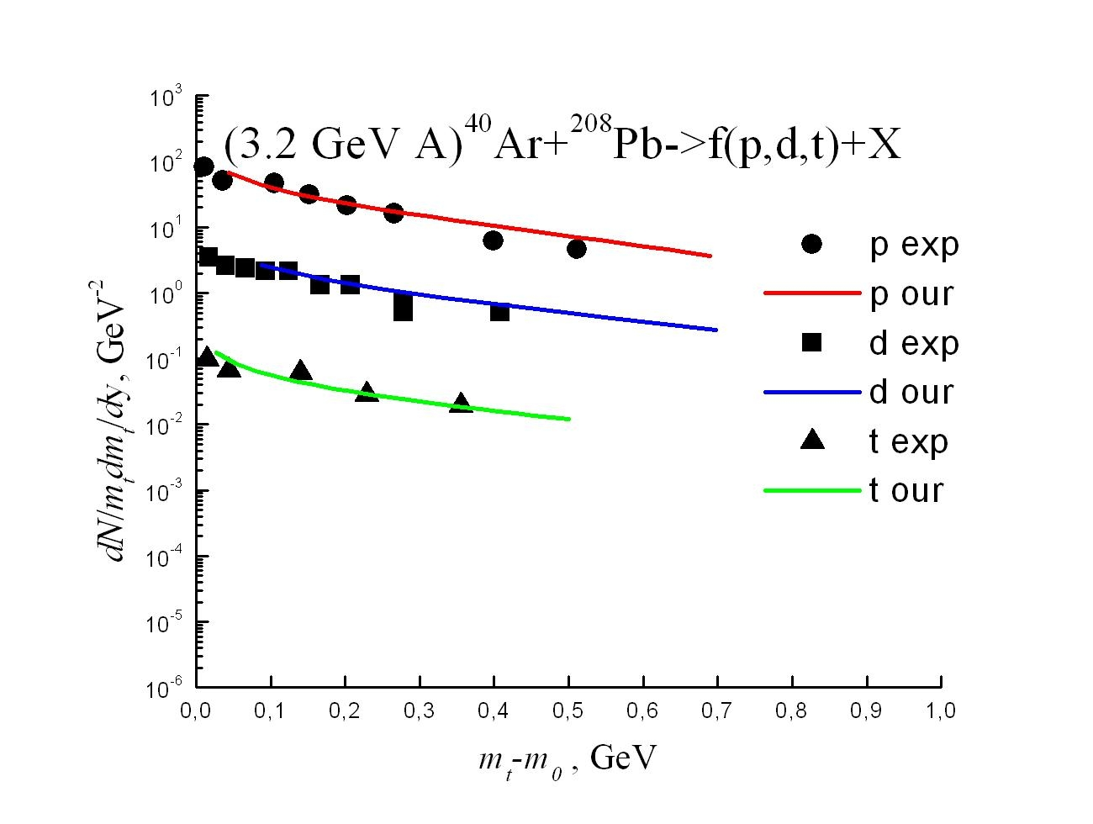
FRAGMENTATION(BM@N)
Fig. 4 shows the double differential cross sections of the yield of p,d,t fragments emitted at the rapidity of y=1.4 in the reaction ⁴⁰Ar+⁶⁴Cu ->f(p,d,t)+X at an energy of 3.2 GeV per nucleon for incident argon nuclei Fig. 5 shows the double differential cross sections of the yield of p,d,t for the incident argon nuclei in the reaction ⁴⁰Ar+²⁰⁸Pb ->f(p,d,t)+X at the centrality of 40%.
The dots correspond to the experimental data obtained in the BM@N (NICA) experiment As can be seen from Figs. 4 and 5, there is agreement between our calculations and the available experimental data.
ICPPA-2024 MEPHI
13

Slide 14
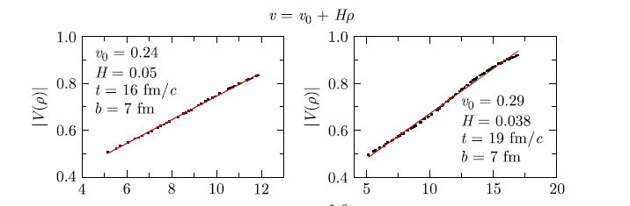
ABOUT HUBBLE'S LAW AND POLARIZATION
Equations (6)-(7) admit a simple solution - Hubble's law with the Hubble constant
or .
For in the work [Baznat, Teryaev and Zinchenko] the results were obtained by the PHSD model for the collision of Au+Au nuclei at the energy of . For the impact parameter b=7fm it turned out that H=0.05 fm⁻¹at t=16 fm/c and H=0.04 fm⁻¹at t=19fm/c. This agrees with the experimental data of STAR (RHIC).
That is, the Hubble law is approximately satisfied for peripheral collisions. It turns out better when choosing t₀ =-4 fm/c. Such a choice of t₀ means, in our opinion, that the agreement with the Hubble law and hydrodynamics is achieved at earlier times than in the PHSD model, i.e. when a hot spot is formed after the initial shock-wave compression. In this case, for everything to converge correctly, for example for the speed of light, the Hubble constant should be equal to 0.08 fm⁻¹ at t=16 fm/c.
Dependence of particle velocity on transverse radius at z = 0 and energy = 7.7 GeV with impact parameter b = 7 fm

Slide 15
On the polarization of Λ- hyperons in Au+Au collisions at energy of
In equation (5), we can distinguish the radial Hubble velocity component and the tangential one during the expansion of the hot spot. Neglecting the expansion, we obtain
From equation (2) in this approximation for the hydrodynamic equations, we can obtain
.
From here, moving to the reduced thermodynamic velocity, we find the polarization for the impact parameter b=8 fm and temperature T=150 MeV
This is in agreement with the experimental data of STAR We can calculate for taking into account the Hubble expansion. In this case, we obtain
,
which leads to in agreement with the experimental data

Slide 16
Conclusions
Thus, in developing the nonequilibrium hydrodynamic approach to describing the yields of fragments, light and close in mass to the incident nucleus, agreement has been achieved with the available experimental data obtained in the IHEP (Serpukhov) experiments at an energy of 19.6 GeV per nucleon and FRAGM (ITEP, Moscow) at an energy of 300 MeV per nucleon for incident carbon nuclei.
The spectra of protons, deuterons and tritons in the description of the IHEP experiment have the same slope (show scaling), which is easily explained in our approach to fragmentation. In the description of the FRAGM experiment, the momentum spectra turned out to be symmetrical with respect to the spectrum maximum.
This can be extended to the energy range of the NICA accelerator complex being built at JINR (Dubna). Already the first comparison with experimental data on the distribution of protons, deuterons and tritons by transverse mass at the rapidity y=1.4 for the collision of argon nuclei at the energy of 3.2 GeV per nucleon with different nuclei in the BM@N experiment turned out to be successful.
Taking the Hubble law as a basis, in the next approximation within the framework of hydrodynamics, the average vorticity was found and the polarization of the emitted particles in collisions of gold nuclei at an energy of GeV/nucleon was estimated.

Slide 17
References
1. Н. Stöcker and W. Greiner, Phys. Rept. 137, 277 (1986).
2. В.Д.Тонеев, Х. Шульц, К.К. Гудима, Г.Репке, ЭЧАЯ 17, 1093( 1986)[Fiz. Elem.Chast. Atom. Yadra. 17, 1093 (1986)]
3.D. Blaschke, S. Liebing. G. Röpke, and В. Dönigus, ArXiv:2408.01399v1 [nucl-th].
4.Г.Н. Флеров, В.С. Барашенков, УФН 114, 351 (1974) [Sov. Phys. Usp. 17, 783 (1975)].
5.А.П. Черняев, ЭЧАЯ 43, 500 (2012) [Fiz. Elem.Chast. Atom. Yadra. 43, 500 (2012)].
6.A.S, Goldhaber, Phys. Lett. B 53, 306 (1974).
7.H. Feshbah and K. Huang, Phys. Lett B. 47, 300 (1973).
8.W. A. Fridman and W.A. Lynch, Phys. Rev. C 28, 16 (1983).
9.H. H. Gutbrod, A. Sandoval, P. J. Johansen, A. M. Poskanzer, J. Gosset, W. G. Meyer, G. D. Westfall, and R. Stock, .Phys. Rev. Lett. 37, 667 (1976).
10.A.Z, Mekjian, Phys. Rev. Lett. 38, 640 (1977).
11.A.T. D’yachenko, Nucl. Phys. A. 696, 273 (1997).
12.J.P. Bondorf, R. Donagelo, I. N. Mishustin, and H. Schulz, Nucl. Phys. A. 443, 321 ( 1985).
13.J,P. Bondorf , R. Donagelo, I.N. Mishustin, and H. Schulz, Nucl. Phys. A. 444, 460 (1985). .
14.A.C.Ботвина, А.С. Ильинов, И.Н. Мишустин, Письма в ЖЭТФ 42, 452 (1985)[JETP Lett. 42, 572 (1985)].
15.G. Peilert, H. Stöcker and W. Greiner, Rep. Prog. Phys. 57, 553 (1994).
16.J. Aichelin, Phys. Rept. 202. 233 (1991).
17.J. Aichelin, E. Bratkovskaya, A. Le Fèvre, V. Kireyeu, V. Kolesnikov, Y. Leifels, V. Voronyuk, and G. Coci, Phys. Rev. C 101, 044905 (2020).
18.Л.Д. Ландау, Изв. АН СССР Сер. физ. 17, 51 (1953); Collected papers of L.D. Landau. Ed. By D. Ter-Haar(Pergamon Press, Oxford, 1965, Paper no. 74.
19.С.З. Беленький, Л.Д. Ландау, УФН 56, 309 (1955).
20.S. Z. Belenkij and L. D. Landau, Nuovo Cimento, Suppl. 3, 15 (1956).
21.А.Т. Дьяченко, ЯФ 86, 428 (2023) [Phys. Atom. Nucl. 86, 289 (2023)].
22.A.T. D’yachenko, Phys. Atom. Nucl. 87, 646 (2024).
23.A.T. D’yachenko and I.A. Mitropolsky, Bull. Russ. Acad. Sci. Phys. 88, 1279 (2024).
24. А..А.Куликовская,Б.М.Абрамов,Ю.А.Бородин,С.А.Булычёв,И.А.Духовской, А.П.Крутенкова, В.В.Куликов,М.А.Мартемьянов,М.А.Мацюк,Е.Н.Турдакина, ЯФ 85, 339 (2022) [ Phys. Atom. Nucl. 85, 466 (2022)].
25.А.Т. Дьяченко, И.А. Митропольский, ЯФ.83, 317 (2020)[Phys. Atom. Nucl. 83, 558 (2020)].
26.А.Т. Дьяченко, И.А. Митропольский, ЯФ 86, 285 (2023)[Phys. Atom. Nucl. 85, 1053 (2022)].
Б.М.Абрамов,П.Н.Алексеев,Ю.А. Бородин, С.А.Булычев,И.А.Духовской,А.П.Крутенкова, В.В. Куликов, М. А. Мартемьянов, М. А. Мацюк, 27.С.Г.Машник,Е.Н.Турдакина,А.И.Ханов, ЯФ. 78, 403 (2015)[Phys. Atom. Nucl. 78, 373 (2015)].
28.Б.М.Абрамов,.Базнат,Ю.А.Бородин,С.А.Булычев,И.А.Духовской, А.П.Крутенкова,В.В.Куликов,М.А.Мартемьянов,М.А.Мацюк,Е.Н.Турдакина, ЯФ. 84, 33 (2021)[Phys. Atom. Nucl. 84, 467 (2021)].
29.А.Т. Дьяченко, ЯФ. 87, 118 (2024) [Phys.Atom. Nucl. 87, 125 (2024)].
30.Н. Н. Антонов, А. А. Балдин, В. А. Викторов, А. С. Галоян, В. А.Гапиенко,Г. С. Гапиенко, В. Н. Гресь, М. А. Илюшин, А. Ф. Прудкогляд, Д.С. Пряников, В. А. Романовский, А. А. Семак, И. П. Солодовников, В.И. Терехов,М. Н. Уханов, С. С. Шиманский, Письма в ЖЭТФ, 111, 291( 2020)[ JETP Lett. 111, 251 (2020)].
31.А.Т.Дьяченко, И.А. Митропольский, Изв. РАН. Сер. физ. 81, 1720 (2017) [Bull. Russ. Acad. Sci. Phys. 81, 1521 (2017)].
32.G. Folger, V.N. Ivanchenko and J.P. Wellisch, Eur. Phys. J. A 21, 407 (2004).
33.J. Dudouet, D. Cussol, D. Durand and M. Labalme, Phys. Rev. C . 89, 054616 (2014).
34.A.T. D’yachenko, K.A. Gridnev and W. Greiner, J. Phys.G40, 085101 (2013).
35.Д.С. Горбунов, В.А. Рубаков, Введение в теорию ранней Вселенной. Космологические возмущения. Инфляционная теория. М.: Красанд, 2010. 568с.; D.S. Gorbunov and V.A. Rubakov, Introduction to the theory of the early Universe. Cosmological perturbations. Inflationary theory. World Scientific, 2011.
36.A.T. Дьяченко, И.А. Митропольский, Изв. РАН. Сер. физ. 85, 716 (2021)[ Bull. Russ. Acad. Sci. Phys. 85, 554 (2021)].
26

Slide 18
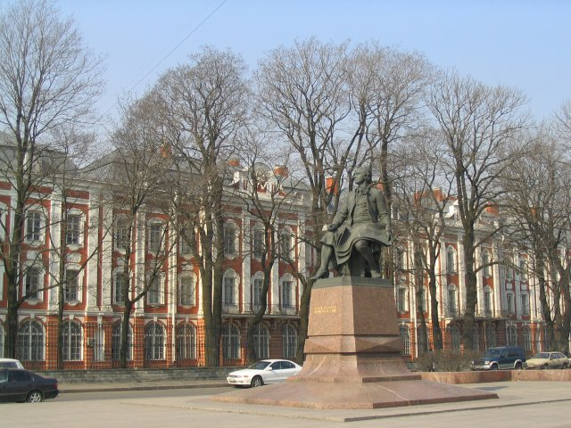
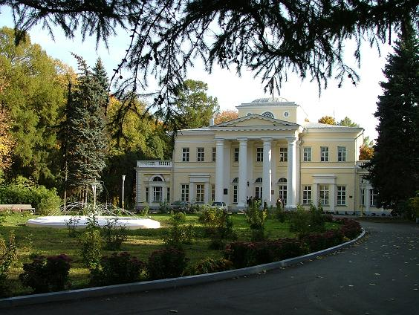
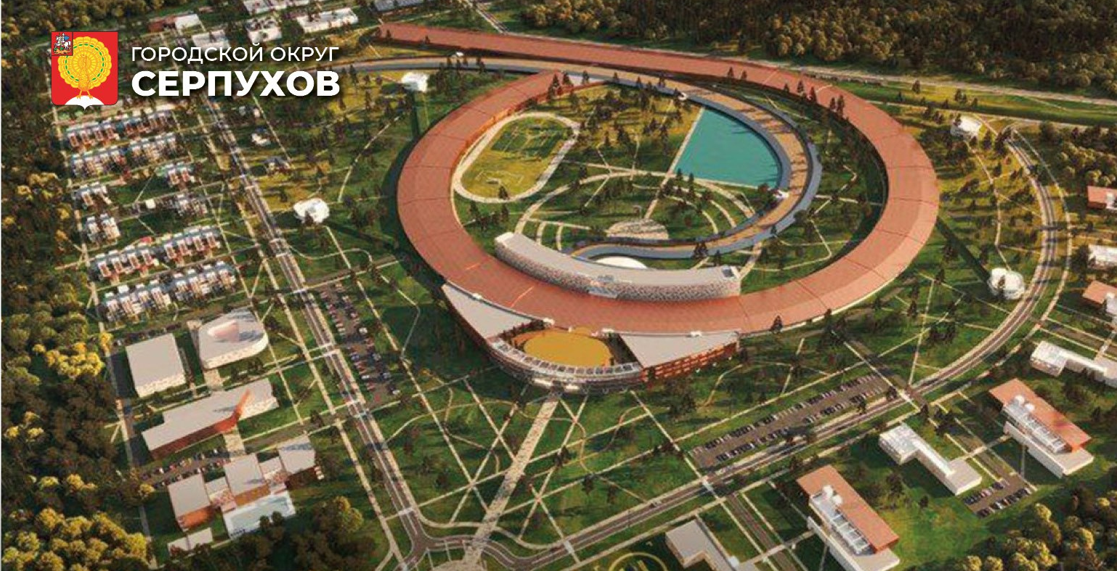
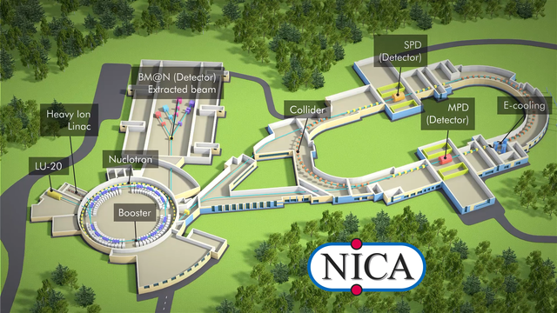
THANK YOU !
27

