Slide 1
Spatial isolation of ions
separated in multi-reflection
time-of-flight mass analyzers
Mikhail Yavor¹, Kirill Koval²
¹Institute for analytical instrumentation RAS
St. Petersburg, Russia
²Peter the Great Polytechnical University
St. Petersburg, Russia

Slide 2
Time-of flight mass analyzers
tan α = v_{x}/v_{z}
tan ß = v_{y}/v_{z}
K+ΔK=K(1+δ)
δ=ΔK/K
X
t
x
y
Z
K = mv²/2
T
Y
I
I
m
m+Δm
m
m+Δm
t
t

Slide 3

Mass resolving power
Flight time
I
m
m+Δm
Time resolution
Δt
Typical time resolution is 1 – 4 ns
t
(dT/dm)Δm
To increase flight time, multi-reflection TOF analyzers are used:
Ions are injected into an electrostatic trap and make several turns in it

Slide 4
Multi-reflection time-of flight mass analyzers
Advantages:
Possibility to analyze short-lives ions (down to 50 ms life time)
High mass resolving power (up to 1 000 000)
MR TOF analyzers are used in many nuclear physics facilities:
GSI (Darmstadt, Germany), TRIUMF (Vancouver, Canada), GANIL (France), RIKEN (Japan), and others
Modes of operation
Spectrometer
Recording flight time by a TOF detector
to measure the mass of ion
Typical time resolution ~ 2 ns
Separator
Isolating ions with specific TOF (i.e. m/q)
for further studies
What is the time resolution
of ion separation?

Slide 5
Methods of ion isolation
Using an electric shutter (Bradbury-Nielsen gate)
+
0
–
0
+
0
–
0
Time resolution is ~ 20 ns
(flight time + duration of time fronts)
+
0
–
0
0
+
0
2. In-flight selective ion trapping
Trap
TOF analyzer
U
U
Time resolution is ~ 20 ns
Time resolution of separation is 10 times worse
than of mass analysis!

Slide 6
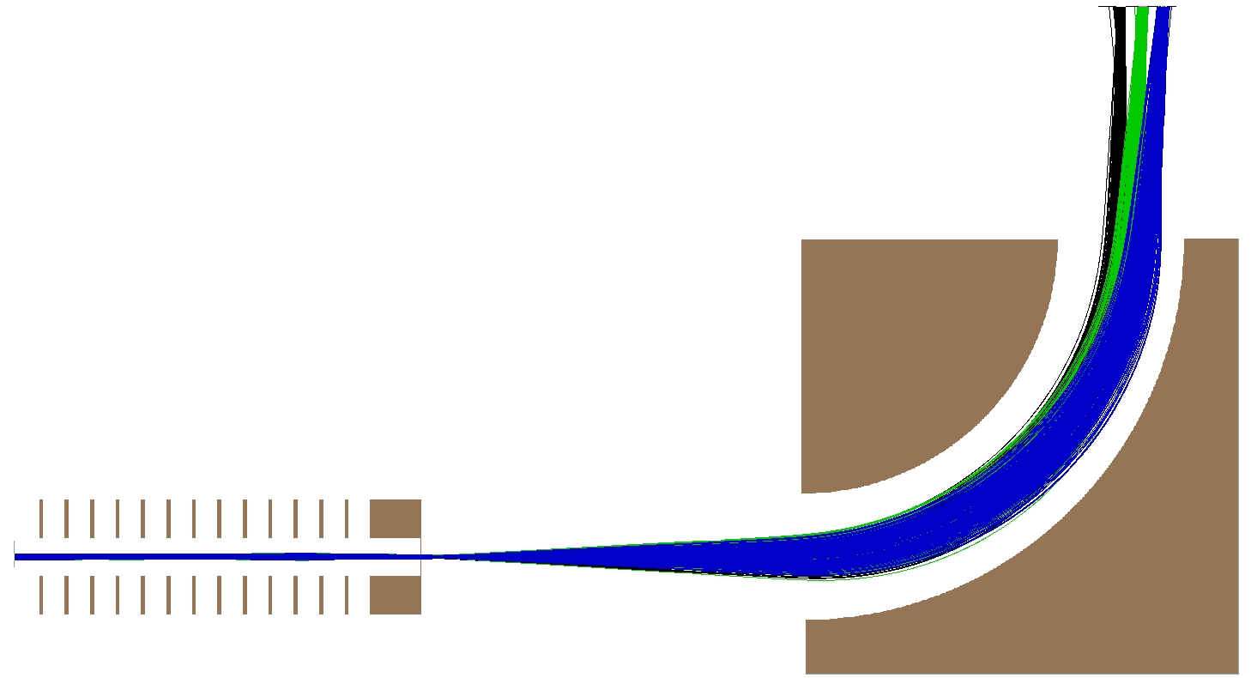
New concept of high-resolution spatial ion isolation
Conversion of flight time through the TOF analyzer to the difference of ion energies
Spatial separation of ions by an electrostatic energy analyzer (ESA)
Ions come to the final time
focus plane of TOF analyzer
at the time t₀ (which depends on m/q)
with the energy spread ΔK
ions with different t₀ can be separated by a slit
ESA creates spatial dispersion on energy =>
as function of t₀
Energy buncher/converter
1. eliminates the energy spread ΔK for a fixed t₀
2. creates the ion energy dependence on the time moment t₀
ESA
energy buncher/converter

Slide 7
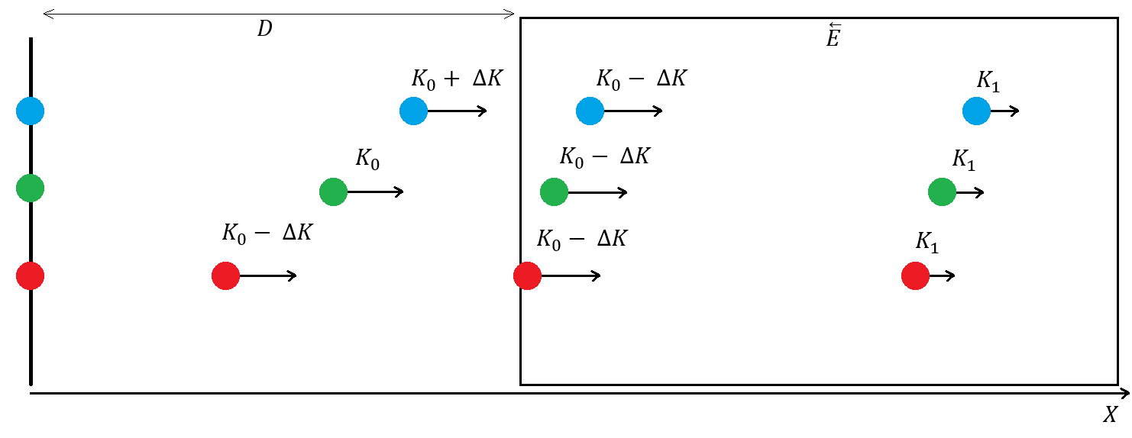
Energy buncher/converter: principle of operation
Drift space
Homogeneous retarding field
final time focus plane of the TOF analyzer
pulsed switching off the retarding field
Ions with the same t₀ but larger energies enter the retarding field earlier and
at a fixed time moment t₁ of pulsed switching off the field lose more energy.
The condition of eliminating ΔK is
qED = 2K₀
The final kinetic energy K₁ depends on t₀ , t₁, and on the ion mass!

Slide 8
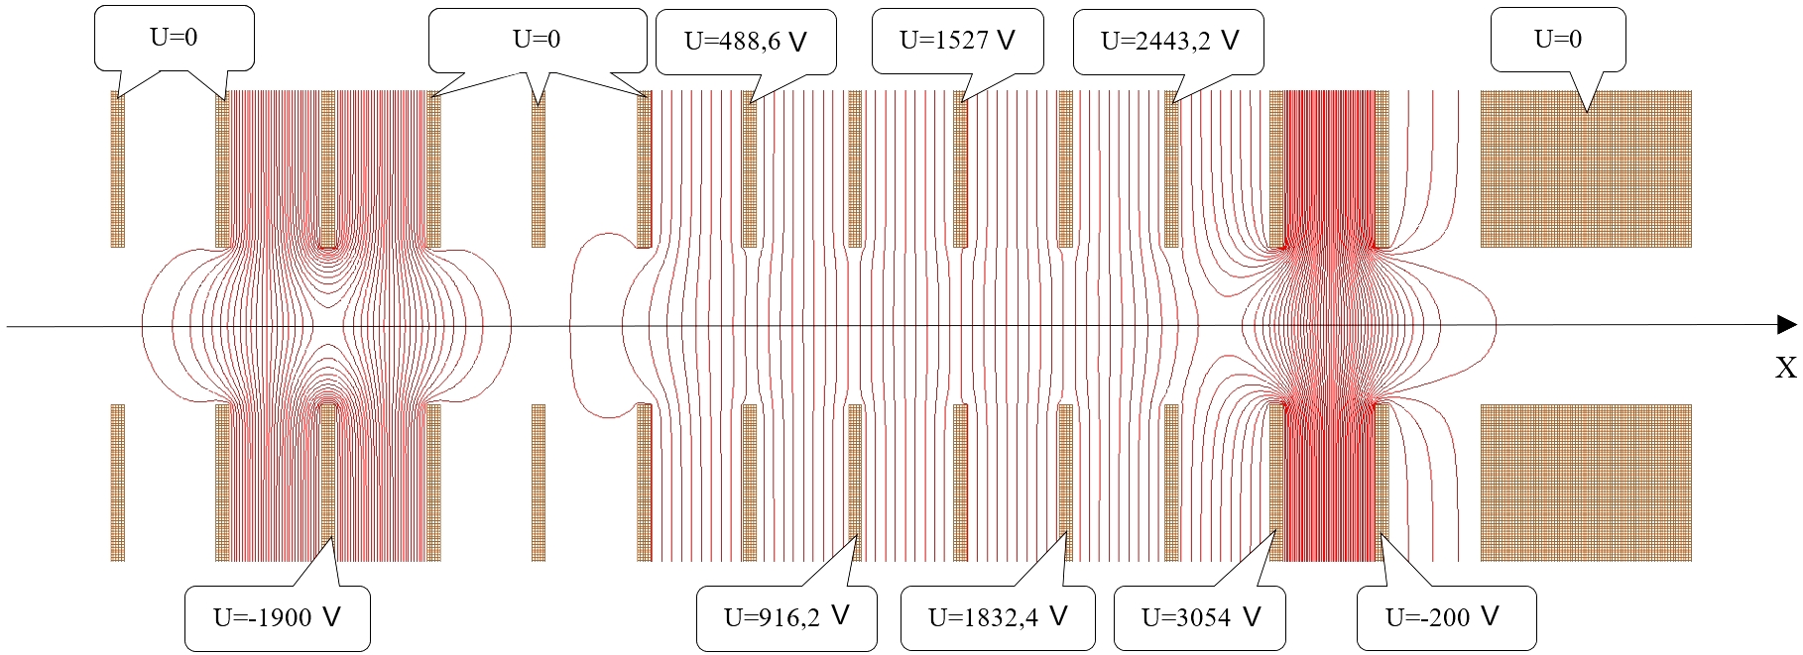
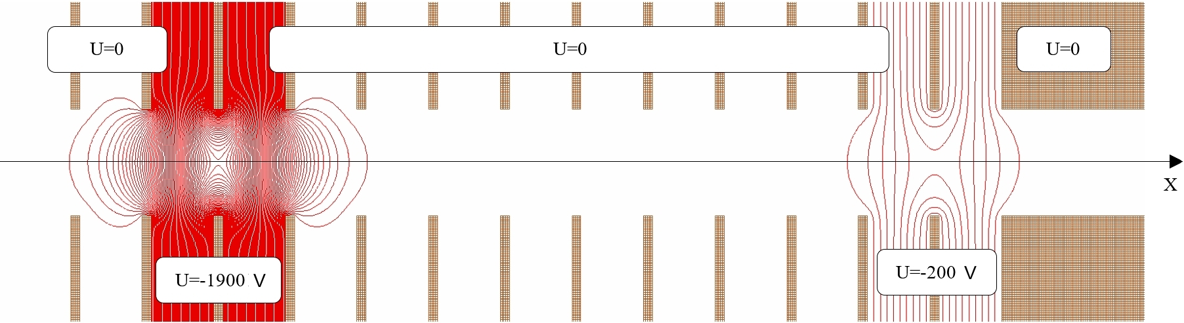
Energy buncher/converter: ion-optical configuration
Retarding field on
Retarding field off
Electrode x_step = 8 mm

Slide 9
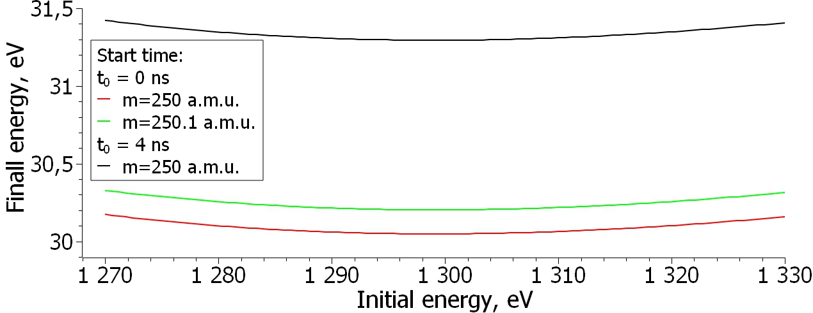
Energy buncher/converter: ion-optical quality
For the same ion mass, the final energy is higher for ions that start from the final
focus plane of the TOF analyzer later.
For the same ion starting time, the final energy is higher for ions of a larger mass.
Since ions of larger masses come to the focus plane later, both effects add.
At high mass resolving power of the TOF MS the energy difference due to the different
starting time dominates.

Slide 10
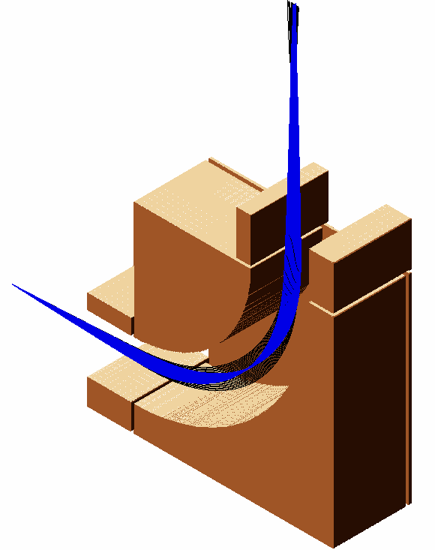
Electrostatic energy analyzer
Simple cylindrical sector field electrostatic
energy analyzer
optic axis radius 100 mm
Y
z-focusing due to the side terminating electrodes
side terminating electrodes (Matsuda plates)
Z
Pre-retarding in the energy buncher
is performed to the minimal
mean kinetic energy ~ 30 eV
to increase the resolving power
of the energy analyzer
X

Slide 11
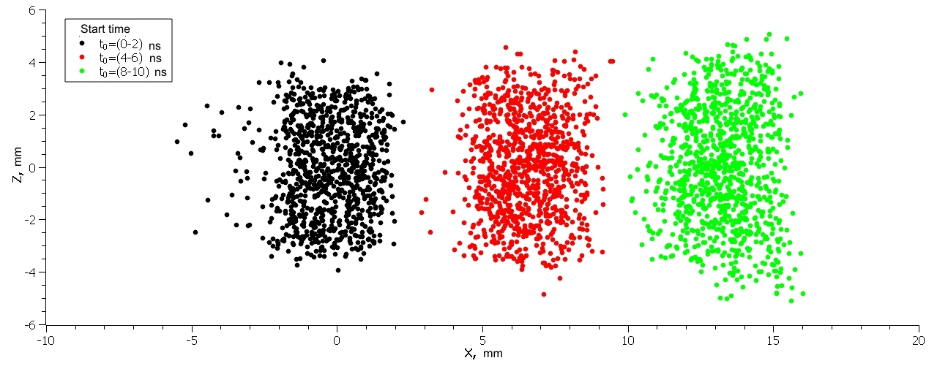
Resulting spatial separation
Full spatial separation for Δt₀ = 4 ns!
Conclusions:
Simulations confirm the 5 times better separator resolution compared with
the BNG gate.
Further improvement of the separation resolution (up to the resolution
of the TOF analyzer) can be achieved by using better quality energy analyzers.

Slide 12
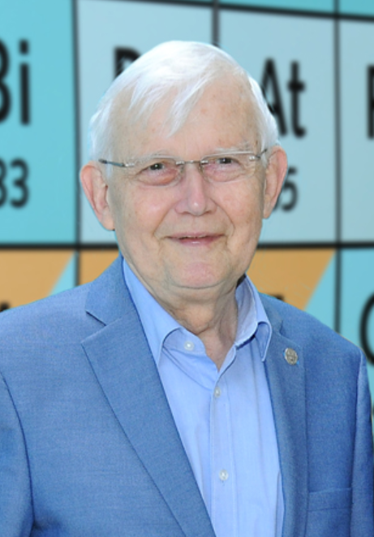
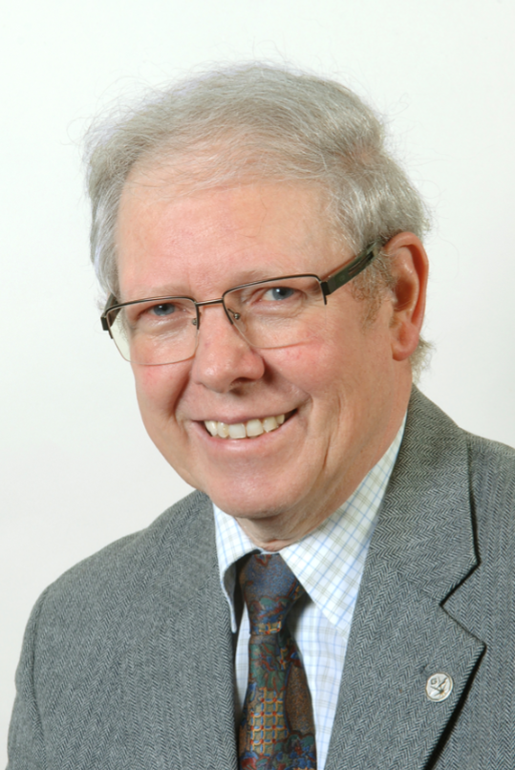
Dedicated to the memory of
Prof. Dr. Gottfried Münzenberg
(GSI Darmstadt)
1940 – 02.01.2024
Prof. Dr. Hans Geissel
(GSI Darmstadt)
1950 – 29.04.2024

Slide 13
Thanks for attention!

