Slide 1
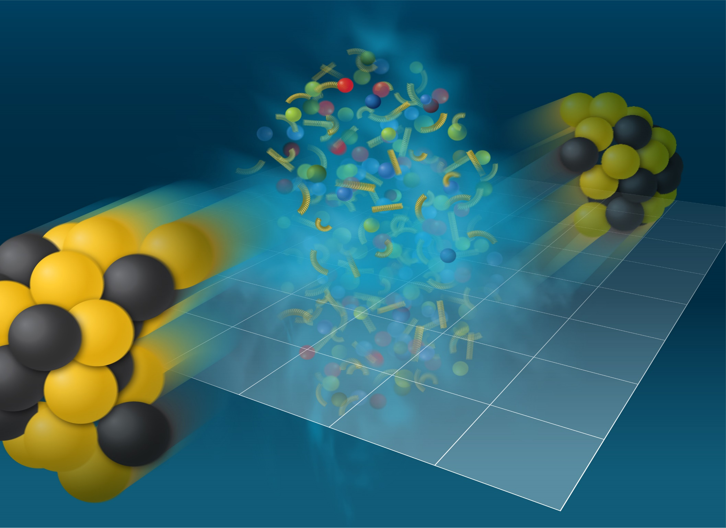
Scaling relations for anisotropic flow at NICA energies collisions

Slide 2
OUTLINE
1) Anisotropic flow: introduction
Flow and sQGP at RHIC/LHC?
Scaling properties of anisotropic flow
Flow results from Beam Energy Scans
Outlook for flow measurements at NICA

Slide 3
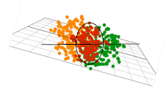
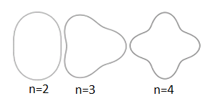


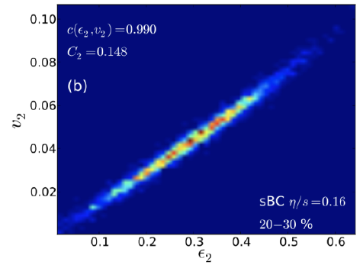
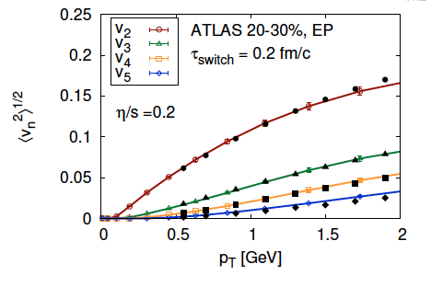
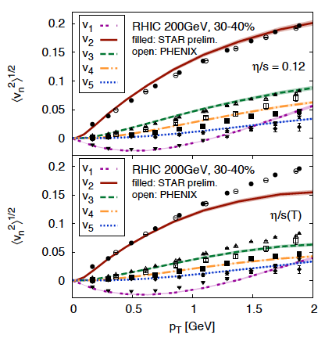
Anisotropic Flow at RHIC-LHC
Gale, Jeon, et al., Phys. Rev. Lett. 110, 012302

Slide 4
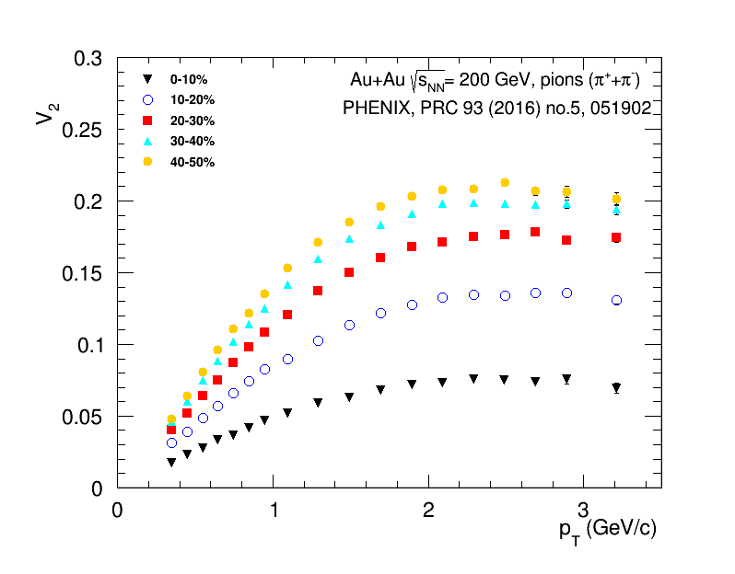
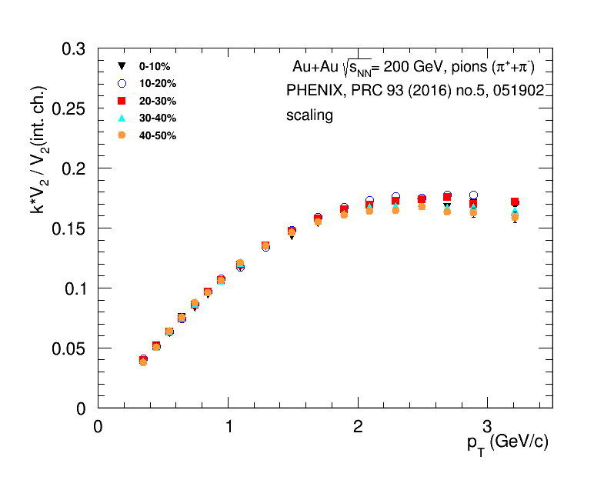
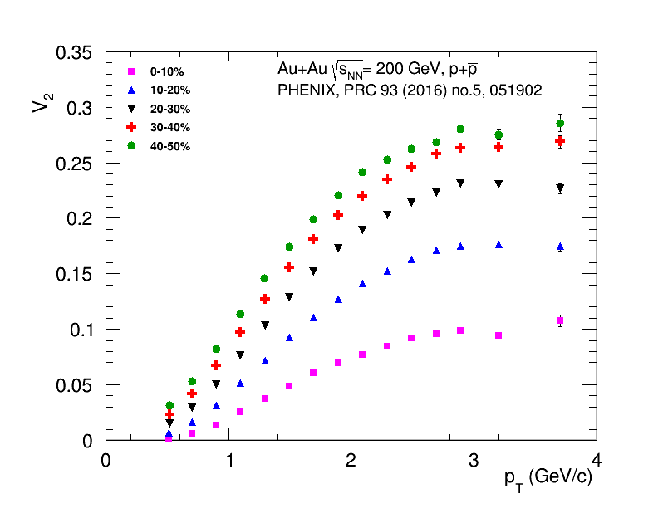
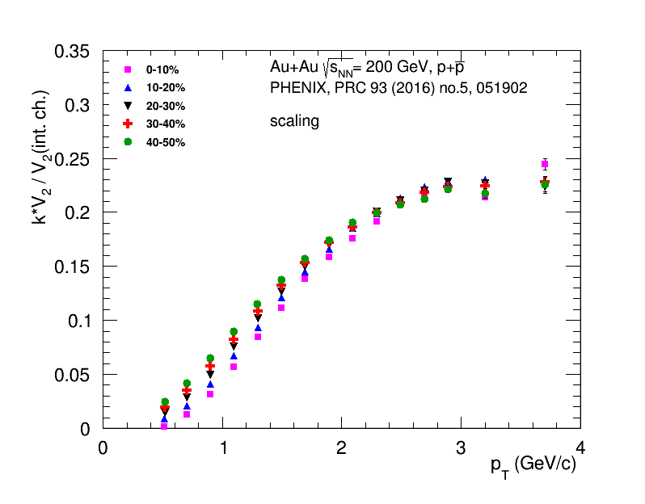
Scaling with integral flow of charged hadrons

Slide 5
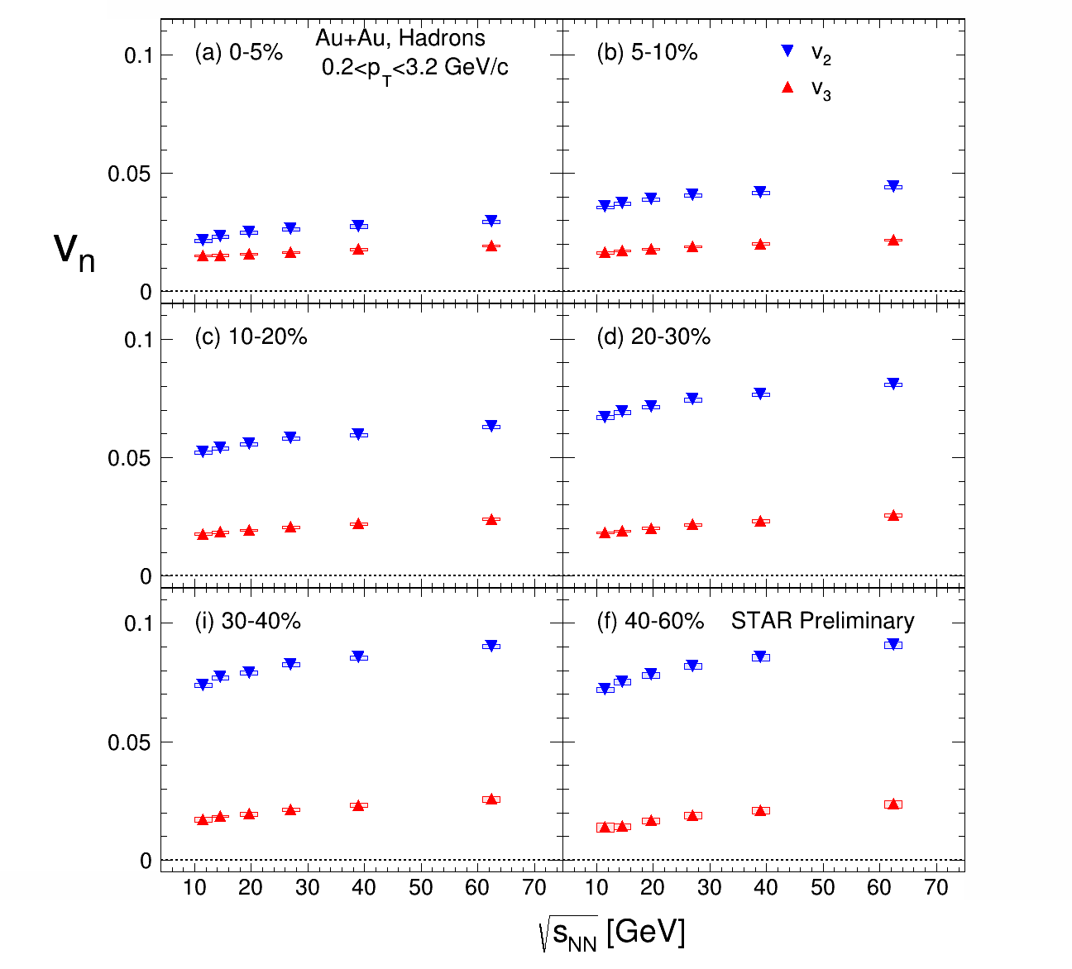
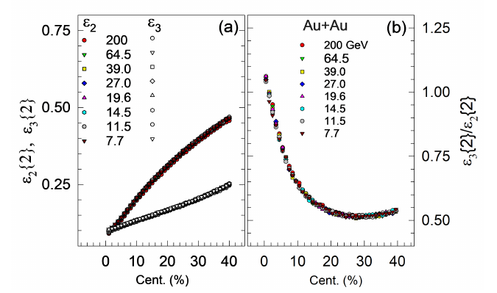
Beam-energy dependence of v₂ and v₃
Petr Parfenov for STAR Collaboration,
of normalized v2 and v3 for all centralities and beam energies J.Phys.Conf.Ser. 1690 (2020) 1, 012128
J.Phys.Conf.Ser. 1690 (2020) 1, 012128
Integrated v₂ and v₃ decrease with decreasing collision energy

Slide 6
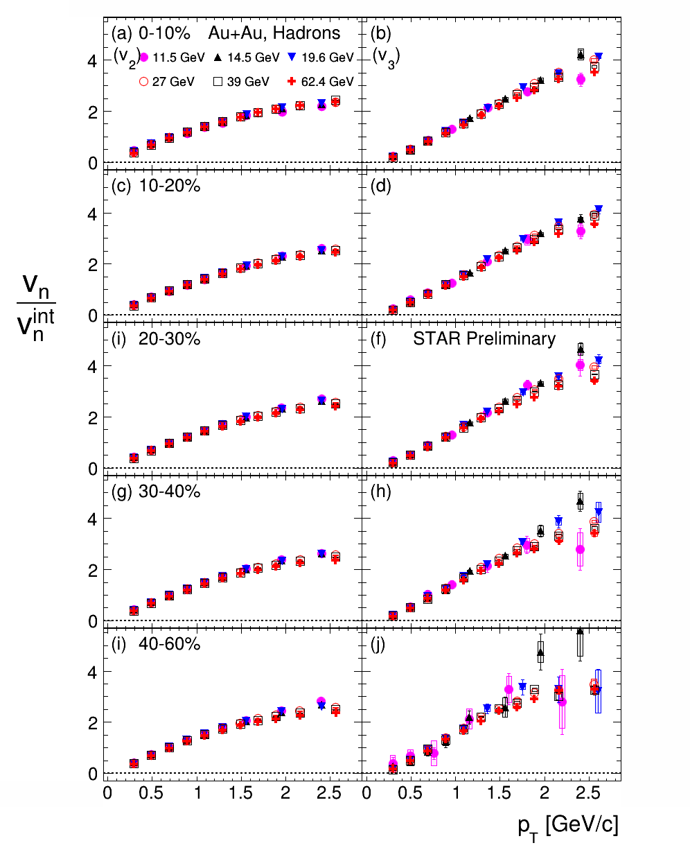
Beam-energy dependence of v₂ and v₃
J.Phys.Conf.Ser. 1690 (2020) 1, 012128
of normalized v2 and v3 for all centralities and beam energies J.Phys.Conf.Ser. 1690 (2020) 1, 012128
Integrated v₂ and v₃ decrease with decreasing collision energy
Similar shape of p_{T} dependence of normalized v₂ and v₃ for all centralities
and collision energies

Slide 7
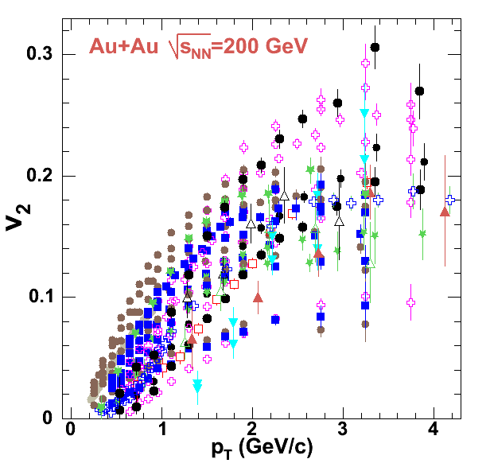
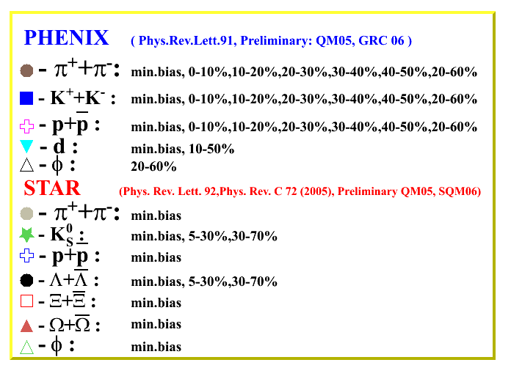
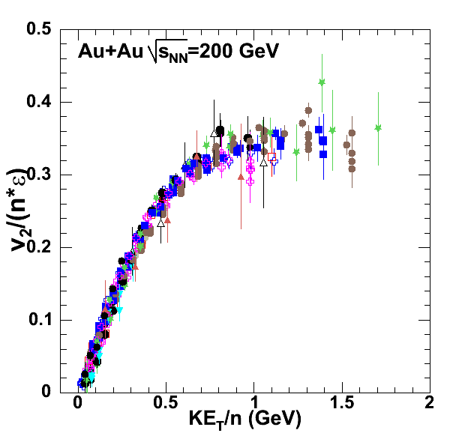
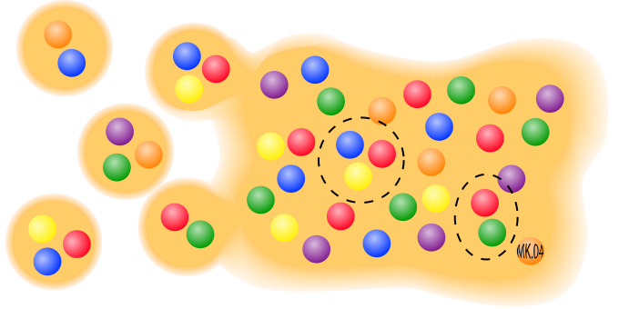

Anisotropic Flow at RHIC – partonic?
= m_{T} – m
n=2 for mesons and
n=3 for baryons
R. Lacey , A. Taranenko
PoS 2006 (2006) 021

Slide 8
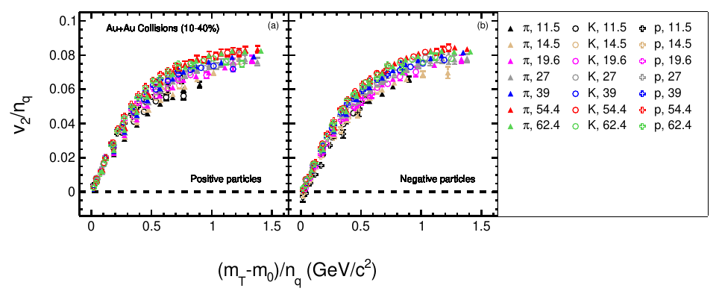
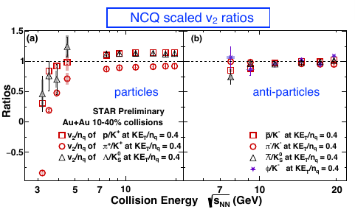
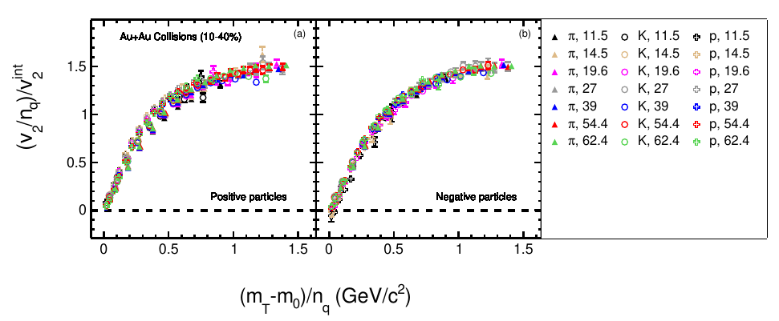
Elliptic flow from STAR BES program
STAR , Phys Rev C93, 14907 (2016)

Slide 9
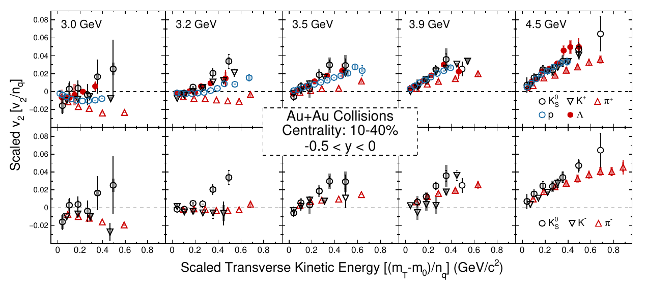
Anisotropic Flow at RHIC BES
Li-Ke Liu (CCNU), STAR Collaboration, CPOD 2024
At high energies, data follows NCQ scaling, indicating partonic collectivity???
NCQ scaling for v2 breaks completely at 3.5 GeV and below,

Slide 10
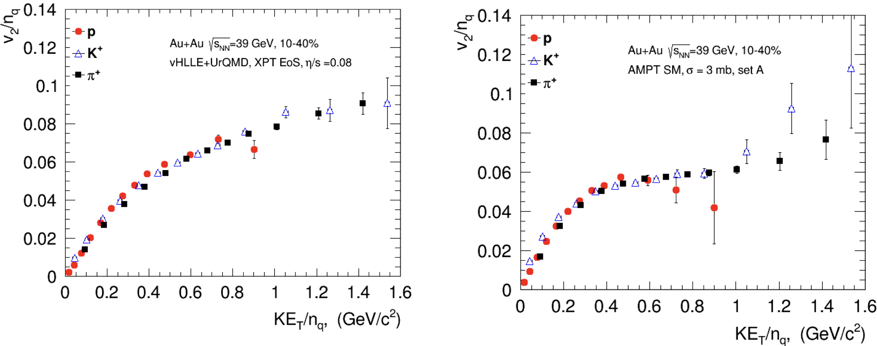
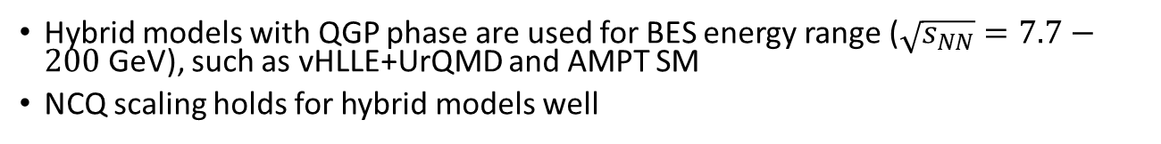
NCQ scaling: hybrid models
Hybrid models with QGP phase are used for BES energy range ($\sqrt{s_{NN}}=7.7−200$ GeV), such as vHLLE+UrQMD and AMPT SM
NCQ scaling holds for hybrid models well

Slide 11
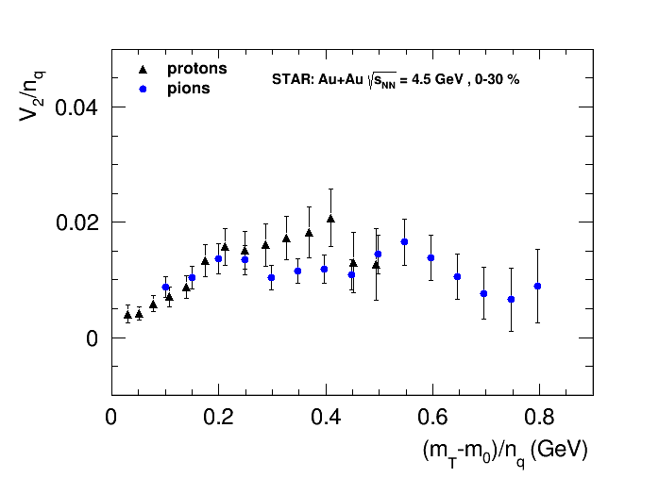
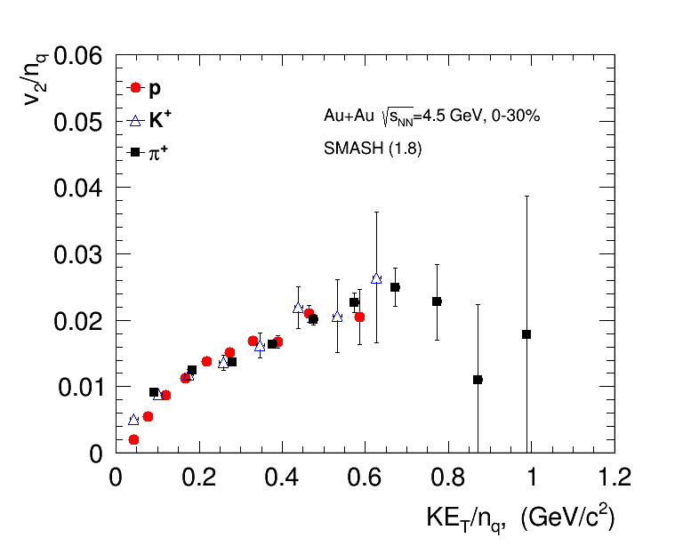
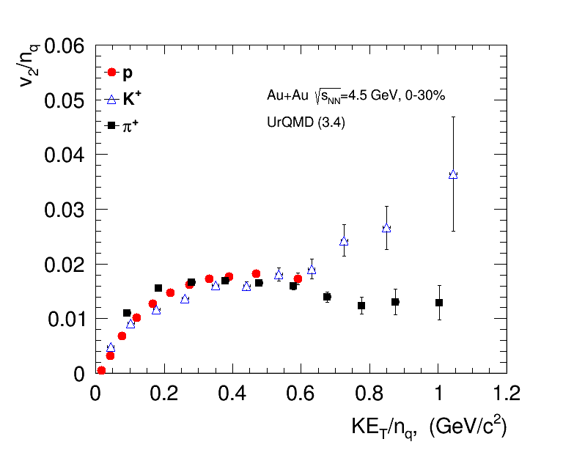
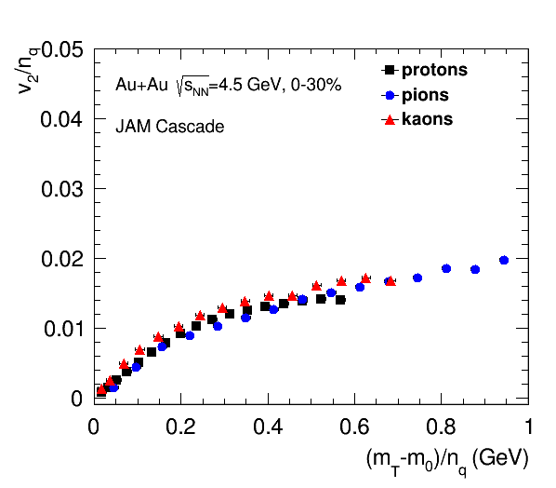
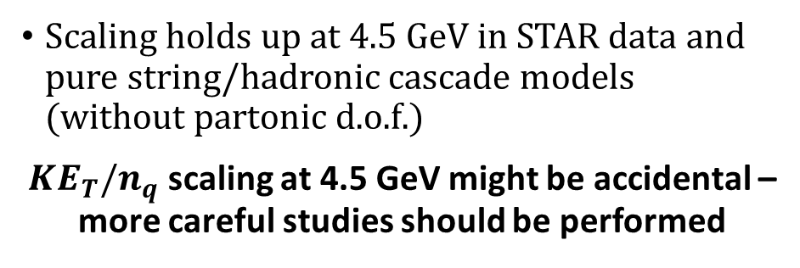
NCQ scaling: cascade models
STAR Collaboration, arxiv.org/abs/2007.14005
Scaling holds up at 4.5 GeV in STAR data and pure string/hadronic cascade models (without partonic d.o.f.)
$KE_{T}/n_{q}$ scaling at 4.5 GeV might be accidental – more careful studies should be performed

Slide 12
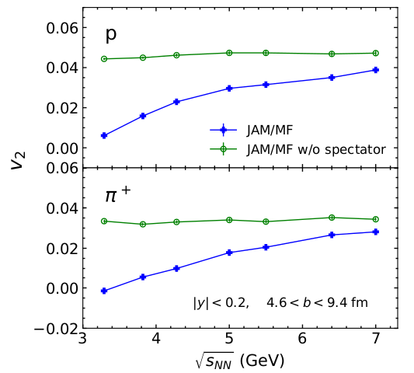
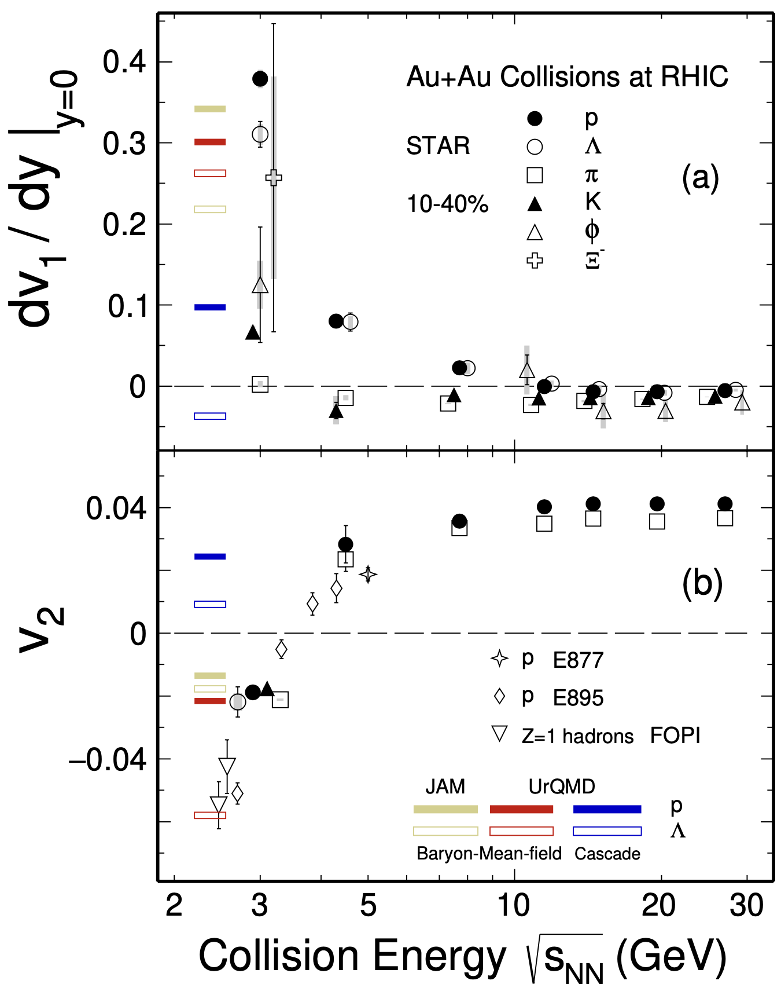
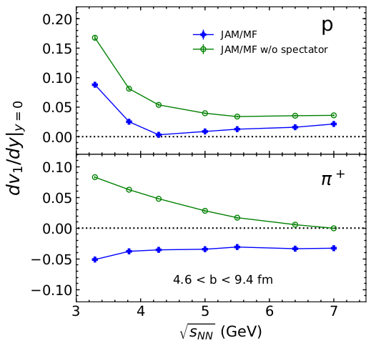

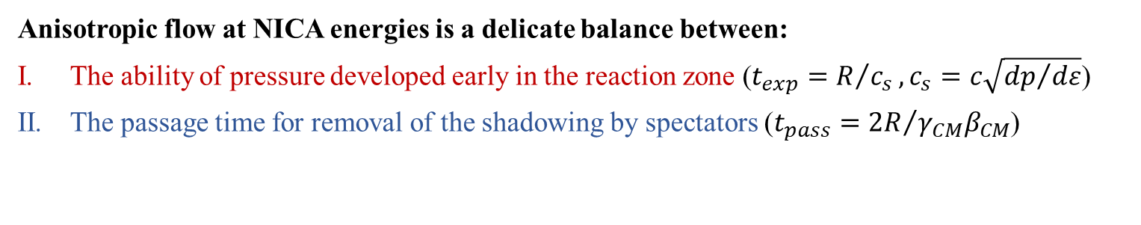
Anisotropic flow in heavy-ion collisions at high baryon density
M. Abdallah et al. STAR, Phys. Lett. B 827, 137003 (2022)
BM@N
CBM
MPD
Anisotropic flow at NICA energies is a delicate balance between:
The ability of pressure developed early in the reaction zone ($t_{exp}=R/{c_{s}}, c_{s}=c\sqrt{{dp}/{dε}}$)
The passage time for removal of the shadowing by spectators ($t_{pass}={2R}/{γ_{CM}β_{CM}}$)

Slide 13
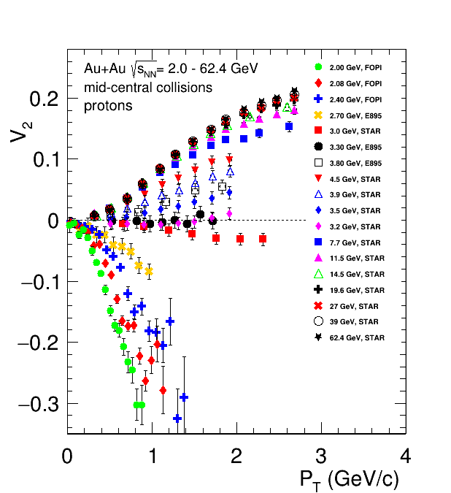
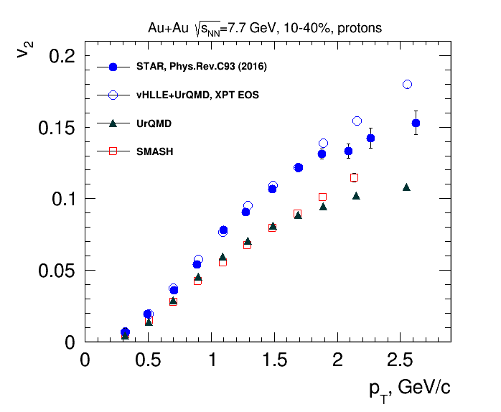
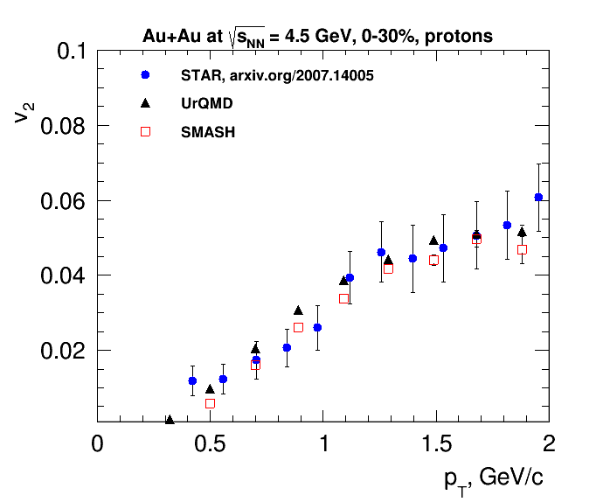
Beam Energy Dependence of Elliptic Flow (v₂)
Strong energy dependence of v₂ at √s_{NN} = 2.4-7 GeV

Slide 14
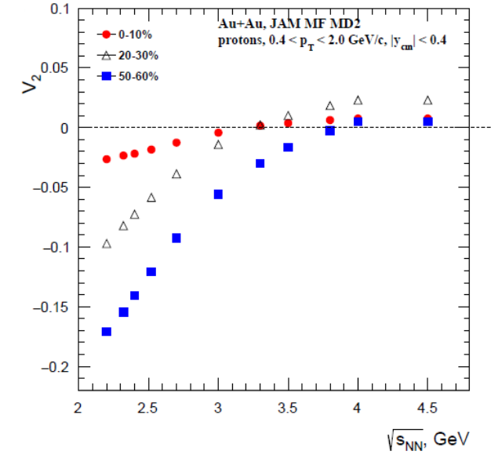
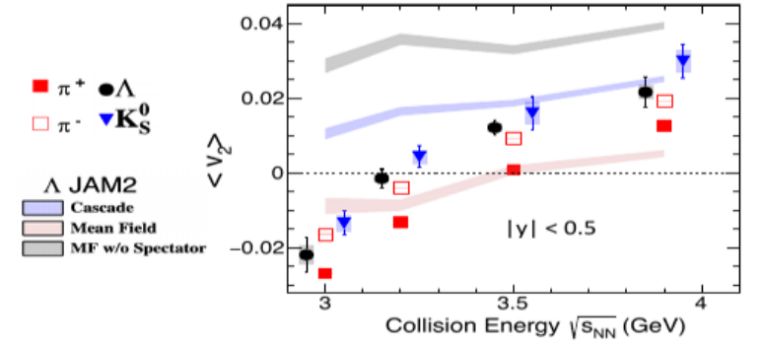
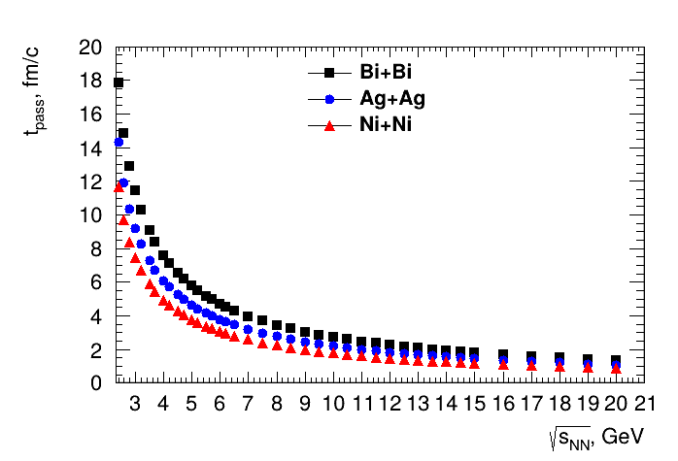
Beam Energy Dependence of Elliptic Flow (v₂)
Li-Ke Liu (CCNU), STAR Collaboration, CPOD 2024
Strong energy dependence of v₂ at √s_{NN} = 2.4-7 GeV

Slide 15
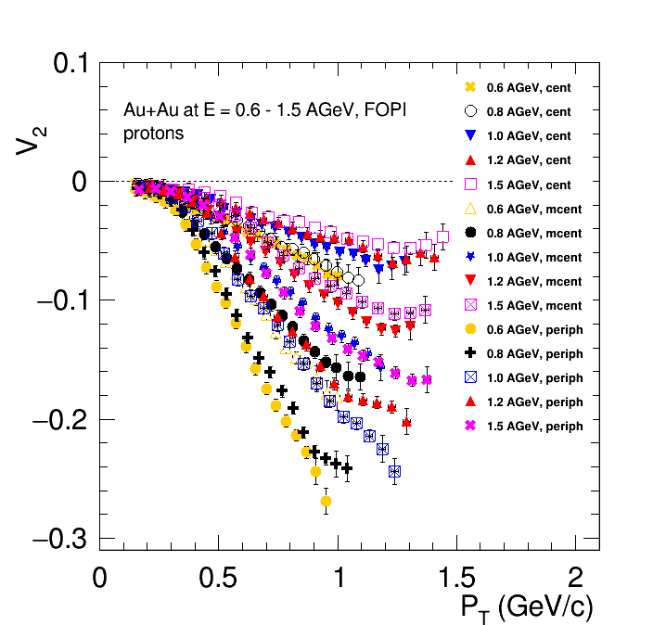
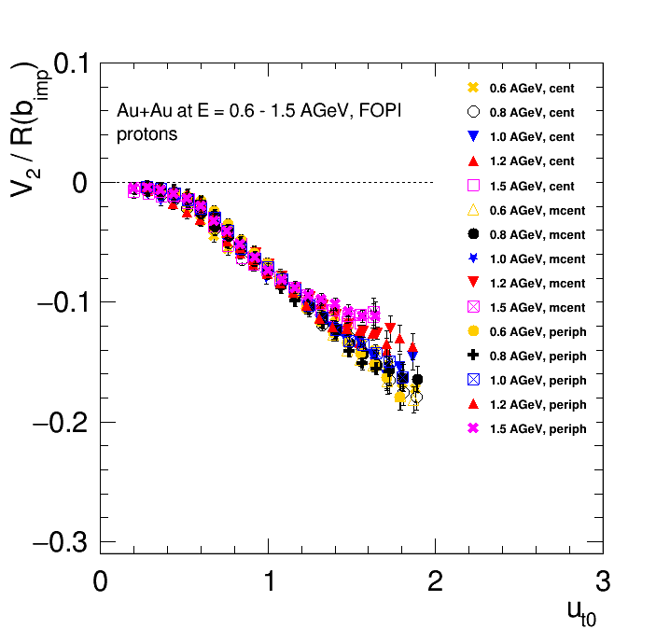
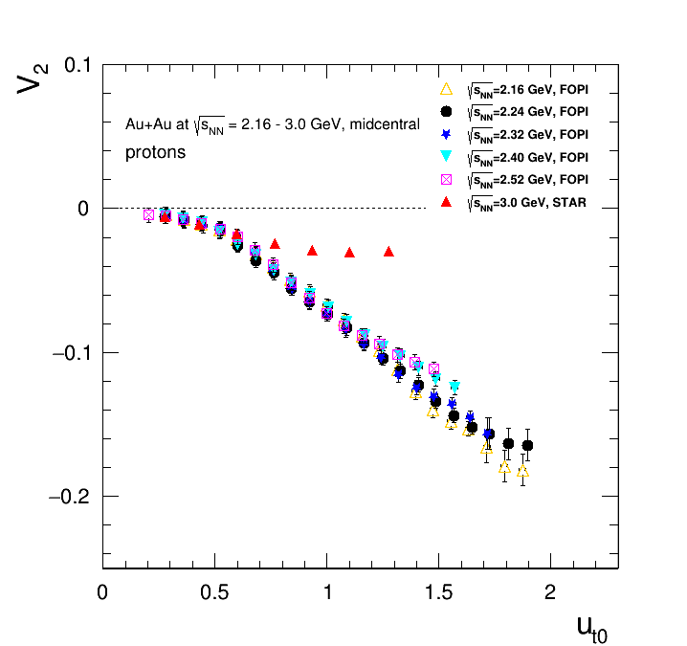
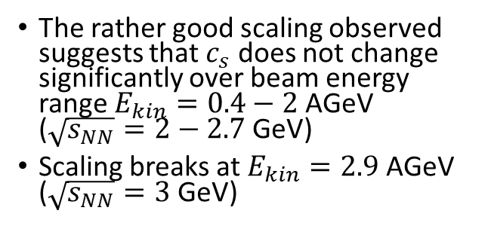
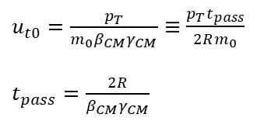
Scaling relations at SIS – scaling with passage time
$u_{t0}=\frac{p_{T}}{m_{0}β_{CM}γ_{CM}}≡\frac{p_{T}t_{pass}}{2Rm_{0}}$
$t_{pass}=\frac{2R}{β_{CM}γ_{CM}}$
Nucl. Phys A 876 (2012) 1-60
The rather good scaling observed suggests that $c_{s}$ does not change significantly over beam energy range $E_{kin}=0.4−2$ AGeV ($\sqrt{s_{NN}}=2−2.7$ GeV)
Scaling breaks at $E_{kin}=2.9$ AGeV ($\sqrt{s_{NN}}=3$ GeV)

Slide 16
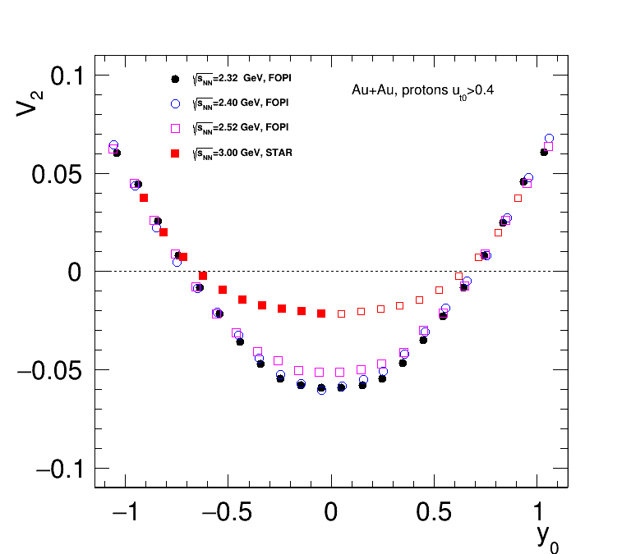
STAR published results for protons : Scaling breaks at √s_{NN}=3GeV – but holds at forward rapidity?

Slide 17
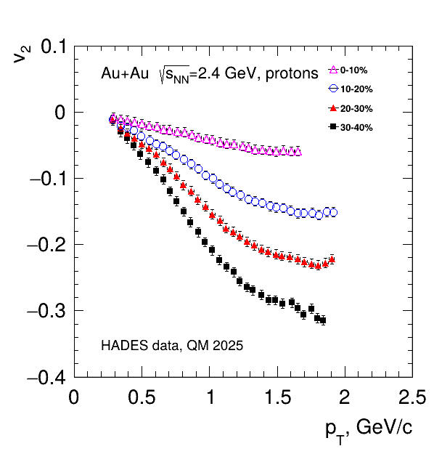
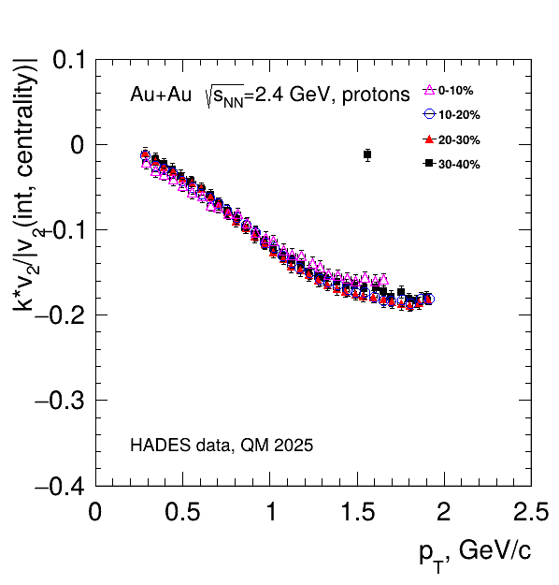
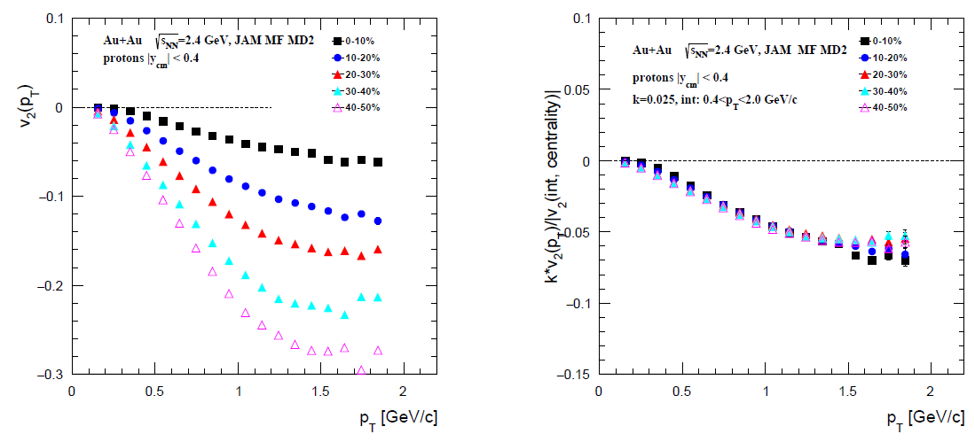
Scaling with integral flow: protons in Au+Au at $\sqrt{s_{NN}}$ = 2.4 GeV
The radial flow is not so srong at low energies

Slide 18
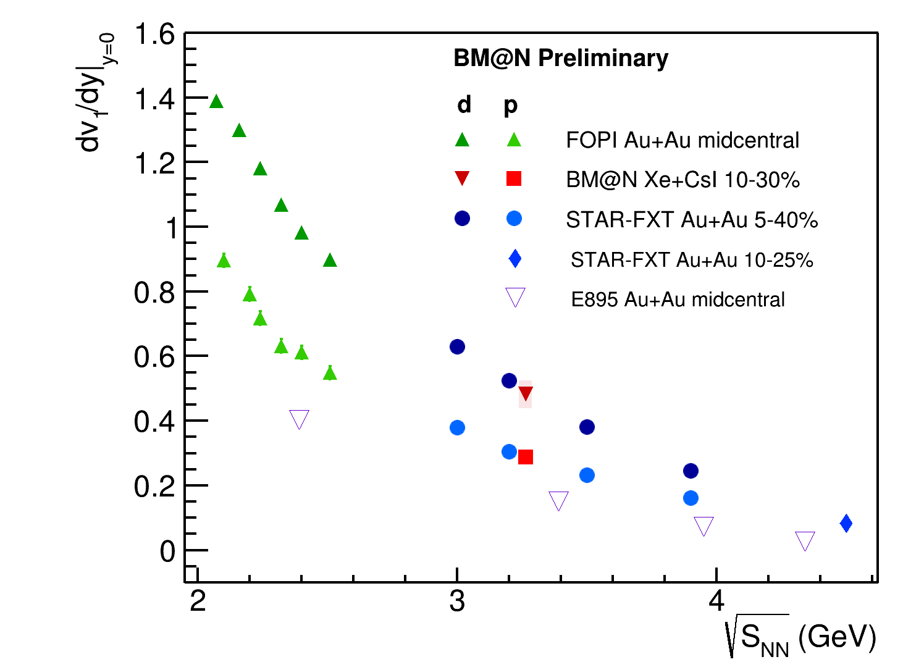
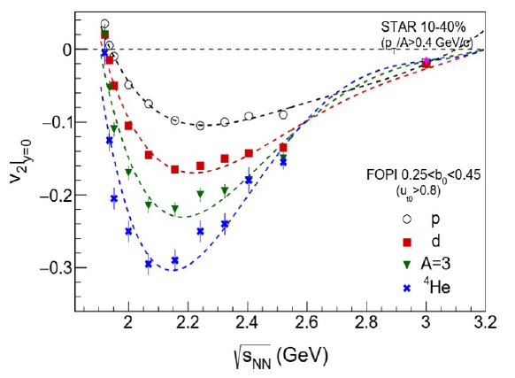
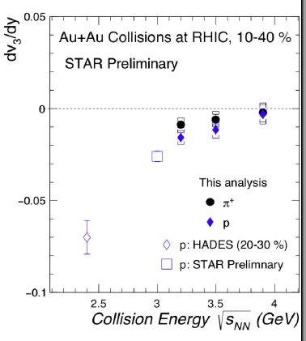
Anisotropic flow at Nuclotron / NICA: 2.5-3.0 GeV
BM@N agrees with STAR
Need new measurements to fill the gap in energy

Slide 19

Summary and outlook
NCQ scaling:
  Holds up for energies $\sqrt{s_{NN}}>4$ GeV in both experimental data and models (hybrid and pure string/hadronic cascade models)
  Scaling at $\sqrt{s_{NN}}=4.5$ GeV in the experimental data and pure string/hadronic cascade models can be accidental – more thorough study should be performed
Scaling with passage time:
  Holds up for energies $\sqrt{s_{NN}}=2−2.7$ GeV and breaks at $\sqrt{s_{NN}}≥3$ GeV
  Shows that at this energy range $v_{2}\left(\sqrt{s_{NN}}\right)$ changes due to the change of the passage time $t_{pass}$ of the spectators
Scaling relations provide a useful tool
to perform comparison between results from different experiments with different system size and beam energies
to constrain existing models

