Slide 1
Towards understanding of enhanced production of strange particles in nucleus-nucleus interactions at high energies
V. Uzhinsky (JINR), A. Galoyan (JINR), N. Chalyi (TGU)
Content
Problem formulation – NA61/SHINE exp. Data on Ar+Sc interactions at 13 – 150 GeV/c/Nucleon (February 2024)
Hypothesis
Possibilities of the Quark-Gluon-String Model (QGSM)
Calculations results
Conclusions
1

Slide 2
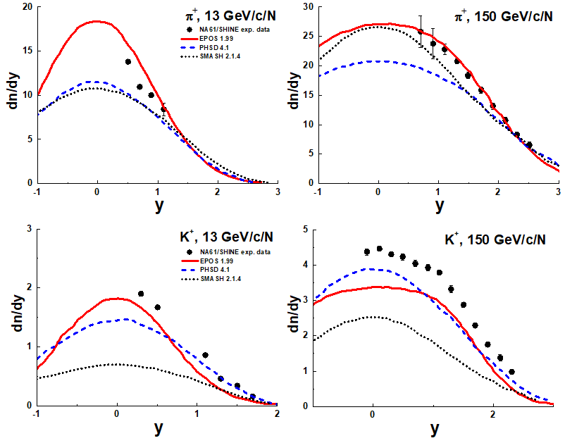
Problem formulation – NA61/SHINE exp. Data on Ar+Sc interactions at 13 – 150 GeV/c/Nucleon
Measurements of π+-, K+-, p and anti-P spectra in Ar-40 + Sc-45 collisions at 13A to 150A GeV/c
NA61/SHINE Collaboration H. Adhikary(Jan Kochanowski U.) et al. Eur. Phys. J. C 84 (2024) 4, 416
0 – 30 % centrality
The most actual models cannot describe K+ and K- meson production
in Ar+Sc interactions !
2

Slide 3
Hypothesis
Quark-Gluon Plasma (It is impossible at 13 GeV/c/N)
Intrinsic strangeness (It is forgotten)
Secondary interactions -- N+N->Y + K (UrQMD model
String fusion ?
EPOS: Core + Corona ?
Quark-Gluon String Model -- QGSM ?
Gevorg H. Arakelyan, Carlos Merino, Yuli M. Shabelski
SciPost Phys.Proc. 15 (2024) 024 ISMD2022, 024
Centrality dependence of multistrange baryon production in high-energy heavy-ion collisions
λs=0.36 ?
3

Slide 4
Possibilities of the Quark-Gluon-String Model (QGSM)
A.B. Kaidalov, Phys. Lett. B 116 (1982) 459: A.B. Kaidalov and K.A. Ter-Martirosian, Phys. Lett. B 117 (1982) 247
Constituent di-quark
Constituent quark
Sea quark
λs ?
Nucl. struct.
Sea anti-quark
λs
String frag.
A.B. Kaidalov and O.I. Piskunova, Z. Phys. C - Particles and Fields 30, 145-150 (1986
δ=0.25 → λs=0.11
4

Slide 5
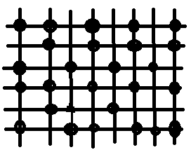
Possibilities of the Quark-Gluon-String Model (QGSM)
for nucleus-nucleus interactions
B
Max number of wounded nucleons = A+B
Max number of binary collisions = A*B!
A
In nucleus-nucleus interactions as in high multiplicity PP interactions
multiplicity of sea-quark-sea-antiquark pairs (2ν) can be essentially larger
then multiplicity of constituent quark-diquark pairs (2A+2B). For the first
ones strangeness suppression Ps-anti-s/Pu-anti-u ~ 1, as in QGP according
to our rough estimation!
How can one check the assumption?
EPOS ?, QGSJET +,
AGT (Amelin-Gudima-Toneev) Model,
DCM (Dubna Cascade Model (used in NICA project).
Geant4 QGSM for h+A interactions (our implementation)
5

Slide 6
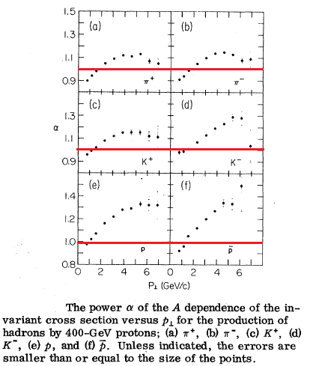
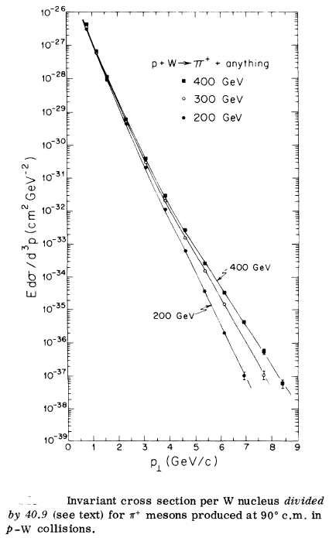
Calculations results: Cronin’s exp., Geant 4 QGSM
J.W. Cronin et al Phys. Rev. Lett. 31 (1973) 1426, 218 citations
E100 Collaboration: J.W. Cronin et al. Phys. Rev. D 11 (1975) 3105, 1 151 citations
D. Antreasyan et al. Phys. Rev. D 19 (1979) 764, 686 citations
P + P, H-2, Be, Ti, W at 200, 300 and 400 GeV/c
It was expected
that hard scat-
tered hadrons
will have A¹.
The results were
very unexpected!
Double partons
scattering !?
There were a lot
of considerations.
For us it is important that the data are the most exact
data on hadron-nucleus interactions.
6

Slide 7
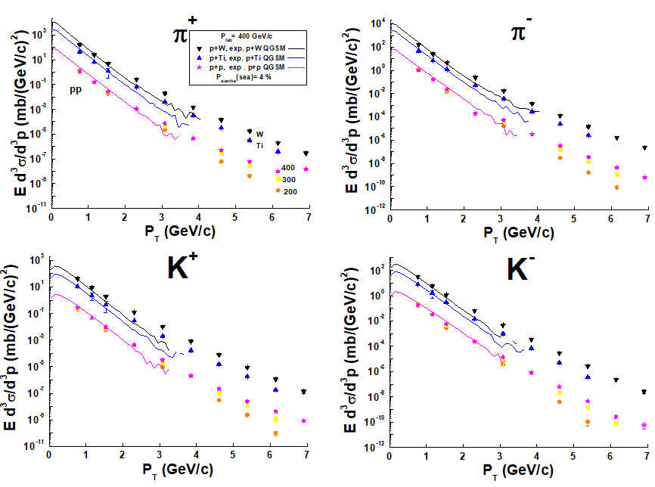
Calculations results: Cronin’s exp., Geant 4 QGSM
J.W. Cronin et al Phys. Rev. Lett. 31 (1973) 1426, 218 citations
E100 Collaboration: J.W. Cronin et al. Phys. Rev. D 11 (1975) 3105, 1 151 citations
D. Antreasyan et al. Phys. Rev. D 19 (1979) 764, 686 citations
P + P, H-2, Be, Ti, W at 200, 300 and 400 GeV/c
Geant 4 QGSM does not include hard interactions which are at P_{T} > 2 – 3 GeV/c.
7

Slide 8
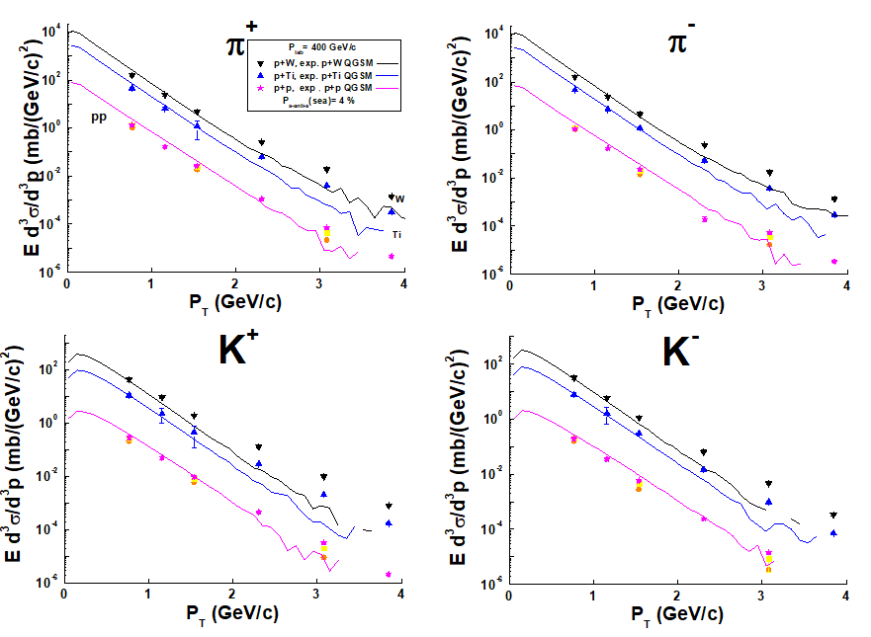
Calculations results: Cronin’s exp., Geant 4 QGSM
J.W. Cronin et al Phys. Rev. Lett. 31 (1973) 1426, 218 citations
E100 Collaboration: J.W. Cronin et al. Phys. Rev. D 11 (1975) 3105, 1 151 citations
D. Antreasyan et al. Phys. Rev. D 19 (1979) 764, 686 citations
P + P, H-2, Be, Ti, W at 200, 300 and 400 GeV/c
Geant 4 QGSM does not include hard interactions which are at P_{T} > 2 – 3 GeV/c.
8

Slide 9
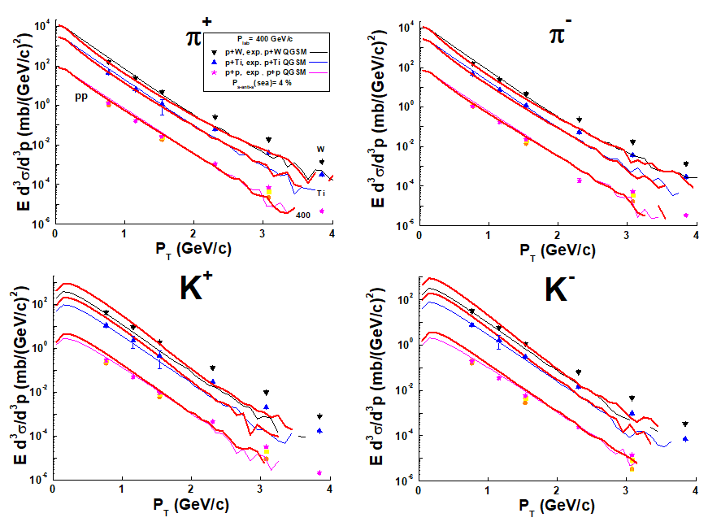
Calculations results: Cronin’s exp., Geant 4 QGSM
E100 Collaboration: J.W. Cronin et al. Phys. Rev. D 11 (1975) 3105, 1 151 citations
P + P, H-2, Be, Ti, W at 200, 300 and 400 GeV/c
Extreme suggestion – P_{s-anti-s} = 1 !
Effect of the strange sea quarks can be seen at P_{T} < 2 GeV/c.
9

Slide 10
Possibilities of the Quark-Gluon-String Model (QGSM)
QGSM – Quark-Gluon String Model by A.B. Kaidalov
implemented in DCM – Dubna-Cascade Model
AGT – Amelin-Gidima-Toneev model,
N. S. Amelin, Yad. Fiz. 51, 512 (1990)
N. S. Amelin, et al, Yad. Fiz. 52, 272 (1990)
a previous version of DCM.
SHIELD – a Monte Carlo Hadron Transport
Code
A.V. Dementyev, N.M. Sobolevsky,
IAI, 2017
SHIELD-HIT12A - a Monte Carlo particle
transport program for ion therapy research
N. Bassler, D.C. Hansen, A.Luhr,
B. Thomsen, J.B. Petersen, N Sobolevsky
Jour. Of Phys. 489 (2014) 12004
User Manual for the Code LA QGSM
K.K. Gudima, S. Mashnik, A.J. Sierk
Los Alamos, December, 2001
DCM - Dubna Cascade Model (NICA)
Monte-Carlo Generator of Heavy Ion
Collisions DCM-SMM,
M. Baznat, A. Botvina, G. Musulmanbekov,
V. Toneev, V. Zhezher
Phys. Part. Nucl. Lett. 17 (2020) 3, 303
A.S. Botvina, K. K. Gudima, J.Steinheimer,
M. Bleicher, and J. Pochodzalla
Phys. Rev. C 95, 014902 (2017)
10

Slide 11
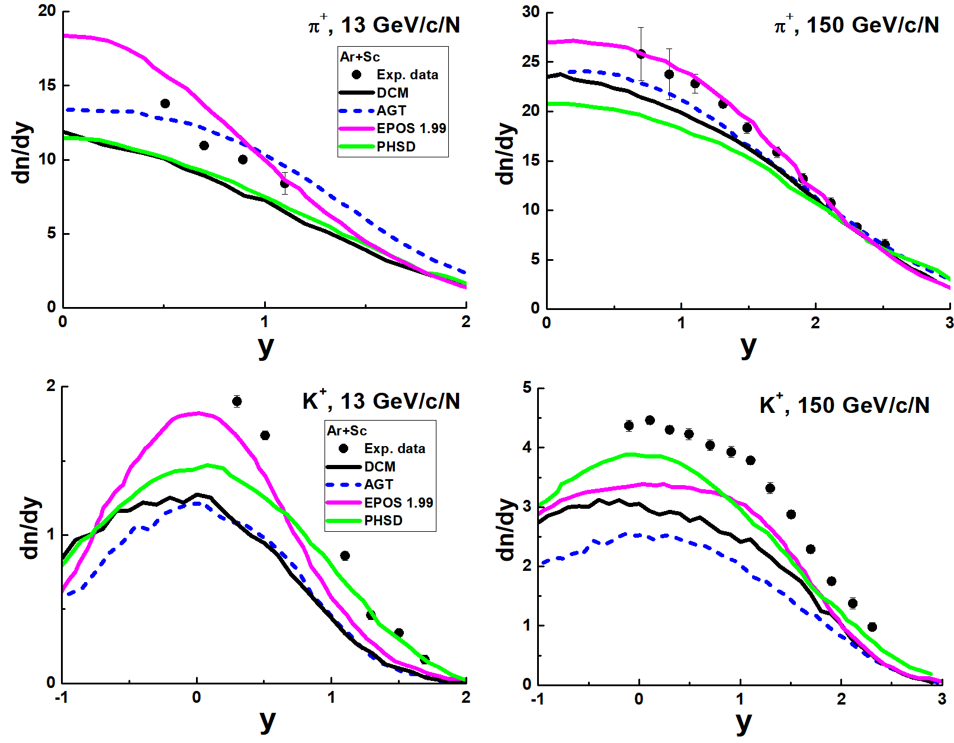
Calculations results: AGT and DCM
Measurements of π+-, K+-, p and anti-P spectra in Ar-40 + Sc-45 collisions at 13A to 150A GeV/c
NA61/SHINE Collaboration H. Adhikary(Jan Kochanowski U.) et al. Eur. Phys. J. C 84 (2024) 4, 416
Default versions of AGT and DCM models cannot reproduce
K-meson yields!
11

Slide 12
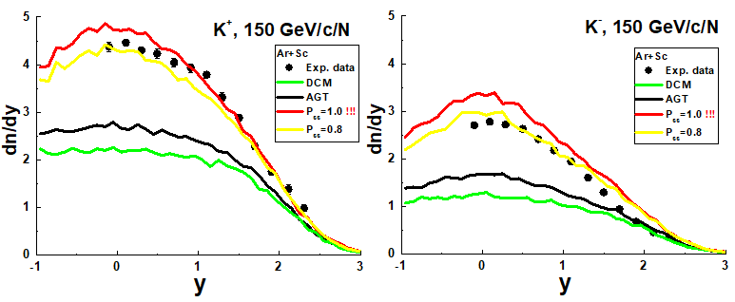
Calculations results: AGT and DCM
SUBROUTINE CHAINS
IF(NAVAL.EQ.0) GO TO 2
IF(NUAVAL.NE.IPAR) GO TO 1
IAA=1
NASEA=NASEA+1
JS1=NASEA
IFLAS(NASEA)=1+INT(RNDM(-1.)/PUD) ! PUD=0.42 ! Uzhi
GO TO 3
1 CONTINUE
2 NAVAL=NAVAL+1
IF(NAVAL.EQ.0) GO TO 2
IF(NUAVAL.NE.IPAR) GO TO 1
IAA=1
NASEA=NASEA+1
JS1=NASEA
c IFLAS(NASEA)=1+INT(RNDM(-1.)/PUD) ! Uzhi
IFLAS(NASEA)= 3 ! Uzhi
GO TO 3
1 CONTINUE
2 NAVAL=NAVAL+1
12

Slide 13
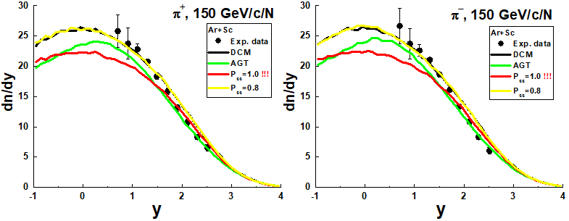
Calculations results
We propose a possible explanation in QGS model.
At the same time a problem with Pi+ and Pi- appeared.
Ps-sbar = 80 % Too much! If QGP would be added, Ps-sbar could be lower.
It would be well to improve the DCM model!
13

Slide 14
Conclusions
The enhancement of the strange particle production in Ar+Sc interactions can be reproduced increasing the strange quark production probability at the ends of sea strings.
It would be well to improve DCM and reach a well description of the strange particle production in AA interactions on a solid basis.
It would be well to obtain analogous results in QGSJET III. Model.
The research was carried out with the support of a grant from the Government of the Russian Federation (Agreement No. 075-15-2025-009 of 28 February 2025)
14

Slide 15
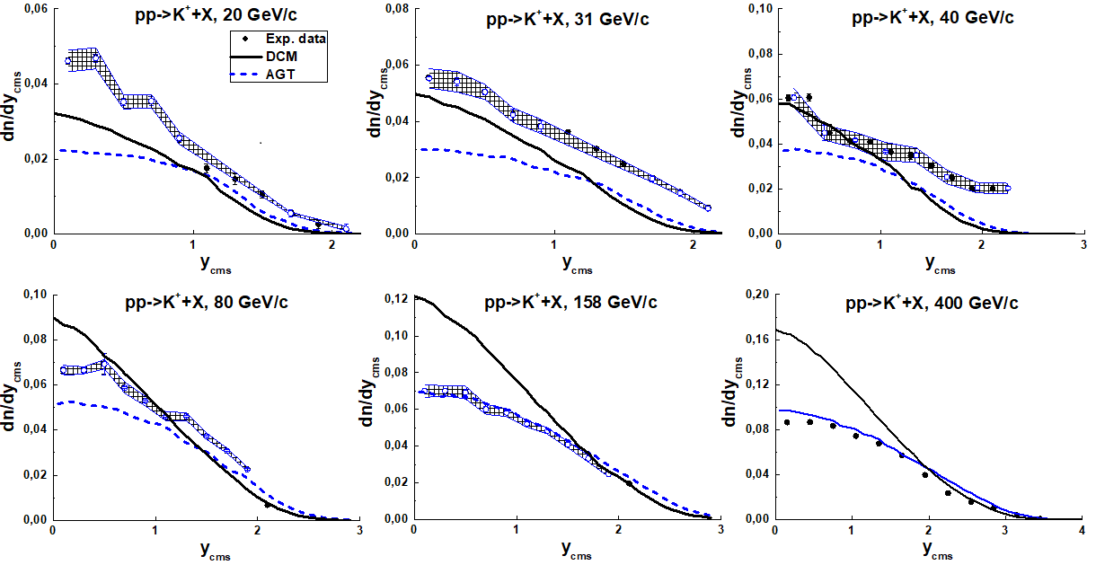
Measurements of π+-, K+-, p and pbar spectra in proton-proton interactions at 20, 31, 40, 80 and 158 GeV/c
with the NA61/SHINE spectrometer at the CERN SPS,
NA61/SHINE Collaboration (A. Aduszkiewicz(Warsaw U.) et al. Eur. Phys. J. C77 (2017) 10, 671
Fig. 3 Rapidity distributions of K⁺-mesons in PP-interactions.
AGT approximately reproduces the energy dependence of the spectra.
DCM essentially overestimate the data at high Plab!
15

Slide 16
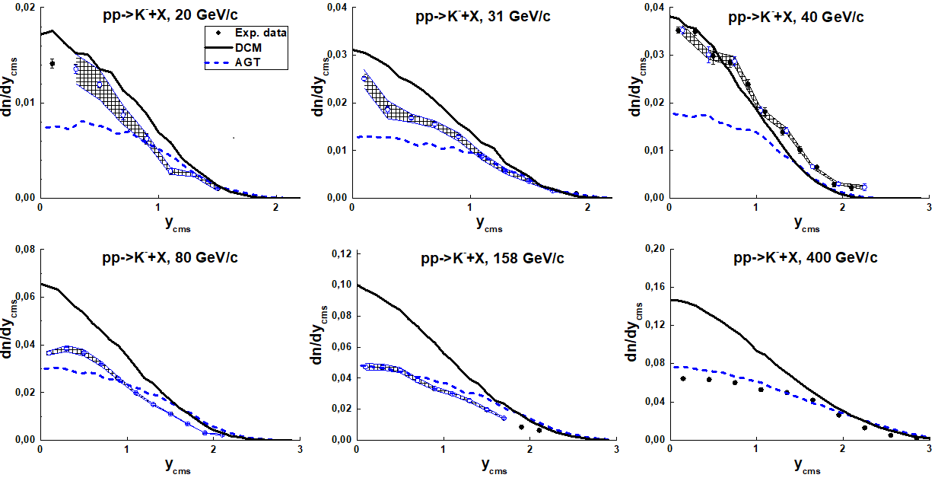
Measurements of π+-, K+-, p and pbar spectra in proton-proton interactions at 20, 31, 40, 80 and 158 GeV/c
with the NA61/SHINE spectrometer at the CERN SPS,
NA61/SHINE Collaboration (A. Aduszkiewicz(Warsaw U.) et al. Eur. Phys. J. C77 (2017) 10, 671
Fig. 4 Rapidity distributions of K⁻-mesons in PP-interactions.
AGT approximately reproduces the energy dependence of the spectra.
DCM essentially overestimate the data at high Plab!
16

Slide 17
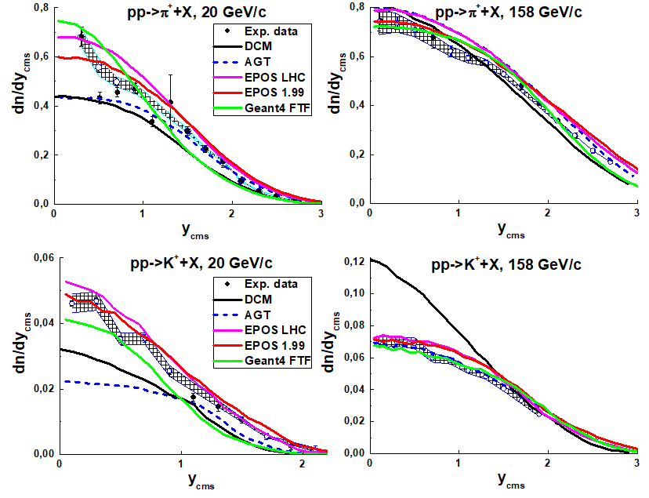
DCM/AGT and other models, PP interactions
AGT is ~ among the other models
DCM has to be improved!
17

Slide 18
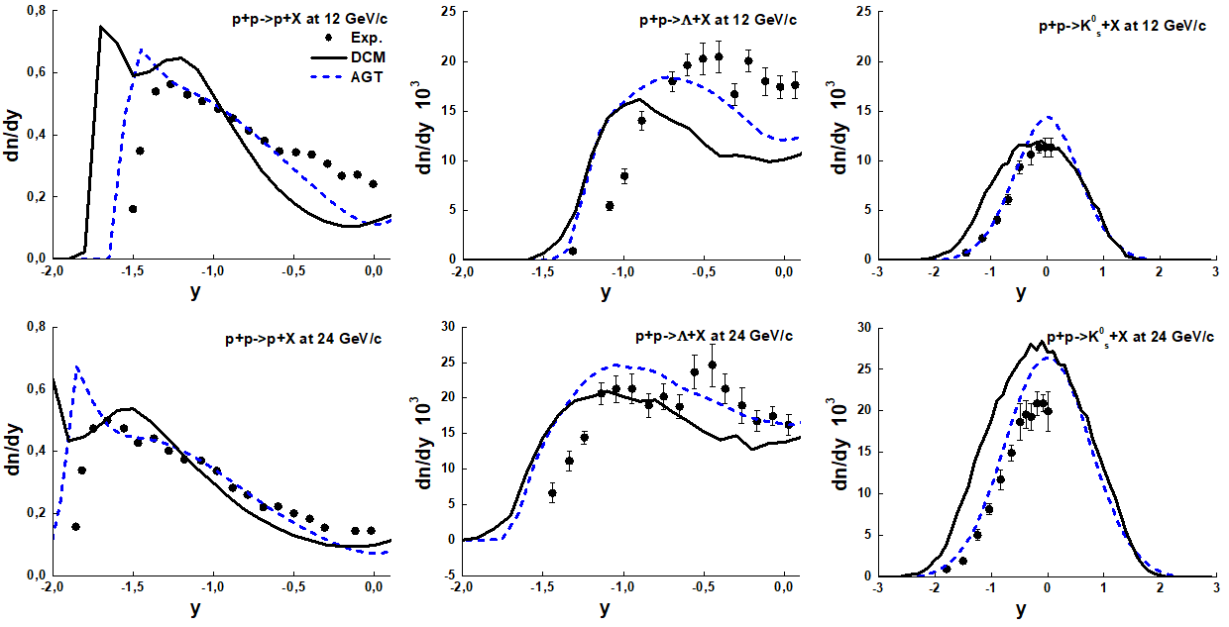
Measurements of π+-, K+-, p and pbar spectra in proton-proton interactions at 20, 31, 40, 80 and 158 GeV/c
with the NA61/SHINE spectrometer at the CERN SPS,
NA61/SHINE Collaboration (A. Aduszkiewicz(Warsaw U.) et al. Eur. Phys. J. C77 (2017) 10, 671
Fig. 8 Rapidity distributions of protons, Δ-hyperons and K⁰_{s} -mesons in PP-interactions.
AGT is a little bit better than DCM.
18

