Slide 1
Simulation of neutron and nuclear fragment production in Urqmd
3.4 model supplemented by clustering model and multi-fragmentation statistical model
A. Galoyan, T.Q.T. Le , A. Taranenko, V. Uzhinsky
Content
1. Main assumptions of Ultra Relativistic Molecular Dynamic model (UrQMD)
2. Description of experimantal data of the NA61/SHINE collaboration on π±, K±, p, pbar production in
Ar+Sc interactions at 13, 19, 30, 40, 75, 150 *A*GeV using UrQMD model version 3.4.
3. Study of neutron production in p+A interactions in the frame of UrQMD model version 3.4.
4. Coupling of the UrQMD 3.4 model with a clustering model and Statistical Multi-fragmentation
Model (SMM) : UrQMD+SMM
5. Analysis of neutron spectra in the UrQMD+SMM model.
6. Description of fragment production in nucleus-nucleus interactions by the UrQMD+SMM model.
7. Summary

Slide 2
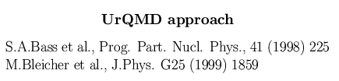
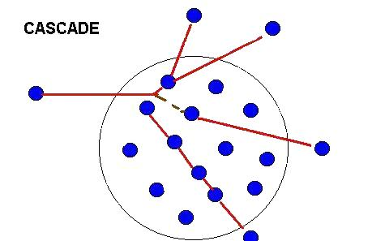

Initialization
In configuration space the centroids of the Gaussians are randomly
distributed within a sphere with R=r₀(0.5*[A+(A^{1/3}-1)³])^{1/3} (fm)
The initial momenta of the nucleons are randomly chosen between 0
and local Thomas-Fermi momentum.
The initialized nuclei are not in their ground state, and can evaporate
single nucleons after 20-30 fm/c. Pauli potential is not included. It can
be included optionally.
Potentials
Skyrme-type, Yukawa, Coulomb and Pauli ones
Collision
Cross sections
are very good!
Pauli blocking
included

Slide 3
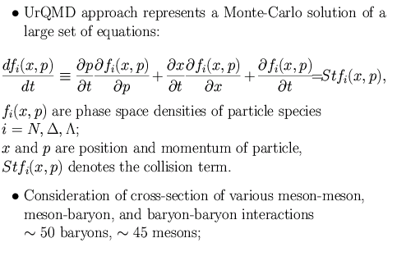
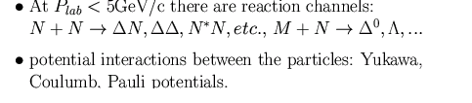
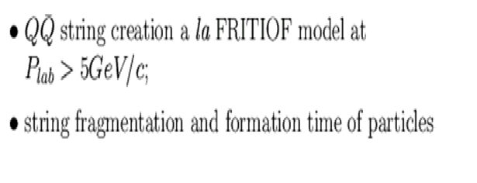
●At high energies, production of various resonanses
(ρ, ω, η, Δ, Λ, Ξ and others) is included;
● Creation of nuclear residuals is not implemented in the original code.

Slide 4
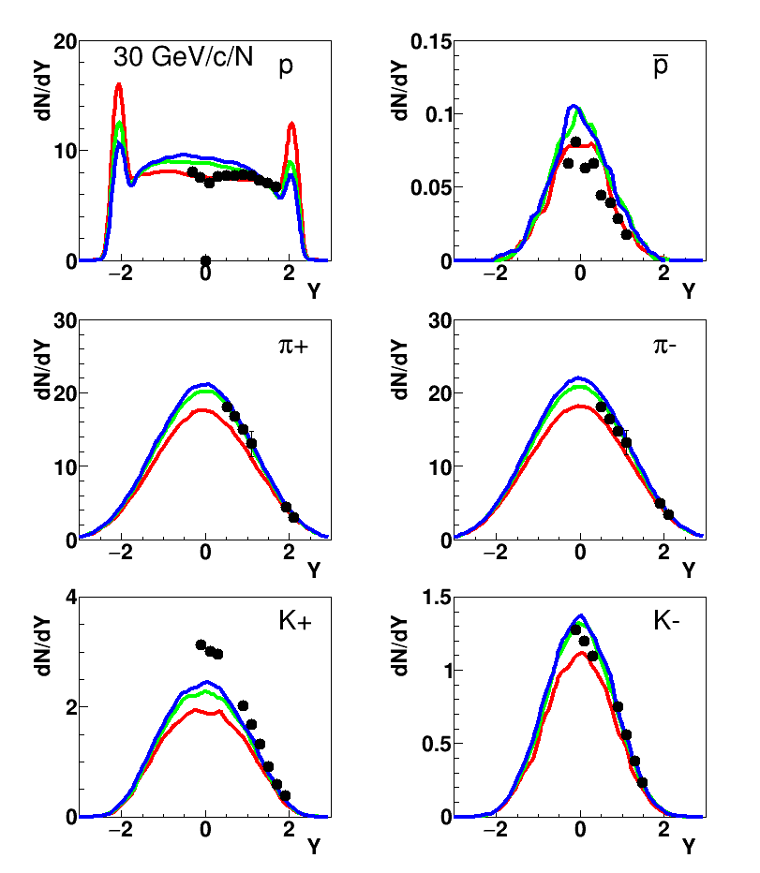
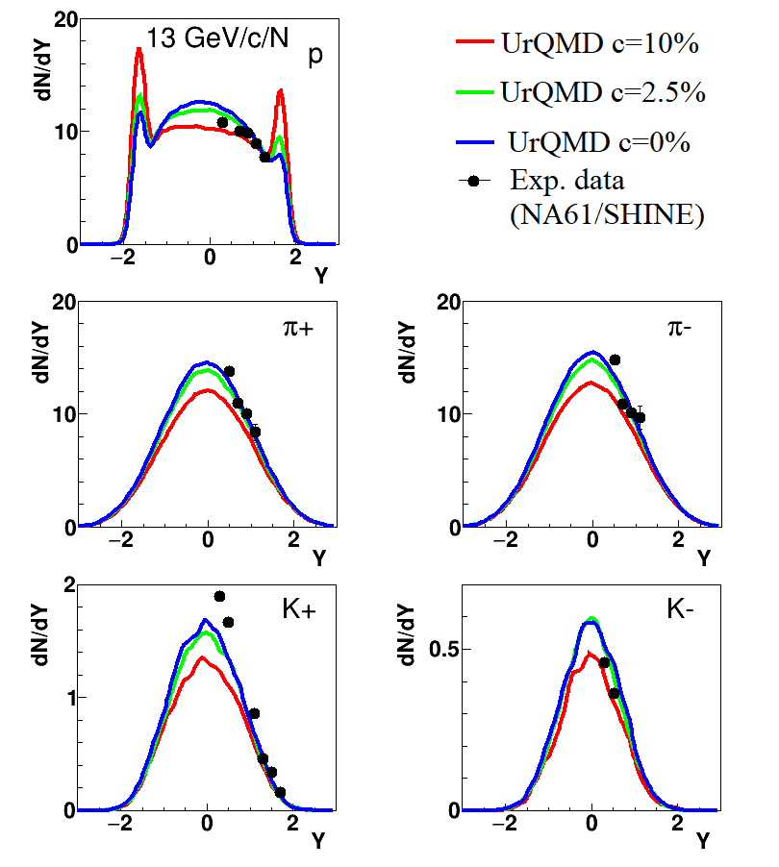





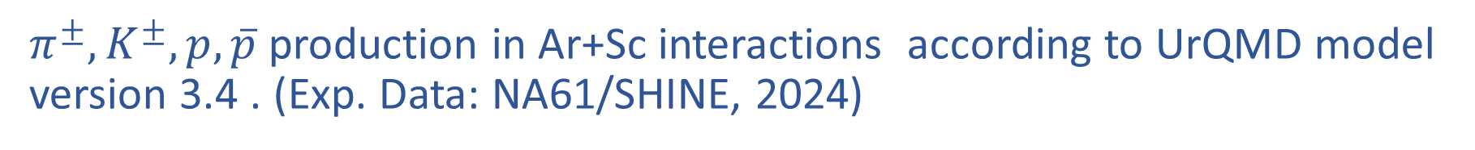


$π^{±},K^{±},p,\overline{p}$ production in Ar+Sc interactions according to UrQMD model version 3.4 . (Exp. Data: NA61/SHINE, 2024)
We installed UrQMD 3.4 at HybriLIT cluster at JINR and performed all calculations at HybriLIT
$$σ^{exp.}=c × σ^{inel.}$$
$$=πB_{max}^{2}$$
$$c=10\%$$
$$→ B_{max}=2.87 fm$$
$$c=2.5\%$$
$$→ B_{max}=1.44 fm$$
$$c=0\%$$
$$→ B_{max}0.0 fm$$
NA61/SHINE Collaboration., Adhikary, H., Adrich, P. et al.
Eur. Phys. J. C 84, 416 (2024)
At $P_{lab}$=19 GeV/c, we obtained the similar results with 13GeV/c

Slide 5
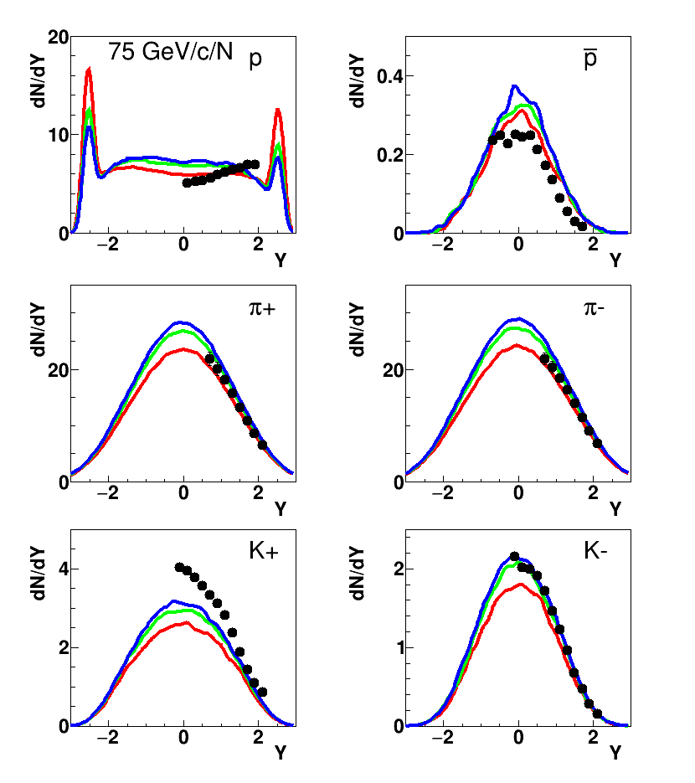
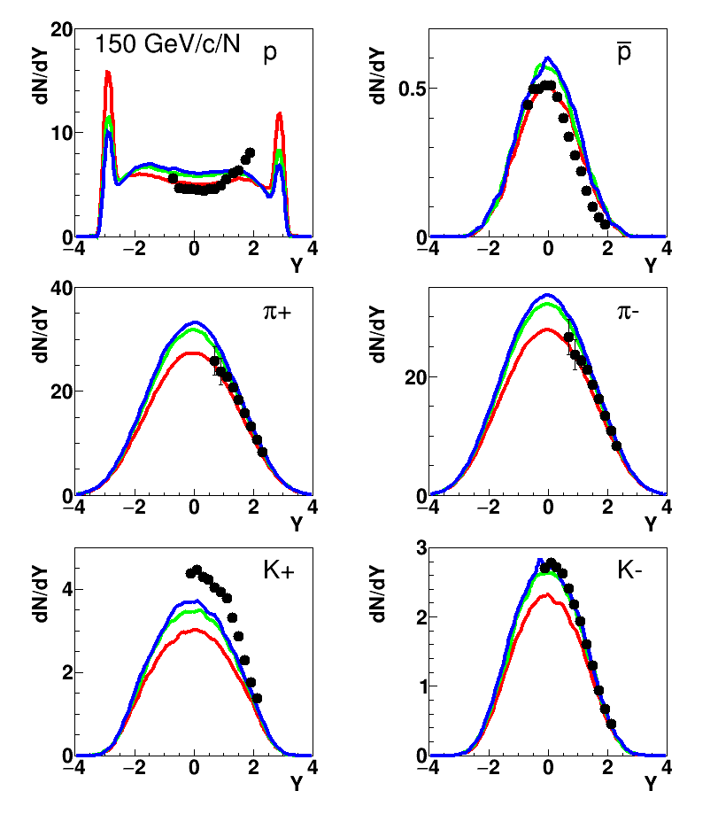
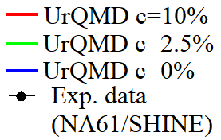
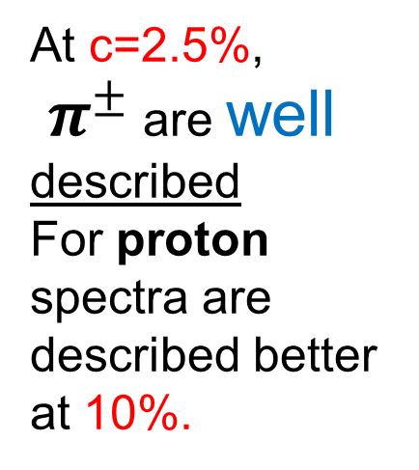
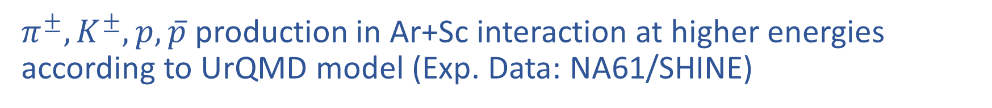
$π^{±},K^{±},p,\overline{p}$ production in Ar+Sc interaction at higher energies according to UrQMD model (Exp. Data: NA61/SHINE)
At c=2.5%,
$π^{±}$ are well described
For proton spectra are described better at 10%.
At $P_{lab}$=40 GeV/c, we obtained the similar results with 75GeV/c

Slide 6
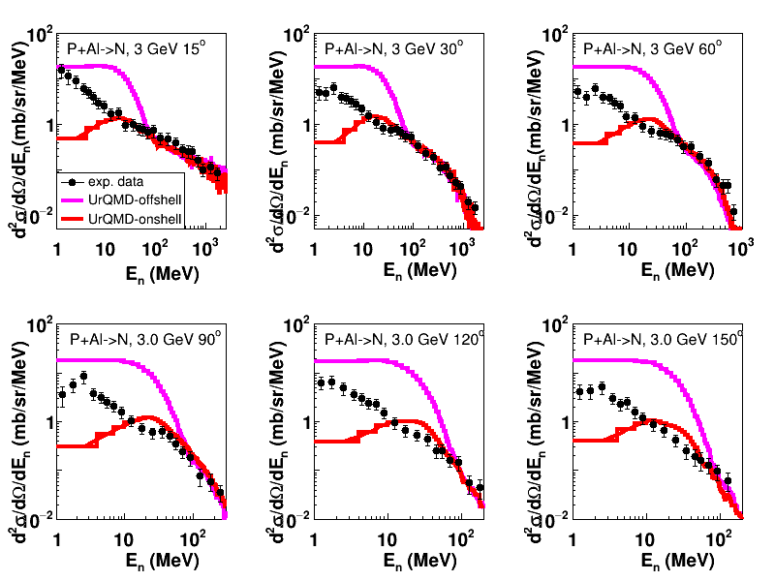
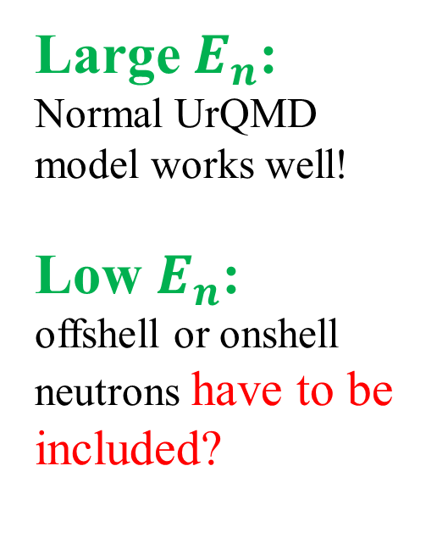
Neutron production using UrQMD model 3.4
in p+Al interactions
(Exp. Data: K. Ishibashi et al., J.Nucl. Sci. Tech., Vol.34, N6 (1997) P. 529)
Similar results are obtained for p+Fe interactions

Slide 7
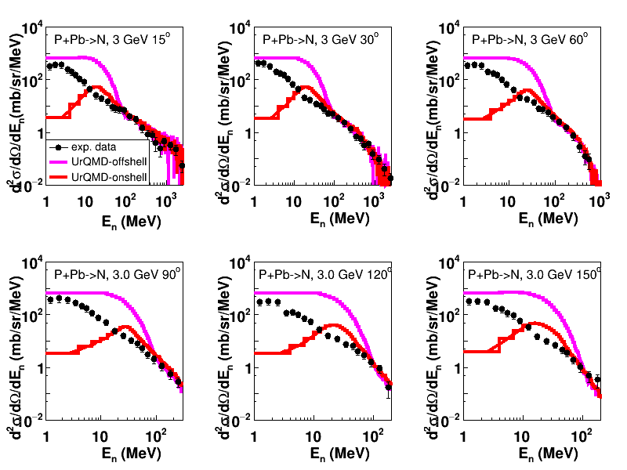
Neutron production using UrQMD model 3.4 in proton
interactions with heavy target.
(Exp. Data: K. Ishibashi et al., J.Nucl. Sci. Tech., Vol.34, N6 (1997) P. 529)
And for p+Pb interactions
Solution →
It is needed to couple UrQMD with clustering model and Statistical Multifragmentation Model (SMM) by Botvina

Slide 8
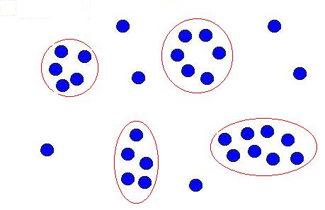
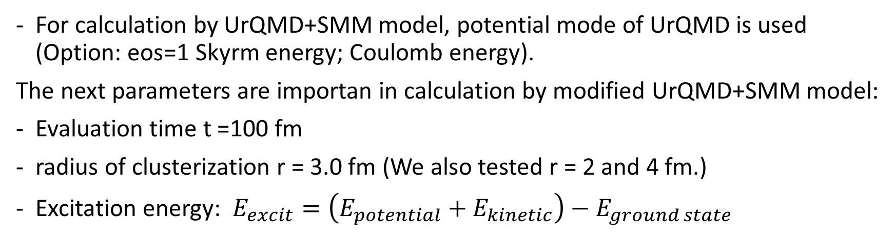
Coupling of UrQMD 3.4, Clustering and SMM models:
UrQMD+SMM
UrQMD 3.4
(Original)
Cluster
(use neutrons, protons)
SMM
Fragments
(n, p, frags)
Mesons, gamma, electron, etc.
For calculation by UrQMD+SMM model, potential mode of UrQMD is used (Option: eos=1 Skyrm energy; Coulomb energy).
The next parameters are importan in calculation by modified UrQMD+SMM model:
Evaluation time t =100 fm
radius of clusterization r = 3.0 fm (We also tested r = 2 and 4 fm.)
Excitation energy: $E_{excit}=\left(E_{potential}+E_{kinetic}\right)−E_{ground state}$

Slide 9
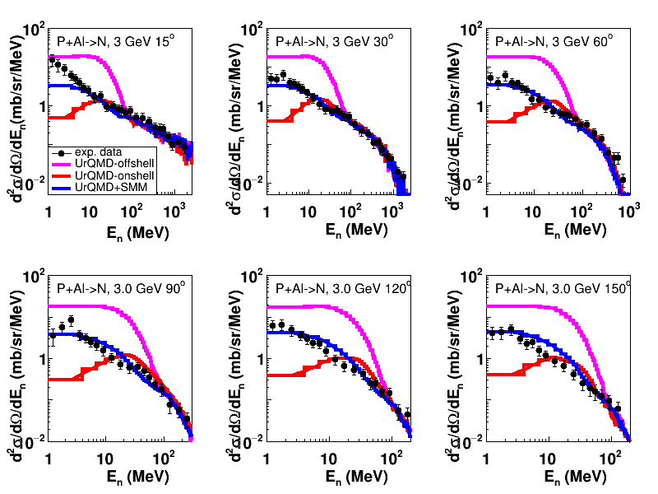
Urqmd 3.4 model supplemented by clustering model
and multi-fragmentation statistical model
Results for P+Al interactions
(Exp. Data: K. Ishibashi et al., J.Nucl. Sci. Tech., Vol.34, N6 (1997) P. 529)
Neutron emission angle from 30-150 degrees, there is a good agreement between the modified model and exp. data at large En.
At smaller angle (15 degree) and small kinetic energies, UrQMD+SMM underestimate the neutron spectra.

Slide 10
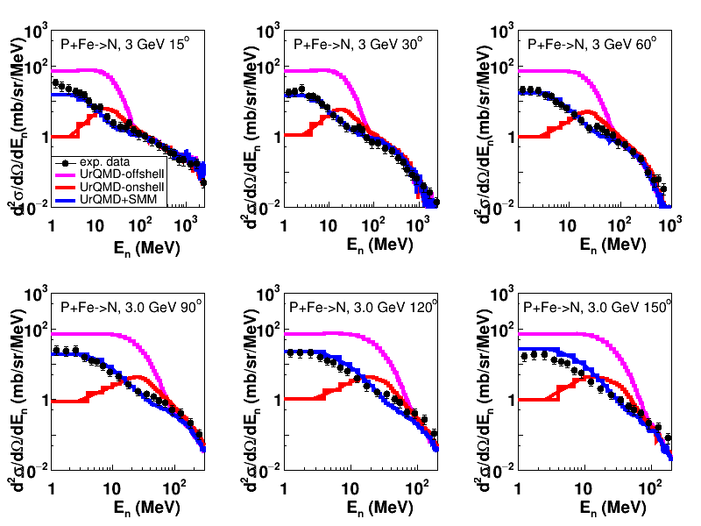
Coupling UrQMD, clustering and SMM models.
Results for neutron production in p+Fe interactions
(Exp. Data: K. Ishibashi et al., J.Nucl. Sci. Tech., Vol.34, N6 (1997) P. 529)
UrQMD+SMM describes well spectra of neutrons at all angles produced in proton interactions with intermediate nuclei.

Slide 11
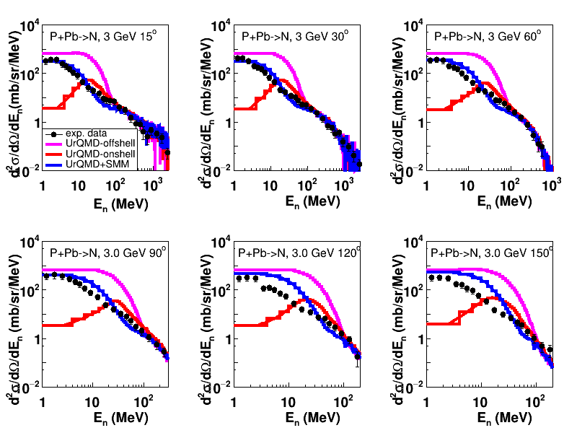
Coupling UrQMD, clustering and SMM models
Results for neutron production in proton interactions with heavy nuclei
(Exp. Data: K. Ishibashi et al., J.Nucl. Sci. Tech., Vol.34, N6 (1997) P. 529)
UrQMD+SMM works well for describing forward angles neutron spectra.
Problem is with description of backward emitted neutron spectra.

Slide 12
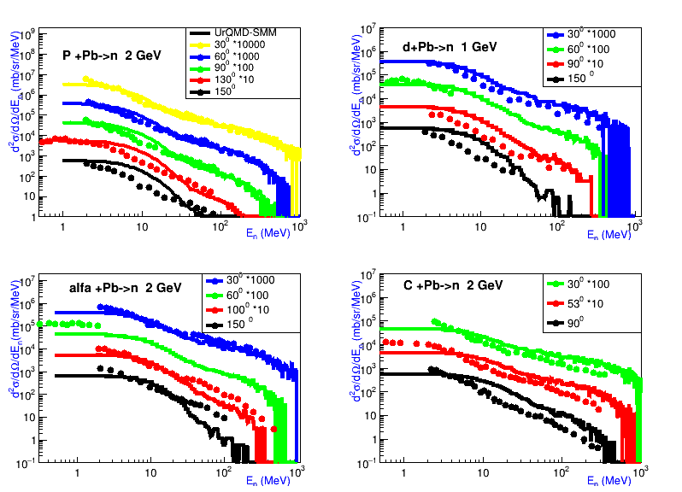
Coupling UrQMD, clustering and SMM models
for studying neutron production in A+Pb interactions at various angles
(Exp. Data: V. I. Yurevich, R.M. Yakovlev, V. G. Lyapin (JINR)
Physics of Atomic Nuclei, 2006, Vol. 69, No. 9, P. 1496)
Description of forward neutron spectra is reasonably well.
Problems is with description of backward emitted neutron spectra.

Slide 13
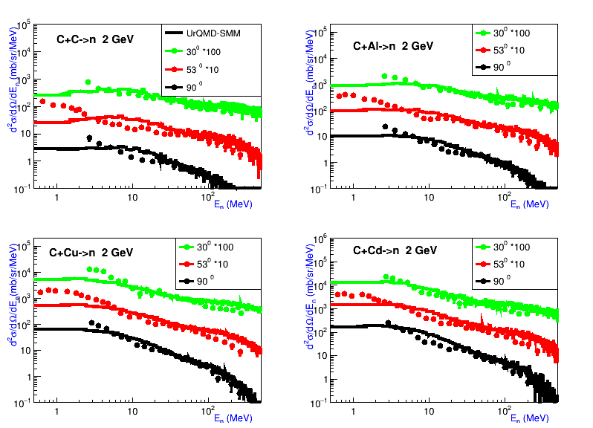
Coupling UrQMD, clustering and SMM models
for studying neutron production in C+A interactions
(Exp. Data: V. I. Yurevich, R.M. Yakovlev, V. G. Lyapin (JINR)
Physics of Atomic Nuclei, 2006, Vol. 69, No. 9, P. 1496)
Good description of neutron production in interactions of C with various nuclei
(C, Al, Cu, Cd) at energy 2 GeV

Slide 14
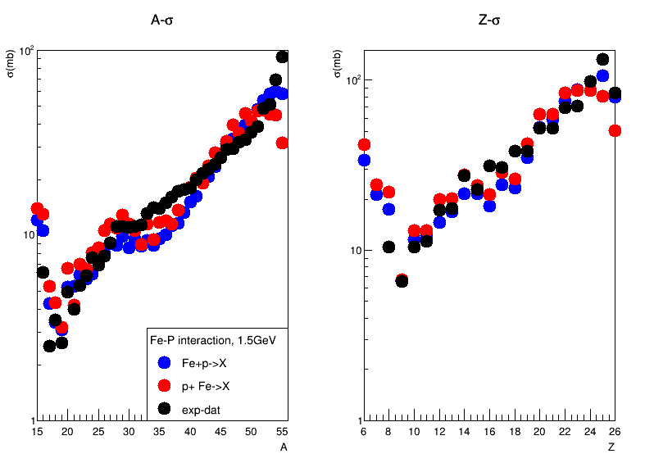
Mass and charge distributions of fragments produced in
Fe+p interactions according to UrQMD+SMM model.
(Exp. Data: C. Villagrasa-Canton et al. Phys. Rev. C 75, 044603 – Published 13 April 2007)
There is observed a symmetry between calculations of Fe+P and P+Fe interactions by UrQMD+SMM model.

Slide 15
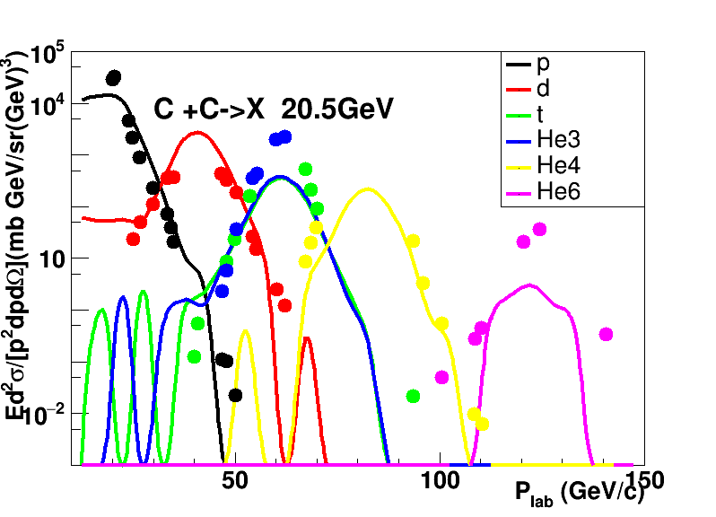
Momentum distributions of fragments produced in C+C interactions at energy
20.5 GeV/N according to UrQMD+SMM model
(Exp. Data: Afonin, A. G., et al. Nuclear Physics A 997 (2020): 121718)
Spectra of
p, d, He4 are described well by UrQMD+SMM
Problems with t, He3, He6 momentum distributions.
At the request of BM@N exp, the calculations of Xe+Cs/I interactions (10000 Ev) at Plab = 4.64 GeV/c/N were done.
Now, mass production (10^6 Events) of Xe+W interactions at Plab=3.3 GeV/c/N has been done for /MPD exp.
The resulting calculations are converting to UNIGEN format for MPD future full simulations.
I am grateful to Jan Bush Jr. and P. Parfenov for help to create the codes for the transition of our
output files to UNIGEN format.

Slide 16
Summary
The UrQMD model version 3.4 was installed at HybriLIT cluster of JINR.
The all calculations with UrQMD model version 3.4 were performed at HybriLIT cluster.
The UrQMD model 3.4 describes quite well the exp. spectra of NA61/SHINE collaboration
on π±, K⁻, p, pbar in nucleus-nucleus interactions at various initial energies. There is a problem
with reproducing of K⁺ exp. data in the model.
The UrQMD model describes satisfactorily kinetic energy distributions of fast neutrons and
can not describe small energy neutron yield in proton-neutron interactions.
The UrQMD 3.4 model has been coupled with clustering model and Statistical Multi-
fragmentation model. On the whole, the UrQMD+SMM model reproduces quite well neutron
and fragment productions in proton-nucleus and nucleus-nucleus collisions.
Outlook:
- Mass production by the UrQMD+SMM model for various nucleus-nucleus interactions for the MPD/NICA experiment.
Studies of neutron and fragment production which are foreseen in BM@N experiment at JINR.
- Implementation of hypernuclei production in nucleus-nucleus interactions in the UrQMD+SMM.
Uzhinsky V. thanks for support of the grant from the Government of the Russian Federation (Agreement No. 075-15-2025-009 of 28 February 2025)

Slide 17
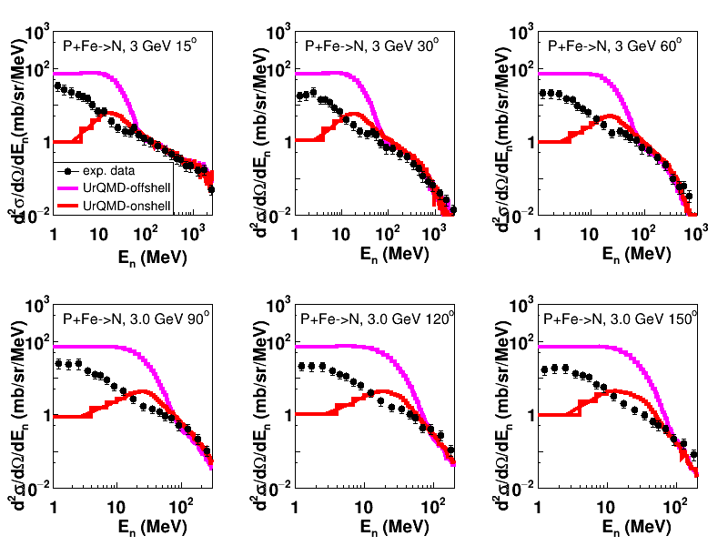
Neutron production using UrQMD model 3.4
in p+Fe interactions
(Exp. Data: K. Ishibashi et al., J.Nucl. Sci. Tech., Vol.34, N6 (1997) P. 529)
Similar results are obtained for p+Fe interactions

Slide 18
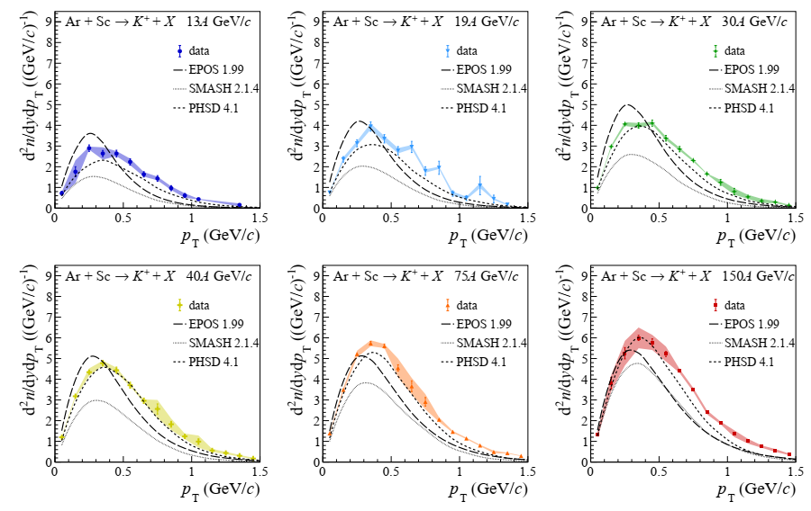
Appendix: K⁺-meson production in different simulation model

Slide 19
Patches to UrQMD Model Code
Changes in the file URQMD.F
c optional decay of all unstable particles before final output
c DANGER: pauli-blocked decays are not performed !!!
if(CTOption(18).eq.0) then
c no do-loop is used because npart changes in loop-structure
i=0
nct=0
actcol=0
c disable Pauli-Blocker for final decays
old_CTOption10=CTOption(10) ! Aida
CTOption(10)=1
c decay loop structure starts here
40 continue
i=i+1
c is particle unstable
if(dectime(i).lt.1.d30) then
41 continue
isstable = .false.
do 44 stidx=1,nstable
if (ityp(i).eq.stabvec(stidx)) then
c write (6,*) 'no decay of particle ',ityp(i)
isstable = .true.
endif
44 enddo
if (.not.isstable) then
c perform decay
call scatter(i,0,0.d0,fmass(i),xdummy)
c backtracing if decay-product is unstable itself
if(dectime(i).lt.1.d30) goto 41
endif
endif
c check next particle
if(i.lt.npart) goto 40
endif ! final decay
CTOption(10)=old_CTOption10 ! Return to the old value !
c final output
Changes in the file STRING.F
! call getmas(m0,w0,mindel,isoit(mindel),mmin,mmax,-1.,amass) !Aida
call getmas(m0,w0,mindel,isoit(mindel),mmin,mmax,-1.d0,amass)!Aida
! ^^

Slide 20
Changes in the file PROPPOT.F
REAL*8 ERF (in Proppot.f)
REAL*4 ERF (Erf.f)
Original line : Cb = Cb0/rjk(j,k)*erf(sgw*rjk(j,k))
was replaced by: Cb = Cb0/rjk(j,k)*erf(sngl(sgw*rjk(j,k))) ! Aida
! ^^^^^ ^
Original lines :
dCb = Cb0*(er0*exp(-(gw*rjk(j,k)*rjk(j,k)))*sgw*rjk(j,k)-
+ erf(sgw*rjk(j,k)))/rjk(j,k)/rjk(j,k)
were replaced by:
dCb = Cb0*(er0*exp(-(gw*rjk(j,k)*rjk(j,k)))*sgw*rjk(j,k)-
+ erf(sngl(sgw*rjk(j,k))))/rjk(j,k)/rjk(j,k) ! Aida
^^^^^ ^
Changes in the file INIT.F
Parameter (nnucl=1) ! 10) ! Aida
For debugging purposes

Slide 21
else ! Uzhi
prob(i)=fbrancx(i,iabs(i1),iz1,m1,branch(i,iabs(i1)), ! Uzhi
& btype(1,i),btype(2,i),btype(3,i),btype(4,i)) ! Uzhi
endif ! Uzhi
endif ! Uzhi
else ! For mesons ! Uzhi
if(isoit(btype(1,i))+isoit(btype(2,i))+isoit(btype(3,i))+
& isoit(btype(4,i)).lt.iabs(iz1).or.
& m1.lt.mminit(btype(1,i))+mminit(btype(2,i))
& +mminit(btype(3,i))+mminit(btype(4,i)) )then
prob(i)=0.d0
else
prob(i)=fbrancx(i,iabs(i1),iz1,m1,branch(i,iabs(i1)),
& btype(1,i),btype(2,i),btype(3,i),btype(4,i))
endif
endif ! Uzhi
3 continue
Due to all of these changes the code works quite fast and stable!
Simulation of 10000 events of Au+Au interactions at 25 GeV/c/nucleon
took only 10 hours.
Now we are revising of evaporation/fragmentation part.

Slide 22
Changes in the file ANNDEC.F
In file "tabinit.f", in "subroutine mkwtab", it is checked that the
probability of decay channel of a resonance is not zero ("bran.gt.1d-9").
If it is zero, the spline coefficients are not determined. At the same time,
in the file anndec.f, in subroutine anndex, it is not checked that the
probability is zero. Due to this the code go out of the allowed region. To
improve the situation we have added many lines in the subroutine anndex.
C one ingoing particle --> two,three,four outgoing particles
C
c... decays
do 3 i=0,maxbr
if((minbar.le.iabs(i1)).and.(iabs(i1).le.maxbar)) then ! Uzhi
call b3type (i1,i,bran_uz,i1_uz,i2_uz,i3_uz,i4_uz) ! Uzhi
if(bran_uz.le.1.d-9) then ! Uzhi see mkwtab
prob(i)=0.d0 ! Uzhi
else ! Uzhi
if(isoit(btype(1,i))+isoit(btype(2,i))+isoit(btype(3,i))+ ! Uzhi
& isoit(btype(4,i)).lt.iabs(iz1).or. ! Uzhi
& m1.lt.mminit(btype(1,i))+mminit(btype(2,i)) ! Uzhi
& +mminit(btype(3,i))+mminit(btype(4,i)) )then ! Uzhi
prob(i)=0.d0 ! Uzhi

