Slide 1
Pion transition form-factor in the frameworks
of the PNJL model and
the quark model with separable interaction
A.Friesen, Yu. Kalinovsky, D. Goderidze, A. Khmelev
INFINUM2025, Dubna, May 12-16

Slide 2
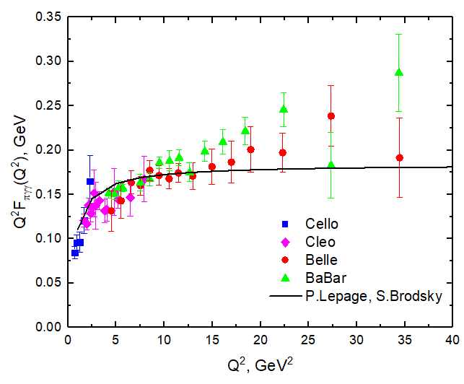




Why $γ^{∗}π^{0}→γ$?
VMD model +Pad’e approx
Belle (PRD86 (2012), 092007) and BaBar (PRD80 (2009) 052002) data
agreed with earlier experiments on their common domain of squared-momentum transfer (CELLO: Z.Phys. C49 (1991) 401-410; CLEO: PRD57 (1998) 33-54)
but are unexpectedly far above the prediction of perturbative QCD at larger values of Q²
DSE approaches
pQCD
non-pQCD
nonlocal chiral quark model
VMD model
Light-front quark model
2fπ
The explaination of the transition form factor within the standard model on full domain of momentum transfer requires the combination of:
features of non-perturbative QCD at low Q
features of perturbative QCD at high Q
ideally - in a single internally-consistent framework

Slide 3
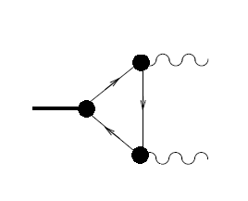






Transition form factor
quark-photon vertex
$${γ_{ν}^{∗}(q}_{1})$$
$$S(p_{2})$$
Pion Bethe-Salpeter amplitude
$$Γ_{π}$$
$$S(p_{3})$$
dressed quark propagator
$$S(p_{1})$$
$${γ_{μ} (q}_{2})$$

Slide 4
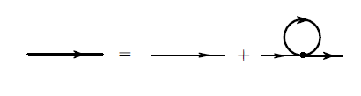
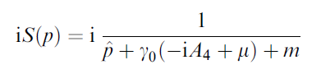
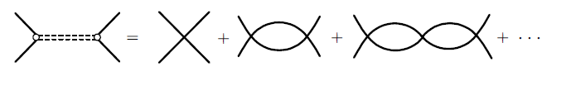
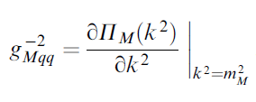

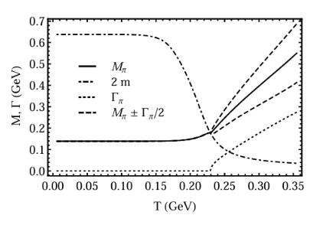

Dressed quarks and mesons in the frame of PNJL model
Schwinger-Dyson equation in the Hartree approximation
The Bethe-Salpeter equation from RPA approximation:

Slide 5
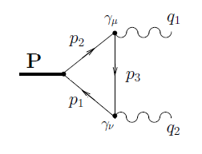



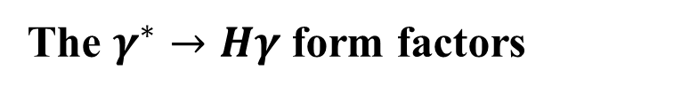

The $γ^{∗}→Hγ$ form factors
The second amplitude $T^{(2)}$can be written by the replacement ${\hat{ε}}_{1}↔{\hat{ε}}_{2}$and $q_{1}↔q_{2}$
Employing the pion vertex function $Γ_{H}≡Γ_{π}=iγ_{5}g_{πqq}$ and $Q_{H}=(e_{u}^{2}−e_{d}^{2})$ with $e_{u} = 2/3$and $e_{d}=−1/3$ and taking the trace, the amplitude T can be written as
With $I_{3}$for PNJL model

Slide 6


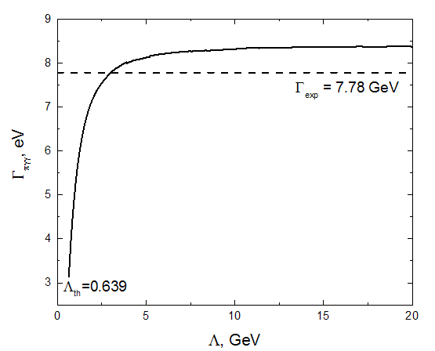
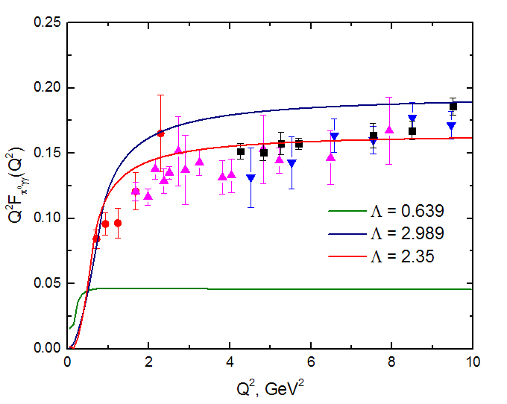

The pion decay width and transition form factor
Λ = 0.639 GeV, m = 0.319 GeV, M_{π} =0.139 GeV, $g_{πqq}=3.387$
kinematics
$q_{1}^{2}=0, q_{2}^{2}=0, 2q_{1}q_{1}={−M}_{π}^{2}$
kinematics
$q_{1}^{2}=0, q_{2}^{2}=Q^{2}, 2q_{1}q_{1}={−(M}_{π}^{2}+Q^{2})$
Klevansky NPA 575 (1994), 605-622
A. Blin Z.PA 331, 75–82 (1988).

Slide 7




Quark model with separable interaction
We start from the Bethe-Salpeter equation
Considering the interaction kernel in separable form
with 4-dimentional form-factor function in Gaussian form
and vertex function rewritten as
the dressed quark propagator is considered in the Euclidean space

Slide 8

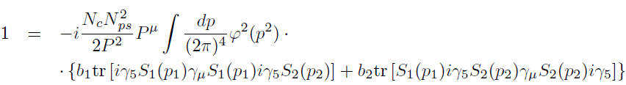



The meson-quark coupling constants N_{H} are determined by the condition
For pseudoscalar mesons weak leptonic decay constant can be obtained from the matrix element of the axial current
And after applying the Feynman parametrization all integrals can be presented in terms of the integrals

Slide 9

The $γ^{∗}→Hγ$ form factors
The second amplitude $T^{(2)}$can be written by the replacement ${\hat{ε}}_{1}↔{\hat{ε}}_{2}$and $q_{1}↔q_{2}$
Employing the pion vertex function $Γ_{H}≡Γ_{π}=iγ_{5}g_{πqq}$ and $Q_{H}=(e_{u}^{2}−e_{d}^{2})$ with $e_{u} = 2/3e$and $e_{d}=−1/3e$ and taking the trace, the amplitude T can be written as
With $I_{3}$for quark model with separable interaction

Slide 10
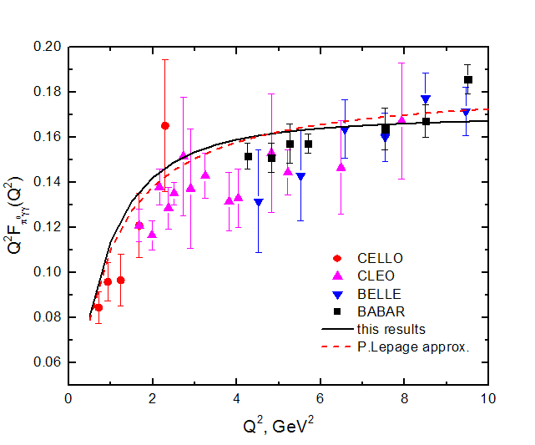
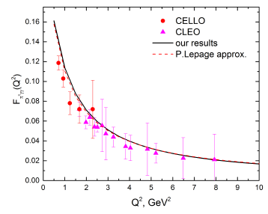
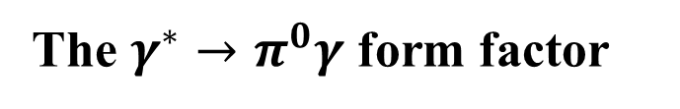
The $γ^{∗}→π^{0}γ$ form factor
m = 0.223 GeV, $Λ_{π}=1.08$GeV, $N_{π}$= 3.7, M$π$ = 0.139 GeV, $f_{π}=0.13$GeV
$g_{πγγ}$ = 0.238 GeV⁻¹ (g_{exp} = 0.276 GeV⁻¹ ) with Γπγγ = 6.38 eV (Γ_{exp} = 7.78 eV)

Slide 11
The $γ^{∗}→Hγ$ form factors
The second amplitude $T^{(2)}$can be written by the replacement ${\hat{ε}}_{1}↔{\hat{ε}}_{2}$and $q_{1}↔q_{2}$
Employing the pion vertex function $Γ_{H}≡Γ_{π}=iγ_{5}g_{Hqq}$ and $Q_{c}=2/3e$ , $Q_{b}=−1/$3e and taking the trace, the amplitude T can be written as
With $I_{3}$for quark model with separable interaction

Slide 12
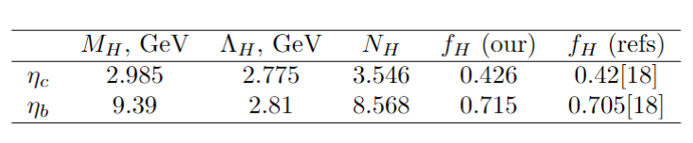
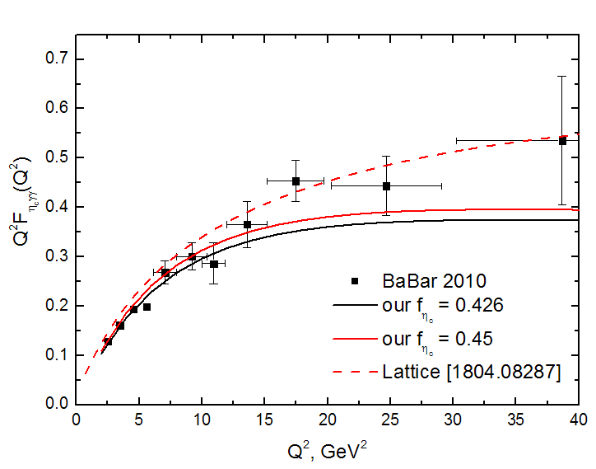
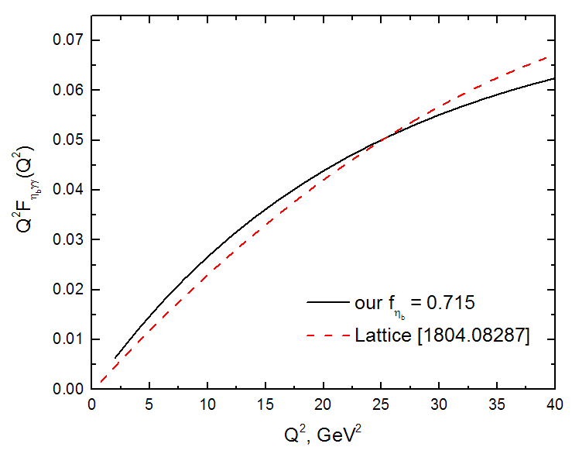


Transition form factors $η_{c}→γ^{∗}γ$, $η_{b}→γ^{∗}γ$
$$η_{c}→γ^{∗}γ$$
$$η_{b}→γ^{∗}γ$$

Slide 13
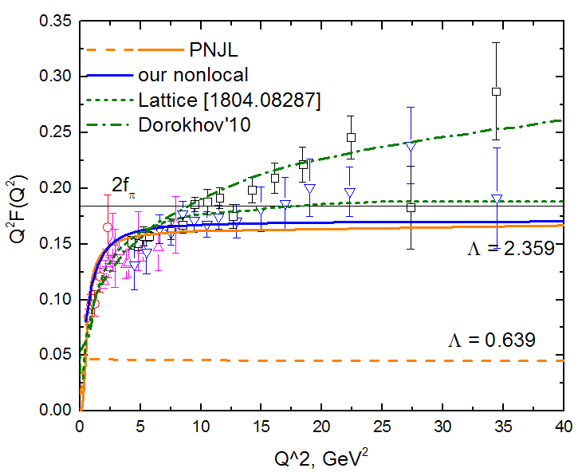
Conclusion
perturbative QCD/Lattice QCD at high Q does not reproduce the bechaviour presented by BaBar data.
there exist couple of models (A.E. Dorokhov, arXiv:0905.4577; A.V. Radyushkin, arXiv:0906.0323) which show logarithmic bechaviour of TFF at high density
non-perturbative QCD well works at low Q both for light and heavy mesons

Slide 14
Thank you for attention

