Slide 1

Deformed nuclear shells in mass and energy distributions of fission fragments of ²³⁶U* compound nucleus in ²³²Th(α,f) reaction at alpha particle energy near the coulomb barrier.
Author: Alimov D.K., PhD, Head of the Laboratory of Fission Physics, Institute of Nuclear Physics, Almaty, Kazakhstan
Co-authors: Pan Andrey, Kovalchuck K.V., Burtebayev N.T., Kosherbayeva R., Janseitov D., Bakirov M.

Slide 2
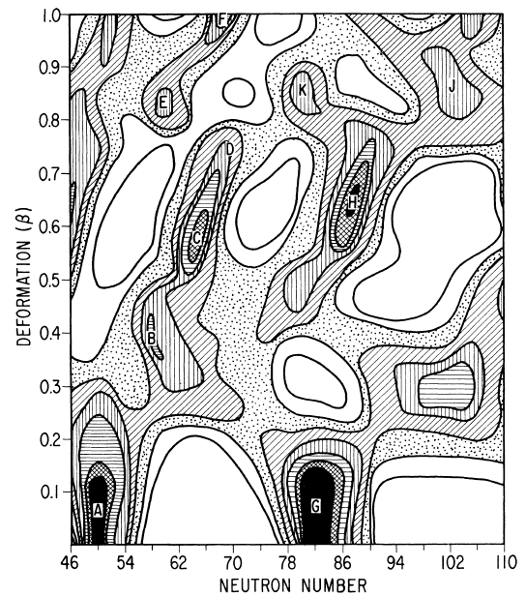
Deformed Nuclear Shells
Nuclear shell N50 and deformed nuclear shell N46.
B. D. Wilkins, E. P. Steinberg, R. R. Chasman, Phys. Rev. C, Vol 14, Num. 5, 1976
G. Barreau, A. Sicre, F. Caitucoli, M. Asghar, T.P. Doan, B. Leroux, G. Martinez, T. Benfoughal,
Nucl. Phys. A, 432, 1985

Slide 3
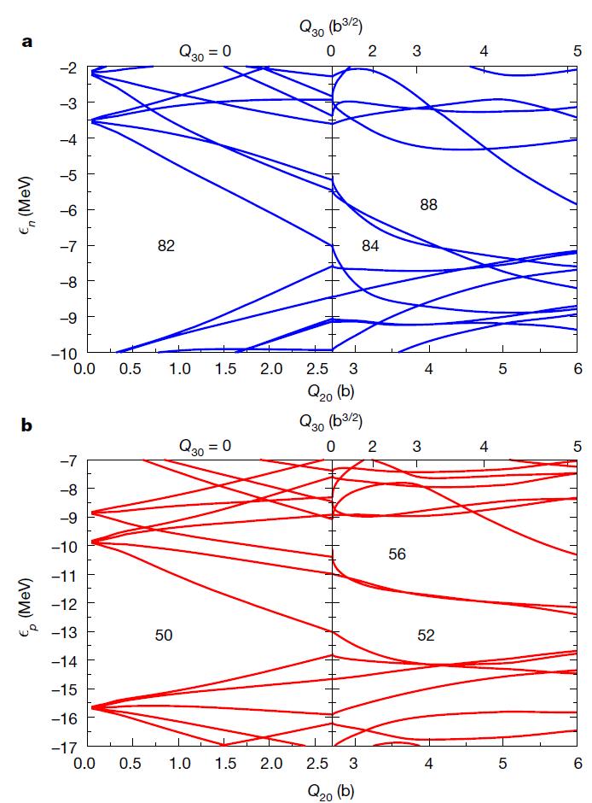
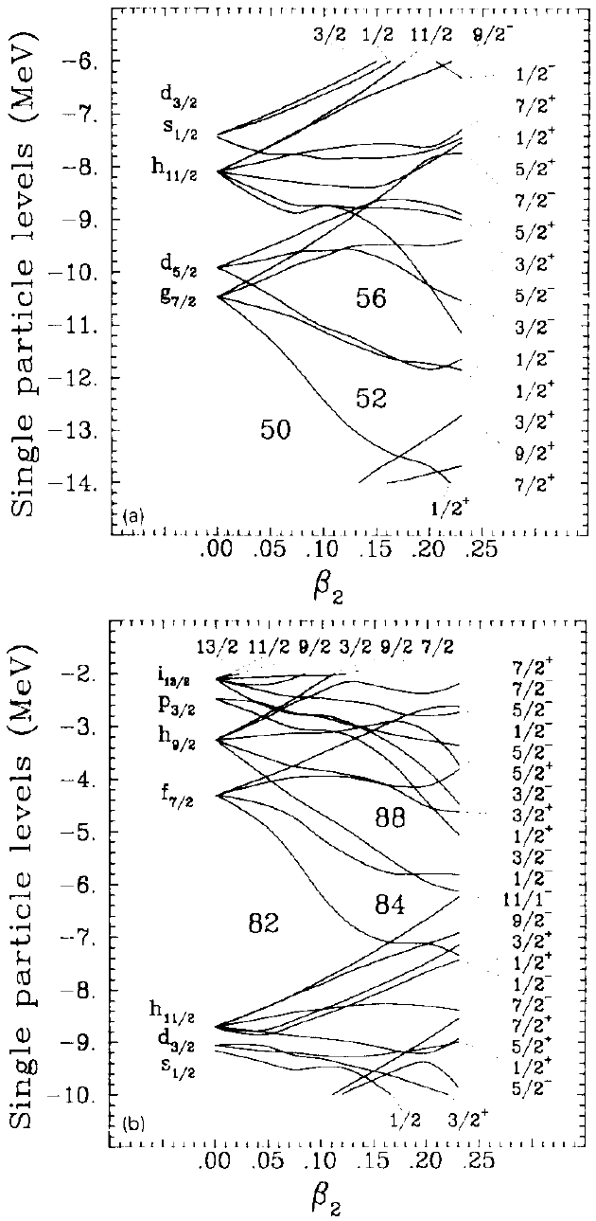
Deformed Nuclear Shells
Deformed shells
Z50 shell separate from S1 mode
S1 mode made of Z52 and N82 shells
S2 mode made from N84 and N88 shells
S.Ćwiok & W.Nazarewicz,
Nucl. Phys. A469,
1989
G.Scamps & C.Simenel, Vol 564, Nature, 2018

Slide 4
Fission modes
Symmetric mode S – charged liquid droplet effects
Asymmetric mode S1 – Z50 N82 shells in heavy fragment
Asymmetric mode S2 – N88 deformed shell in heavy fragment
Asymmetric mode S3 – N50 Z28 shells in light fragment
U.Brosa, S.Grossmann, A.Müller, Phys. Rep. 197, No 4, 1990
S.I.Mulgin, V.N.Okolovich, S.V.Zhdanova, Phys. Lett. B 462, 1999
S.I.Mulgin, S.V.Zhdanov, N.A.Kondratiev, K.V.Kovalchuk, A.Ya.Rusanov, Nucl. Phys. A 824, 2009

Slide 5
Object of the study
During the fission process charged liquid droplet and nuclear shells effects influence the formation of fragments and therefore influence mass and energy distributions (MEDs) of fission fragments.
Decomposing MEDs into yields of separate fission modes allows to study nuclear structure and shells

Slide 6
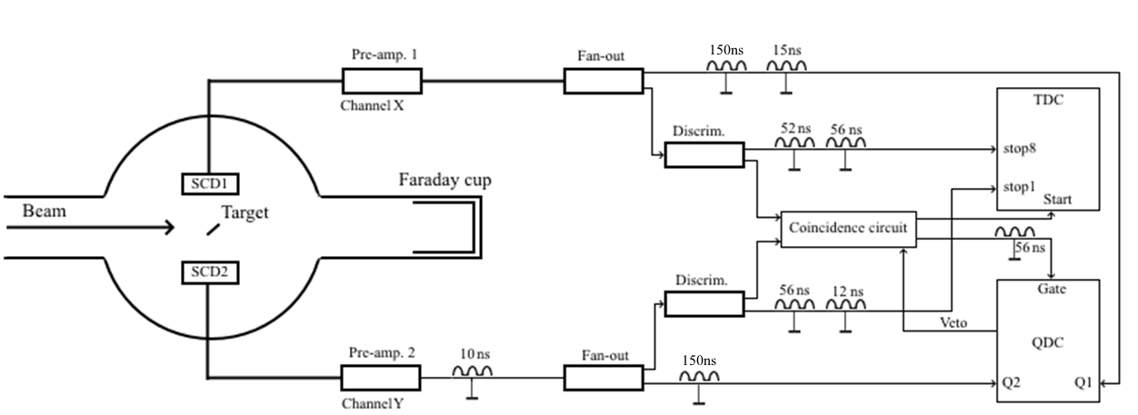
Electronic scheme of the experiment

Slide 7
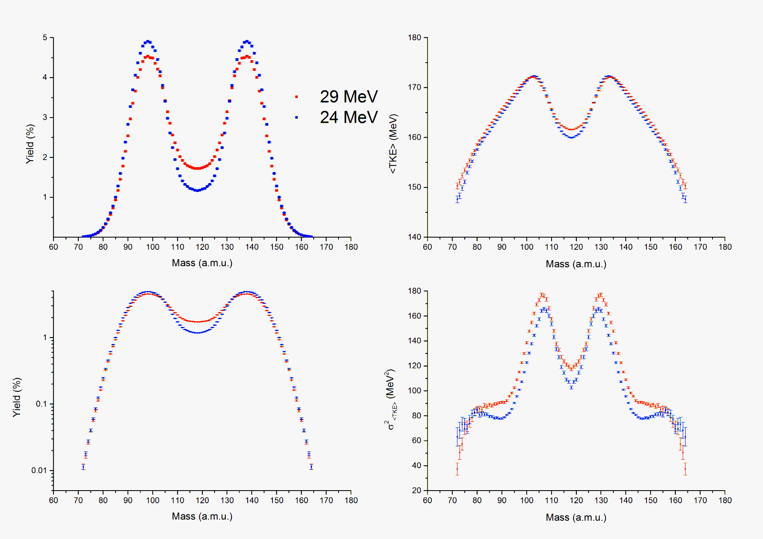
Results of the experiment
²³²Th(α,f)

Slide 8
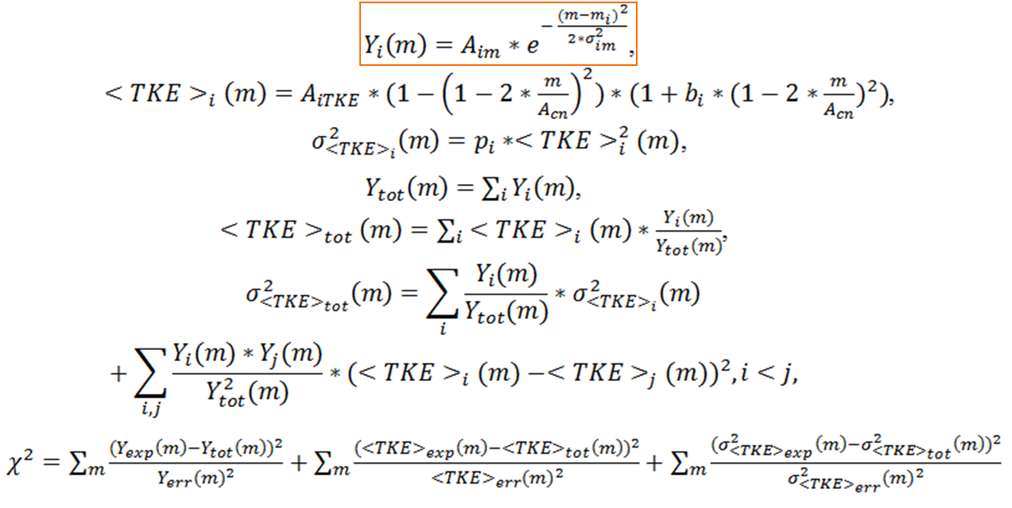
Method of analysis
Tathagata Banerjee, E.M.Kozulin, N.T.Burtebayev, K.B.Gikal, G.N.Knyazheva, I.M.Itkis, K.V.Novikov, T.N.Kvochkina, Y.S.Mukhamejanov, A.N. Pan, Phys. Rev C 105, 2022
A.N.Pan, N.Burtebayev, K.V.Kovalchuk, T.N.Kvochkina, NNC RK Bulletin, Iss. 2(94), 2023

Slide 9
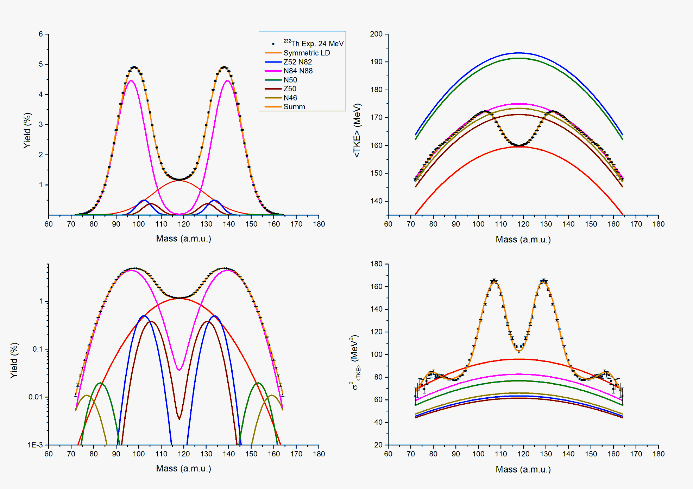
The result of decomposition

Slide 10
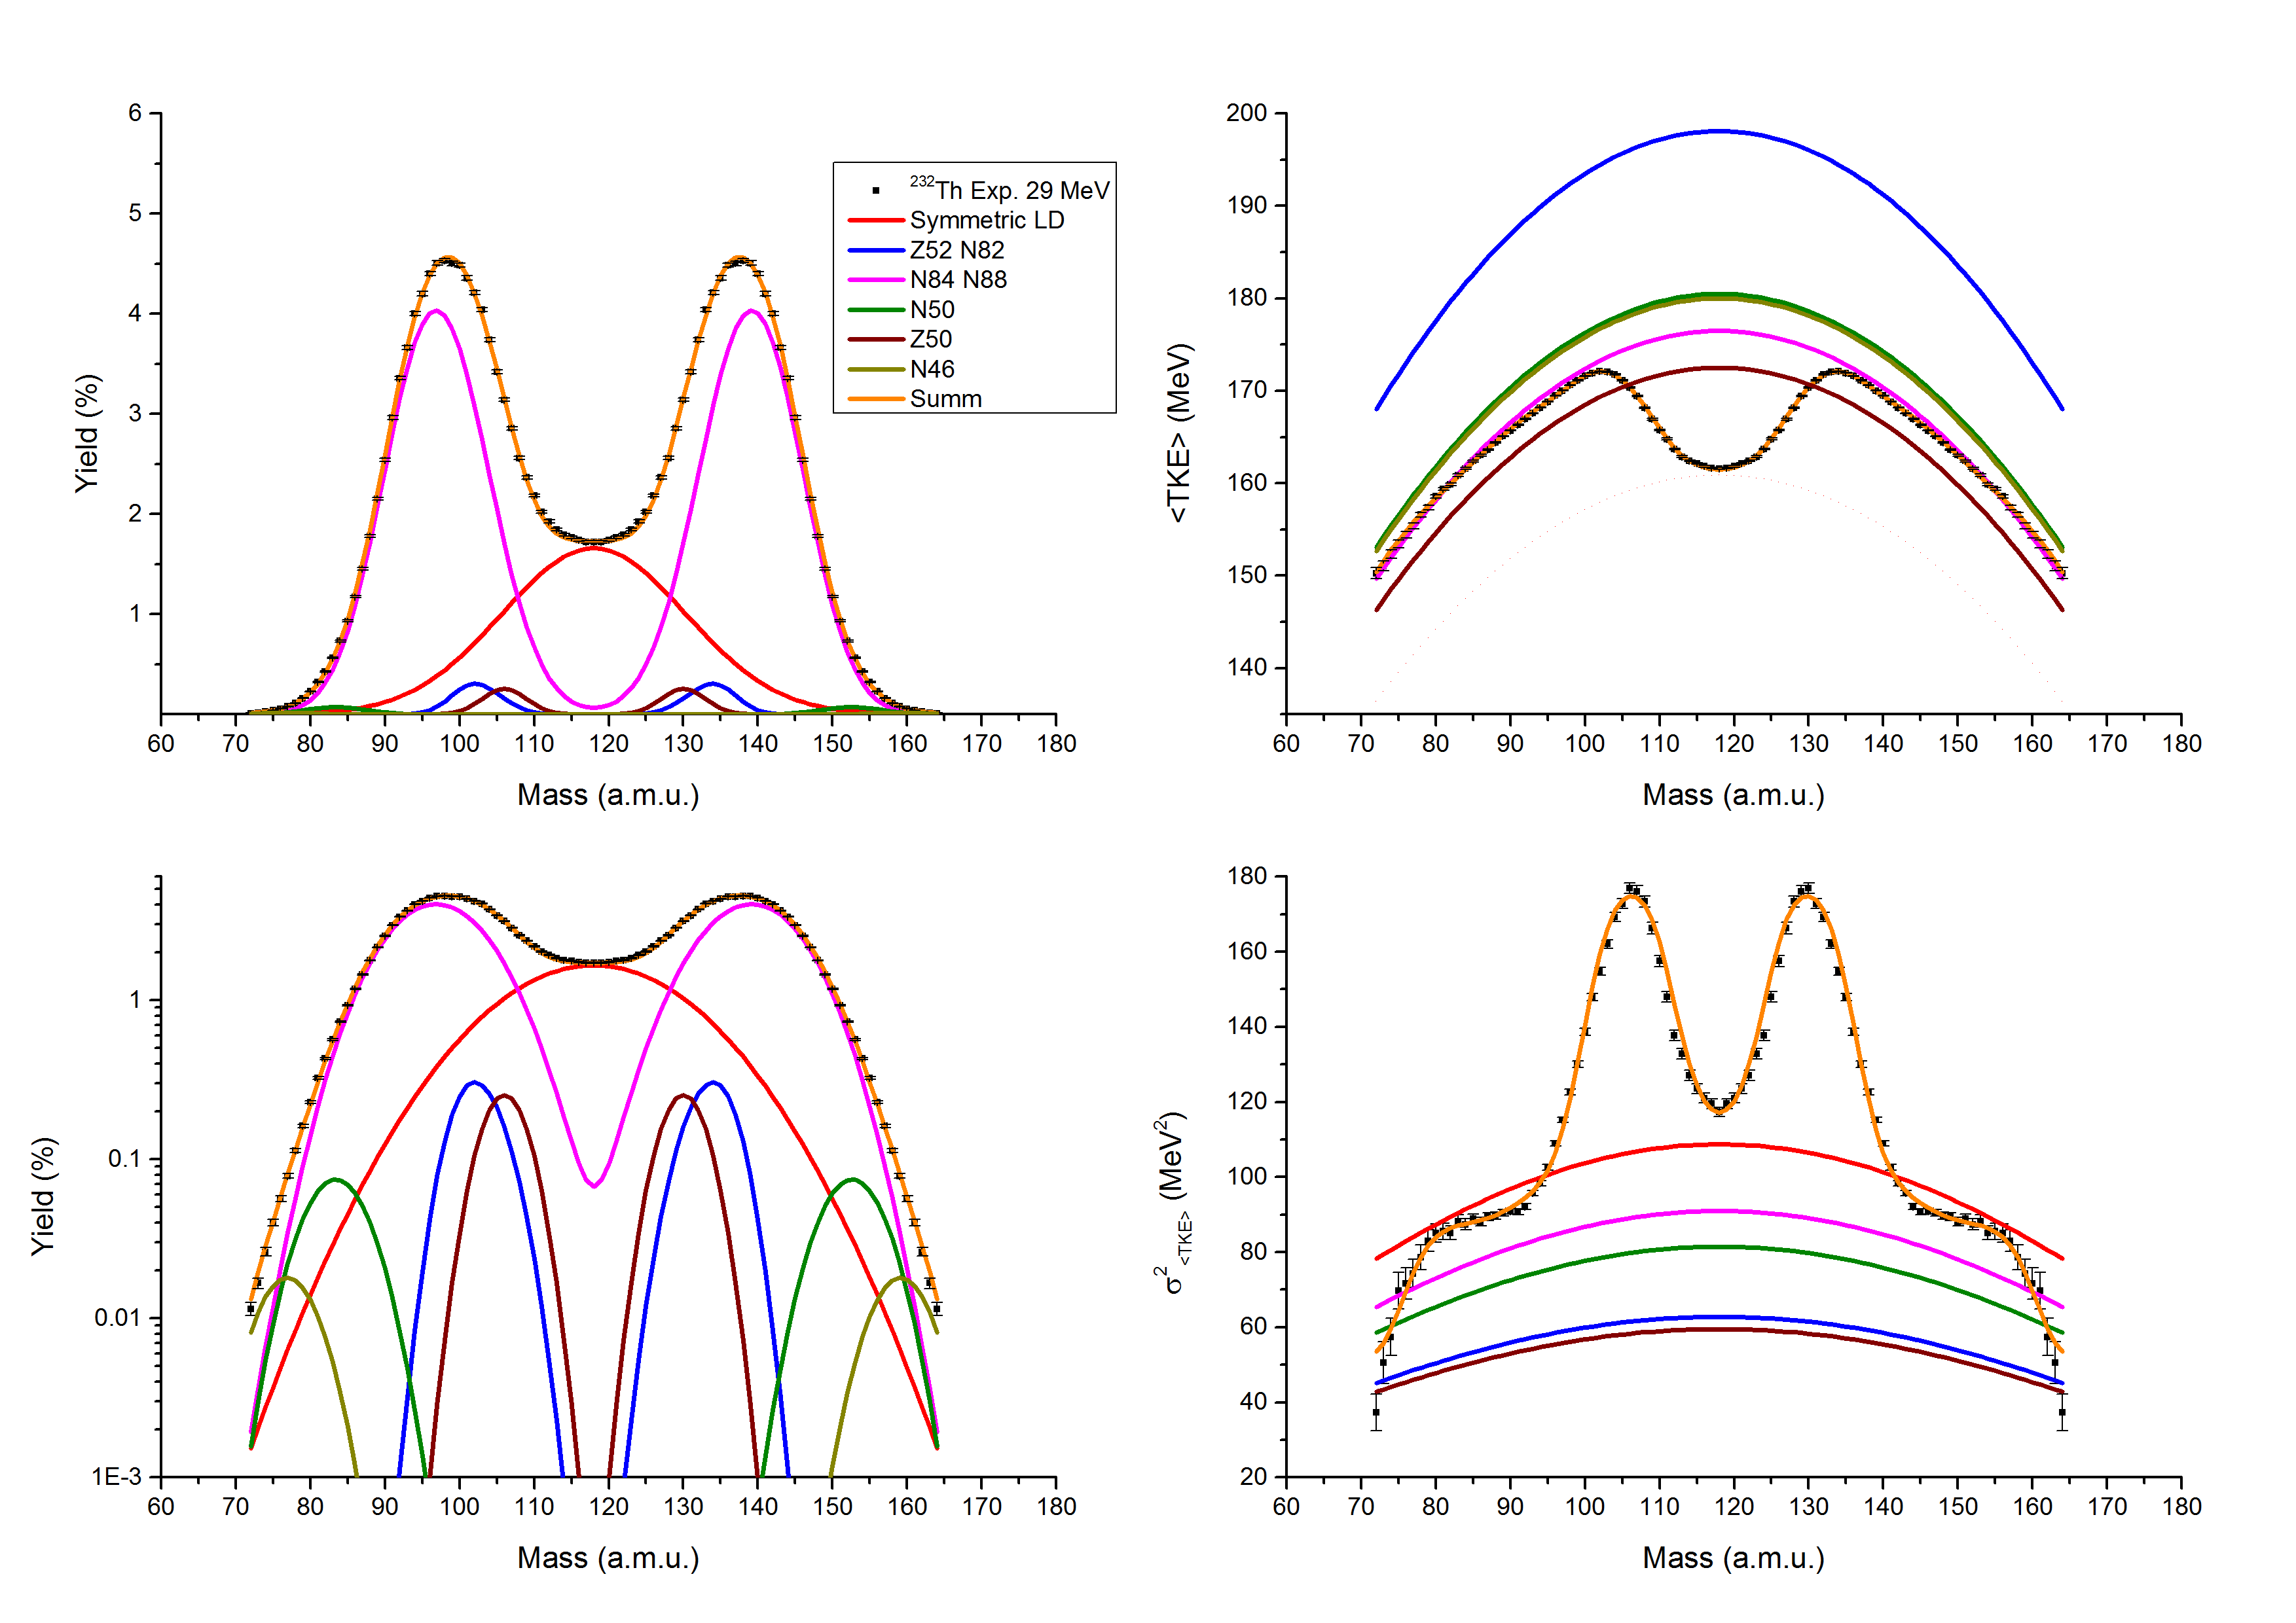
The result of decomposition

Slide 11
Main results
Mass and energy distributions of fission fragments of compound nuclei ²³⁷Pu* formed in ²³³U(a,f) reaction at incident alpha particle energies of 24 and 29 MeV were measured
Influence of deformed shells was detected and described

Slide 12
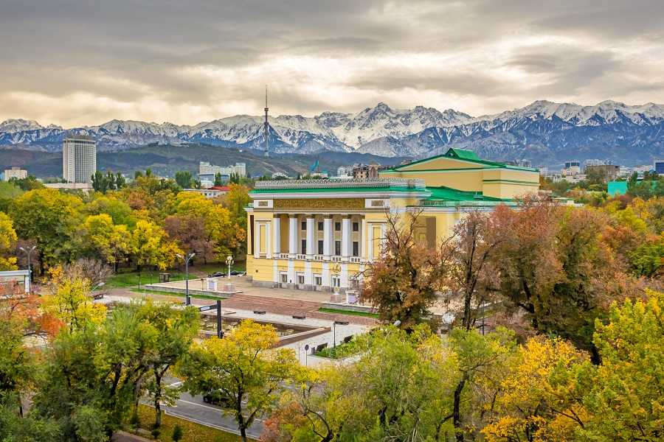
Thank you for your attention!
Almaty

